Slide 1
Resurrection Sunday 2026

Slide 2
Resurrection Sunday?
or
Easter Sunday?

Slide 3
christianity.com
“Easter is a term that promotes historical continuity because of the widespread recognition that it has.”

Slide 4
christianity.com
“It has become deeply ingrained in the cultural and religious traditions of many communities around the world.”

Slide 5
christianity.com
“The word Easter is likely derived from the Old English word “Eastre,” which originally referred to the pagan festival of springtime and fertility.”

Slide 6
I like the fact that Resurrection Sunday emphasizes the central focus of what the day we are celebrating actually is. It provides greater theological precision by expressing the event being celebrated … the resurrection of Jesus Christ.

Slide 7
christianity.com
“Resurrection Day directs attention to the core message of Christianity: the triumph of Jesus over sin and death through His resurrection.”

Slide 8
Foundations of the Christian Faith …

Slide 9
Foundations of the Christian Faith …
The virgin birth of Christ

Slide 10
Isaiah 7:14
“Therefore the Lord Himself will give you a sign: Behold, the virgin shall conceive and bear a Son, and shall call His name Immanuel.”

Slide 11
Matthew 1:18-25
“Now the birth of Jesus Christ was as follows: After His mother Mary was betrothed to Joseph, before they came together, she was found with child of the Holy Spirit. Then Joseph her husband, being a just man, and not wanting to make her a public example, was minded to put her away secretly. But while he

Slide 12
Matthew 1:18-25
thought about these things, behold, an angel of the Lord appeared to him in a dream, saying, “Joseph, son of David, do not be afraid to take to you Mary your wife, for that which is conceived in her is of the Holy Spirit. And she will bring forth a Son and you shall call His name JESUS, for He will save His people from

Slide 13
Matthew 1:18-25
their sins.” So all this as done that it might be fulfilled which was spoken by the Lord through the prophet, saying: “Behold, the virgin shall be with child, and bear a Son, and they shall call His name Immanuel,” which is translated, “God with us.” Then Joseph, being aroused from sleep, did as the angel of

Slide 14
Matthew 1:18-25
the Lord commanded him and took to him his wife, and did not know her till she had brought forth her firstborn Son. And he called His name JESUS.”

Slide 15
Matthew 1:18-25
“Now the birth of Jesus Christ was as follows: After His mother Mary was betrothed to Joseph, before they came together, she was found with child of the Holy Spirit. Then Joseph her husband, being a just man, and not wanting to make her a public example, was minded to put her away secretly. But while he

Slide 16
Matthew 1:18-25
“Now the birth of Jesus Christ was as follows: After His mother Mary was betrothed to Joseph, before they came together, she was found with child of the Holy Spirit. Then Joseph her husband, being a just man, and not wanting to make her a public example, was minded to put her away secretly. But while he

Slide 17
Matthew 1:18-25
“Now the birth of Jesus Christ was as follows: After His mother Mary was betrothed to Joseph, before they came together, she was found with child of the Holy Spirit. Then Joseph her husband, being a just man, and not wanting to make her a public example, was minded to put her away secretly. But while he

Slide 18
Matthew 1:18-25
the Lord commanded him and took to him his wife, and did not know her till she had brought forth her firstborn Son. And he called His name JESUS.”

Slide 19
Luke 1:26-31
“Now in the sixth month the angel Gabriel was sent by God to a city of Galilee named Nazareth, to a virgin betrothed to a man whose name was Joseph, of the house of David. The virgin’s name was Mary. And having come in, the angel said to her, “Rejoice, highly favored one, the Lord is with you; blessed are you among women!”

Slide 20
Luke 1:26-31
But when she saw him, she was troubled at his saying, and considered what manner of greeting this was. Then the angel said to her, “Do not be afraid, Mary, for you have found favor with God. And behold, you will conceive in your womb and bring forth a Son, and shall call His name JESUS.”

Slide 21
Luke 1:34
“How can this be, since I do not know a man?”

Slide 22
Luke 1:34
“How can this be, since I do not know a man?”
Luke 1:35
“The Holy Spirit will come upon you, and the power of the Highest will overshadow you; therefore, also, that Holy One who is to be born will be called the Son of God.”

Slide 23
Matthew 1:18-25
their sins.” So all this as done that it might be fulfilled which was spoken by the Lord through the prophet, saying: “Behold, the virgin shall be with child, and bear a Son, and they shall call His name Immanuel,” which is translated, “God with us.” Then Joseph, being aroused from sleep, did as the angel of

Slide 24
Foundations of the Christian Faith …
The virgin birth of Christ
The deity of Christ

Slide 25
1 John 4:15
“Whoever confesses that Jesus is the Son of God, God abides in him, and he in God.”

Slide 26
1 John 5:5
“Who is he who overcomes the world, but he who believes that Jesus is the Son of God?”

Slide 27
John 10:28-30
“And I give them eternal life, and they shall never perish; neither shall anyone snatch them out of My hand. My Father, who has given them to Me, is greater than all; and no one is able to snatch them out of My Father’s hand. I and My Father are one.”

Slide 28
Jesus is speaking about giving those that believe in Him eternal life and stating that they will never perish.

Slide 29
Jesus is speaking about giving those that believe in Him eternal life and stating that they will never perish.
No one is able to snatch those who believe in Him out of His hand

Slide 30
John 10:28-30
“And I give them eternal life, and they shall never perish; neither shall anyone snatch them out of My hand. My Father, who has given them to Me, is greater than all; and no one is able to snatch them out of My Father’s hand. I and My Father are one.”

Slide 31
“He guarantees it. If eternal life could be lost, then the Lord Jesus is lying here and throughout the Fourth Gospel.”
The Grace New Testament Commentary

Slide 32
John 10:28-30
“And I give them eternal life, and they shall never perish; neither shall anyone snatch them out of My hand. My Father, who has given them to Me, is greater than all; and no one is able to snatch them out of My Father’s hand. I and My Father are one.”

Slide 33
John 10:28-30
“And I give them eternal life, and they shall never perish; neither shall anyone snatch them out of My hand. My Father, who has given them to Me, is greater than all; and no one is able to snatch them out of My Father’s hand. I and My Father are one.”

Slide 34
John 10:31-33
“Then the Jews took up stones again to stone Him. Jesus answered them, “Many good works I have shown you from My Father. For which of those works do you stone Me?” The Jews answered Him, saying, “For a good work we do not stone You, but for blasphemy, and because You, being a Man, make Yourself God.”

Slide 35
Foundations of the Christian Faith …
The virgin birth of Christ
The deity of Christ
Jesus’ atonement for sin

Slide 36
Romans 5:10-11
“For if when we were enemies we were reconciled to God through the death of His Son, much more, having been reconciled, we shall be saved by His life. And not only that, but we also rejoice in God through our Lord Jesus Christ, through whom we have now received the reconciliation.”

Slide 37
God is the One that made the effort to make things right with man, and that through the death of His Son, Jesus Christ.

Slide 38
2 Corinthians 5:21
“For He made Him who knew no sin to be sin for us, that we might become the righteousness of God in Him.”

Slide 39
1 John 2:2
“And He Himself is the propitiation for our sins, and not for ours only but also for the whole world.”

Slide 40
Propitiation
Strong’s –
“atonement that is (concretely) an expiator.”
Webster’s
“something that propitiates or appeases specifically: an atoning sacrifice.”

Slide 41
God reconciled the world to Himself by removing the universal sin barrier whether or not people become believers. It’s God’s reconciliation that makes people savable.

Slide 42
One becomes justified when that person believes in Jesus Christ for His promise of everlasting life.

Slide 43
Romans 3:23-26
“For all have sinned and fall short of the glory of God, being justified freely by His grace through the redemption that is in Christ Jesus, whom God set forth as a propitiation by His blood, through faith, to demonstrate His righteousness, because in His forbearance God had passed over the sins that were previously committed, to demonstrate at the present time His righteousness, that He might be just and the justifier of the one who has faith in Jesus.”

Slide 44
Romans 5:1
“Therefore, having been justified by faith, we have peace with God through our Lord Jesus Christ …”.

Slide 45
It is Christ’s resurrection from the dead – His victory over the grave, that forever sealed Satan’s fate of defeat in his quest to become as God Himself.

Slide 46
Genesis 3:14-15
“So the LORD God said to the serpent, “Because you have done this, “Cursed are you above all livestock and all wild animals! You will crawl on your belly and you will eat dust all the days of your life. And I will put enmity between you and the woman, and between your offspring and hers; He will crush your head, and you will strike His heel.”

Slide 47
Genesis 3:14-15
“So the LORD God said to the serpent, “Because you have done this, “Cursed are you above all livestock and all wild animals! You will crawl on your belly and you will eat dust all the days of your life. And I will put enmity between you and the woman, and between your offspring and hers; He will crush your head, and you will strike His heel.”

Slide 48
Why Jesus’ Resurrection Matters …
Jesus’ resurrection fulfilled prophecy

Slide 49
Mark 8:31
“And He began to teach them that the Son of Man must suffer many things, and be rejected by the elders and chief priests and scribes, and be killed, and after three days rise again.”

Slide 50
Psalm 16:9-11
“Therefore my heart is glad, and my glory rejoices; my flesh also will rest in hope. For You will not leave my soul in Sheol, nor will You allow Your Holy One to see corruption. You will show me the path of life; in Your presence is fullness of joy; at Your right hand are pleasures forevermore.”

Slide 51
Luke 24:1-12
“Now on the first day of the week, very early in the morning, they, and certain other women with them, came to the tomb bringing the spices which they had prepared. But they found the stone rolled away from the tomb. Then they went in and did not find the body of the Lord Jesus. And it happened, as they were greatly perplexed about this, that behold, two men stood by

Slide 52
Luke 24:1-12
them in shining garments. Then, as they were afraid and bowed their faces to the earth, they said to them, “Why so you seek the living among the dead? He is not here, but is risen! Remember how He spoke to you when He was still in Galilee, saying, ‘The Son of Man must be delivered into the hands of sinful men, and be crucified, and the third day rise again.’” And they

Slide 53
Luke 24:1-12
remembered His words. Then they returned from the tomb and told all these things to the eleven and to all the rest. It was Mary Magdalene, Joanna, Mary the mother of James, and the other women with them, who told these things to the apostles. And their words seemed to them like idle tales, and they did not believe them. But Peter arose

Slide 54
Luke 24:1-12
and ran to the tomb; and stooping down, he saw the linen cloths lying by themselves; and he departed, marveling to himself at what had happened.”

Slide 55
Why Jesus’ Resurrection Matters …
Jesus’ resurrection fulfilled prophecy
There would be no compelling reason to believe Jesus is who He said He is

Slide 56
Matthew 27:62-66
“On the next day, which followed the Day of Preparation, the chief priests and Pharisees gathered together to Pilate, saying, “Sir, we remember, while He was still alive, how that deceiver said, ‘After three days I will rise.’ Therefore command that the tomb be made secure until the third day, lest His disciples come by night and steal Him away, and say

Slide 57
Matthew 27:62-66
to the people, ‘He has risen from the dead.’ So the last deception will be worse than the first.” Pilate said to them, “You have a guard; go your way, make it as secure as you know how.” So they went and made the tomb secure, sealing the stone and setting the guard.”

Slide 58
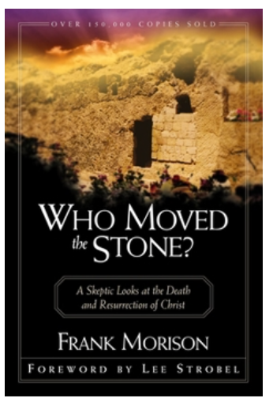

Slide 59
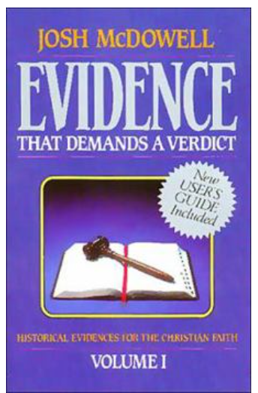

Slide 60
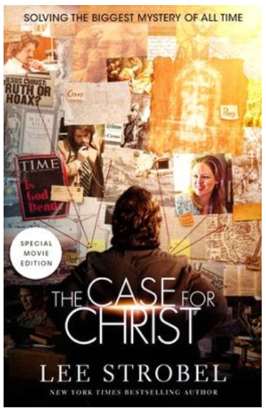

Slide 61
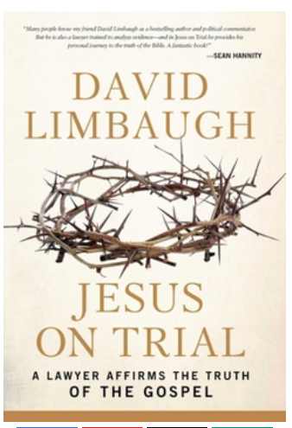

Slide 62
Why Jesus’ Resurrection Matters …
Jesus’ resurrection fulfilled prophecy
There would be no compelling reason to believe Jesus is who He said He is
Our justification hinges on it

Slide 63
Romans 4:25 (NIV)
“He was delivered over to death for our sins and was raised to life for our justification.”

Slide 64
Hebrews 7:25
“Therefore He is also able to save to the uttermost those who come to God through Him, since He always lives to make intercession for them.”

Slide 65
Why Jesus’ Resurrection Matters …
Jesus’ resurrection fulfilled prophecy
There would be no compelling reason to believe Jesus is who He said He is
Our justification hinges on it
Our very faith depends on it

Slide 66
Ephesians 1:18-20
“… know what is the hope of His calling, what are the riches of the glory of His inheritance in the saints, and what is the exceeding greatness of His power toward us who believe, according to the working of His mighty power which He worked in Christ when He raised Him from the dead and seated Him at His right hand in the heavenly places.”

Slide 67
John 14:2-3
“In My Father’s house are many mansions; if it were not so, I would have told you. I go to prepare a place for you. And if I go and prepare a place for you, I will come again and receive you to Myself; that where I am, there you may be also.”

Slide 68
1 Corinthians 15:12-19
“Now if Christ is preached that He has been raised from the dead, how do some among you say that there is no resurrection of the dead? But if there is no resurrection of the dead, then Christ is not risen. And if Christ is not risen, then our preaching is empty and your faith is also empty. Yes, and we are found false witnesses of God, because we have testified of God that He raised up

Slide 69
1 Corinthians 15:12-19
Christ, whom He did not raise up – if in fact the dead do not rise. For if the dead do not rise, then Christ is not risen. And if Christ is not risen, your faith is futile; you are still in your sins! Then also those who have fallen asleep in Christ have perished. If in this life only we have hope in Christ, we are of all men the most pitiable.”

Slide 70
1 Corinthians 15:20
“But now Christ is risen from the dead, and has become the firstfruits of those who have fallen asleep.”

Slide 71
1 Corinthians 15:22-23
“For as in Adam all die, even so in Christ all shall be made alive. But each one in his own order: Christ is the firstfruits, afterward those who are Christ’s at His coming.”

Slide 72
Romans 8:11
“But if the Spirit of Him who raised Jesus from the dead dwells in you, He who raised Christ from the dead will also give life to your mortal bodies through His Spirit who dwells in you.”

Slide 73
John 3:16-18
“For God so loved the world that He gave His only begotten Son, that whoever believes in Him should not perish but have everlasting life. For God did not send His Son into the world to condemn the world, but that the world through Him might be saved. “He who believes in Him is not condemned; but he who does not believe is condemned already, because he has not believed in the name of the only begotten Son of God.”

