Slide 1
Ephesians

Slide 2
Acts 2:38
“Then Peter said to them, “Repent, and let every one of you be baptized in the name of Jesus Christ for the remission of sins; and you shall receive the gift of the Holy Spirit.”

Slide 3
My main concern about bringing repentance up in evangelism to unbelievers is that the only thing they are going to understand about that is that “repenting” is something they must do in order to make themselves acceptable before God.

Slide 4
Salvation isn’t about anything we must do for God. Salvation is entirely 100% about what God did for us through His Son, Jesus Christ.

Slide 5
Our salvation is 100% dependent upon what Jesus did for us – the redemption He provides through His shed blood on the Cross of Calvary.

Slide 6
Victory in Jesus verse 1 lyrics …
I heard an old, old story,
how a Savior came from glory,
How He gave His life on Calvary
to save a wretch like me.

Slide 7
Victory in Jesus verse 1 lyrics …
I heard about His groaning,
of His precious blood’s atoning,

Slide 8
1 John 2:2
“And He Himself is the propitiation for our sins, and not for ours only but also for the whole world.”

Slide 9
Victory in Jesus verse 1 lyrics …
I heard about His groaning,
of His precious blood’s atoning,
Then I repented of my sins
and won the victory.

Slide 10
According to what this line of the song says, it was repenting of his sins that was the thing that sealed the deal for him … over and above what Jesus did that won the victory for him.

Slide 11
Victory in Jesus verse 1 lyrics …
I heard about His groaning,
of His precious blood’s atoning,

Slide 12
Options for better lyrics …
I heard about His groaning,
of His precious blood’s atoning,
‘Twas that which cleansed my life from sin
and won the victory.

Slide 13
Options for better lyrics …
I heard about His groaning,
of His precious blood’s atoning,
‘Twas that which washed away my sin
and won the victory.

Slide 14
Options for better lyrics …
I heard about His groaning,
of His precious blood’s atoning,
‘Twas that which took away my sin
and won the victory.

Slide 15
Options for better lyrics …
I heard about His groaning,
of His precious blood’s atoning,
His blood redeemed me from my sin
and won the victory.

Slide 16
Sadly, whether the songwriter realized it or not, it’s that very kind of theology that pervades modern evangelical Christianity.

Slide 17
If one is using repentance in their message of evangelism, then it puts the onus on the individual to work at their salvation instead of realizing that their salvation is 100% because of what Christ has done for them.

Slide 18
Victory in Jesus chorus …
O victory in Jesus,
my Savior, forever!
He sought me and bought me
with His redeeming blood;
He loved me ere I knew Him,
and all my love is due Him –
He plunged me to victory
beneath the cleansing flood.

Slide 19
Victory in Jesus chorus …
O victory in Jesus,
my Savior, forever!
He sought me and bought me
with His redeeming blood;
He loved me ere I knew Him,
and all my love is due Him –
He plunged me to victory
beneath the cleansing flood.

Slide 20
Salvation isn’t through Christ plus something else.
Salvation is through Christ alone … period!

Slide 21
“Repentance,” per se, is not meant for unbelievers but for believers to get back on track in their relationship with the Lord.

Slide 22
1 John 1:9
“If we confess our sins, He is faithful and just to forgive us our sins and to cleanse us from all unrighteousness.”

Slide 23
Where repentance is necessary is when one has had a major falling away from walking with the Lord.

Slide 24
When one finally realizes that he has done wrong and is not living the way he should nor walking with the Lord in the way that he should – then repentance is the proper course of action.

Slide 25
Acts 2:37
“Now when they heard this, they were cut to the heart, and said to Peter and the rest of the apostles, “Men and brethren, what shall we do?”

Slide 26
When Peter tells them in verse 38 to “repent and be baptized,” the repentance Peter is referring to isn’t a repentance in the context of becoming saved, it is a repentance for them to be absolved of their guilt of killing their very own Messiah.

Slide 27
Acts 2:38
“Then Peter said to them, “Repent, and let every one of you be baptized in the name of Jesus Christ for the remission of sins; and you shall receive the gift of the Holy Spirit.”

Slide 28
Acts 2:38
“Then Peter said to them, “Repent, and let every one of you be baptized in the name of Jesus Christ for the remission of sins; and you shall receive the gift of the Holy Spirit.”

Slide 29
Most everyone thinks that salvation is about going to heaven when they die.

Slide 30
Most everyone thinks that salvation is about going to heaven when they die.
Salvation is about God’s dealing with the problem of man’s sin. And ultimately, salvation is about God taking away man’s sin through the redemption that is found in Christ Jesus, with everlasting life being the benefit received because of that.

Slide 31
Because Christ was born of a virgin with Mary becoming pregnant through the Holy Spirit overshadowing her … Christ did not have a sin nature. That meant that not only was He 100% man being born of a human and totally in human form Himself, He was also 100% God because His Father was none other than God Himself.

Slide 32
Hebrews 9:12
“Not with the blood of goats and calves, but with His own blood He entered the Most Holy Place once for all, having obtained eternal redemption.”

Slide 33
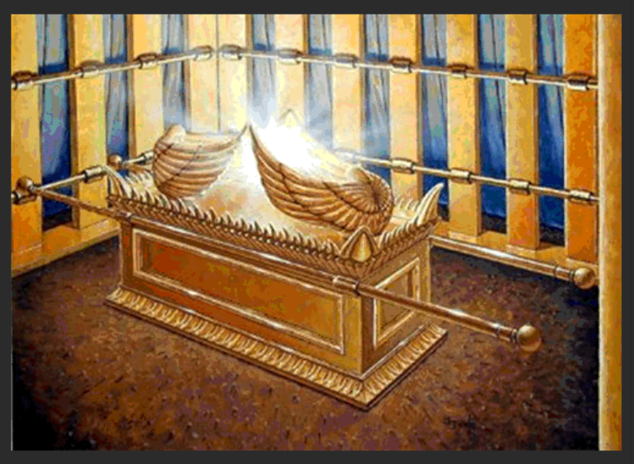

Slide 34
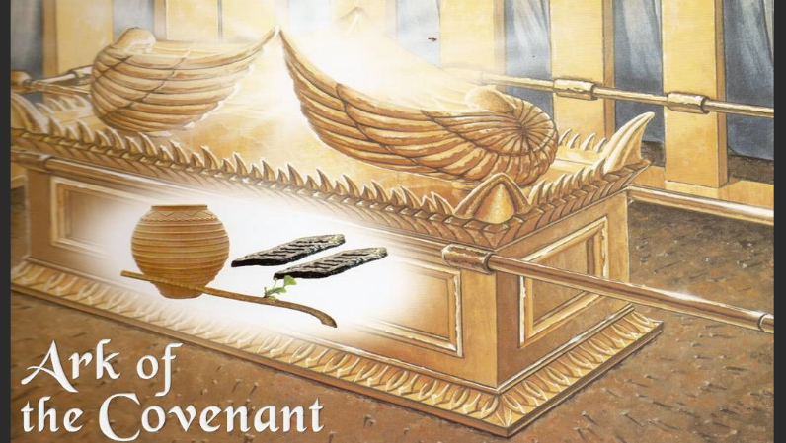

Slide 35
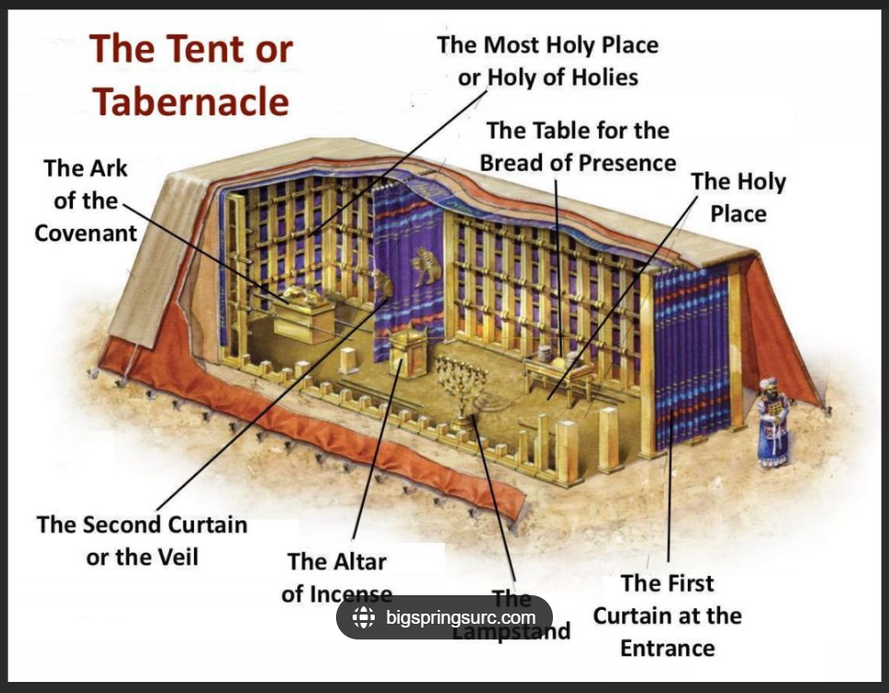

Slide 36
Exodus 40:34
“Then the cloud covered the tabernacle of meeting, and the glory of the LORD filled the tabernacle.”

Slide 37
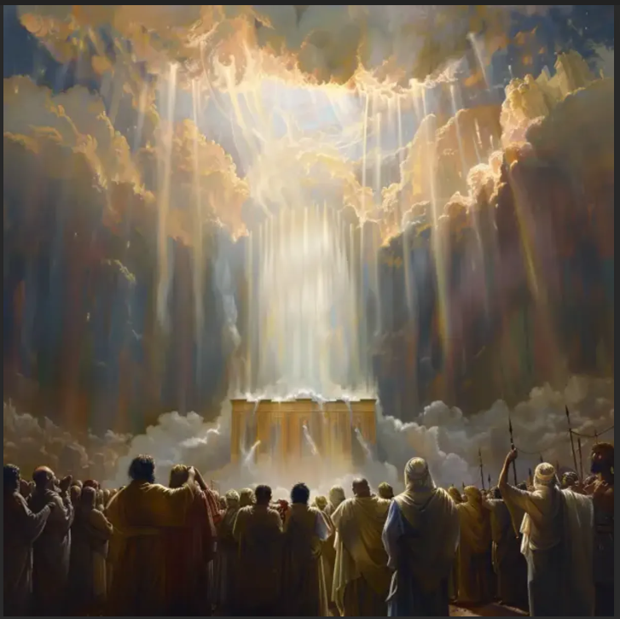
The glory of the LORD filling the tabernacle.

Slide 38
Exodus 40:35-38
“And Moses was not able to enter the tabernacle of meeting, because the cloud rested above it, and the glory of the LORD filled the tabernacle. Whenever the cloud was taken up from above the tabernacle, the children of Israel would go onward in all their journeys. But if the cloud was not

Slide 39
Exodus 40:35-38
taken up, then they did not journey till the day that it was taken up. For the cloud of the LORD was above the tabernacle by day, and fire was over it by night, in the sight of all the house of Israel, throughout all their journeys.”

Slide 40
“The reason Moses could not enter is tied to the overwhelming holiness of God. The Tabernacle was not merely a physical structure but a sacred dwelling where heaven and earth converged. God’s glory, often described as a consuming fire, was so intense that even Moses, who had previously spoken with God “face to face” outside the camp, could not enter. This demonstrates that access to God’s presence requires priestly consecration, sacrifice, and divine permission, emphasizing the need for mediated access to the holy.”
crosstalk.com

Slide 41
“Jewish mystical thought, such as the concept of Tzimtzum, suggests that God’s presence contracts to allow space for creation and human independence. In this view, the fullness of God’s glory in the Tabernacle left no room for anyone, including Moses, illustrating that even the most faithful servant must respect the limits of divine holiness.”
myjewishlearning.com

Slide 42
“Moses’ exclusion also foreshadows the structured access to God established through the priesthood in Leviticus. It underscores that holiness is not merely moral but ontological, and that God’s presence is supremely other, requiring reverence and preparation. The narrative also reflects the consequences of Israel’s prior sins, such as the golden calf incident, which disrupted the harmony between God and His people, making even Moses’ direct access temporarily impossible.”
bibleproject.com

Slide 43
“Moses was barred from entering the Tabernacle because God’s glory filled it to such an extent that no human could enter, highlighting the absolute holiness of God, the necessity of mediated access through priesthood and sacrifice, and the profound spiritual significance of the Tabernacle as a dwelling place for the divine presence.”
biblehub.com

Slide 44
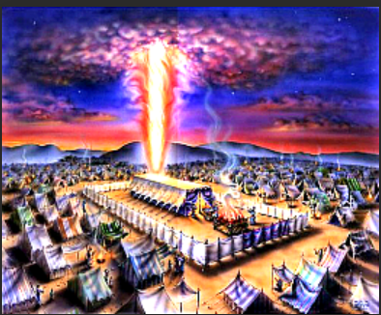
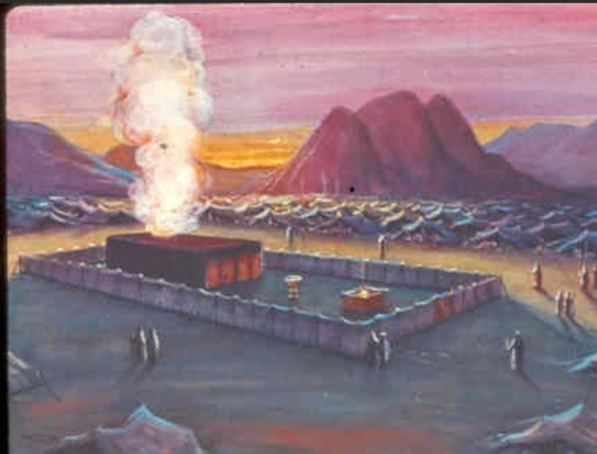
Fire by night Cloud by day

Slide 47
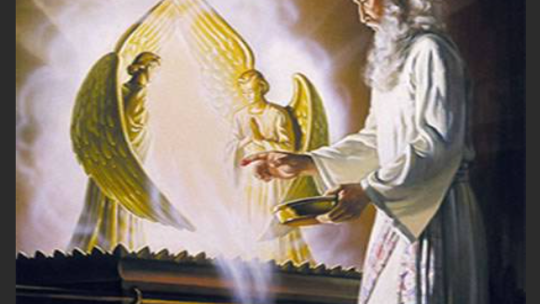

Slide 48
Hebrews 9:12
“Not with the blood of goats and calves, but with His own blood He entered the Most Holy Place once for all, having obtained eternal redemption.”

Slide 49
Hebrews 9:12
“Not with the blood of goats and calves, but with His own blood He entered the Most Holy Place once for all, having obtained eternal redemption.”

Slide 50
Hebrews 9:23-28
“Therefore it was necessary that the copies of the things in the heavens should be purified with these, but the heavenly things themselves with better sacrifices than these. For Christ has not entered the holy places made with hands, which are copies of the true, but into heaven itself, now to appear in the

Slide 51
Hebrews 9:23-28
presence of God for us; not that He should offer Himself often, as the high priest enters the Most Holy Place every year with blood of another – He then would have had to suffer often since the foundation of the world; but now, once at the end of the ages, He has appeared to put away sin by the sacrifice of

Slide 52
Hebrews 9:23-28
Himself. And as it is appointed for men to die once, but after this the judgment, so Christ was offered once to bear the sins of many. To those who eagerly wait for Him He will appear a second time, apart from sin, for salvation.”

Slide 53
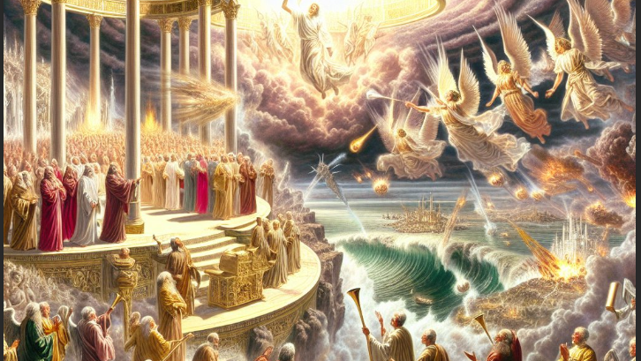

Slide 54
Hebrews 9:24
“For Christ has not entered the holy places made with hands, which are copies of the true, but into heaven itself, now to appear in the presence of God for us …”.

Slide 55
Hebrews 9:25-26
“… not that He should offer Himself often, as the high priest enters the Most Holy Place every year with blood of another – He then would have had to suffer often since the foundation of the world; but now, once at the end of the ages, He has appeared to put away sin by the sacrifice of Himself.”

Slide 57
Characteristics of the Heavenly Temple …
It is eternal and perfect

Slide 58
Revelation 11:19
“Then the temple of God was opened in heaven, and the ark of His covenant was seen in His temple …”.

Slide 59
Characteristics of the Heavenly Temple …
It is eternal and perfect
  Unlike the earthly tabernacle that was made of fabric and wood, the heavenly tabernacle is permanent and eternal, reflecting God’s true dwelling.

Slide 60
Characteristics of the Heavenly Temple …
The temple involves Jesus’ divine ministry

Slide 61
Characteristics of the Heavenly Temple …
The temple involves Jesus’ divine ministry
  Jesus Christ serves as the High Priest in this heavenly sanctuary, interceding for humanity and offering a once-for-all sacrifice, unlike the repeated sacrifices of the earthly priesthood.

Slide 62
Characteristics of the Heavenly Temple …
The temple’s spiritual reality

Slide 63
Characteristics of the Heavenly Temple …
The temple’s spiritual reality
  the heavenly tabernacle is not a physical structure … at least not in the same material sense we find here on earth, but it is a spiritual reality where God’s presence dwells fully and directly.

Slide 64
Revelation 21:22-23
“But I saw no temple in it, for the Lord God Almighty and the Lamb are its temple. The city had no need of the sun or of the moon to shine in it, for the glory of God illuminated it. The Lamb is its light.”

Slide 65
“The first thing John mentions about the interior of the city is that he saw no temple in it. For centuries on earth the tabernacle and temple symbolized God’s presence with man. It played a major role in the lives of His covenant people. But in the eternal state the symbol will no longer be necessary for the Lord God Almighty and the Lamb are its temple. Under the Law of Moses only the high priest could enter the Most Holy Place and only once a year. In eternity people will live in God’s presence continually.”

Slide 66
Colossians 1:13-14
“He has delivered us from the power of darkness and conveyed us into the kingdom of the Son of His love, in whom we have redemption through His blood, the forgiveness of sins.”

