Slide 1
Providence

Slide 2
“While there is nothing that is prophetically written in Scripture about what you or I will ever do or achieve in this life, God’s providence in our lives is just as real and true as the prophecies he gives in His Word regarding prophetic events.”

Slide 3
“And by that, I mean that just as God knew everything that had to take place for His prophecies to come to be, God also knows everything in our lives and works through our lives so that He can mold us into what He wants us to be.”

Slide 4
Jeremiah 29:11 (NIV)
“For I know the plans I have for you, declares the Lord, plans to prosper you and not to harm you, plans to give you hope and a future.”

Slide 5
Genesis 41:46 (NIV)
“Joseph was thirty years old when he entered the service of Pharaoh the king of Egypt.”

Slide 6
Genesis 37:2 (NIV)
“This is the account of Jacob’s family line. Joseph, a young man of seventeen, was tending the flocks with his brothers …”.

Slide 7
The Discipline of Service

Slide 8
The Discipline of Service
The Discipline of Self-Control

Slide 9
The Discipline of Service
The Discipline of Self-Control
The Discipline of Suffering

Slide 10
Genesis 41:46 (NIV)
“Joseph was thirty years old when he entered the service of Pharaoh the king of Egypt.”

Slide 11
Genesis 37:2-4 (NIV)
“Joseph, a young man of seventeen, was tending the flocks with his brothers, the sons of Bilhah and the sons of Zilpah, his father’s wives, and he brought their father a bad report about them. Now Israel loved Joseph more than any of his other sons, because he had been born to him in his old age; and he made an ornate robe for him.”

Slide 12
Genesis 37:2-3 (NIV)
“Joseph, a young man of seventeen, was tending the flocks with his brothers, the sons of Bilhah and the sons of Zilpah, his father’s wives, and he brought their father a bad report about them. Now Israel loved Joseph more than any of his other sons, because he had been born to him in his old age; and he made an ornate robe for him.”

Slide 13
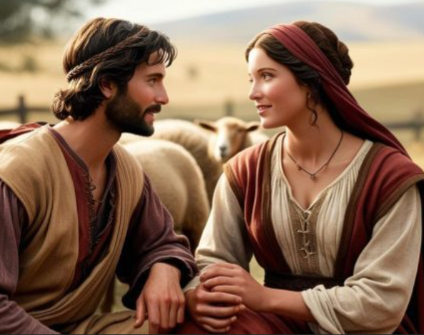
Jacob (Israel) falls in love with Rachel and wants to marry her.

Slide 14
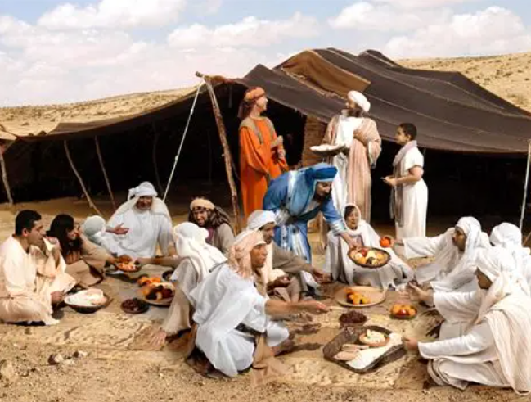

Slide 15
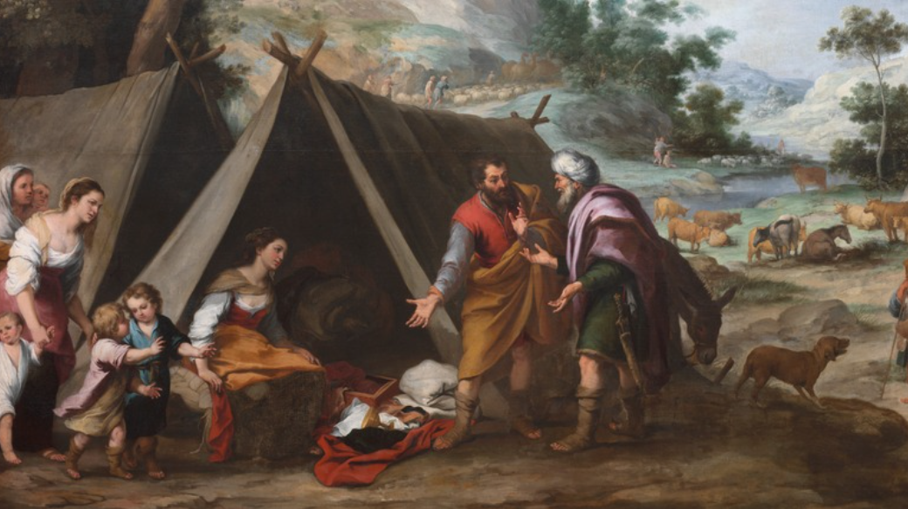

Slide 16
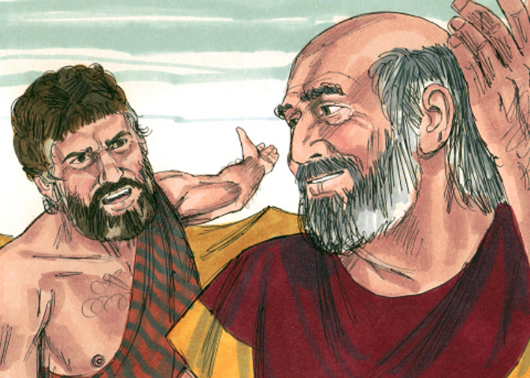

Slide 17


Slide 18


Slide 19
Genesis 37:4 (NIV)
“When his brothers saw that their father loved him more than any of them, they hated him and could not speak a kind word to him.”

Slide 20
Genesis 37:12-14 (NIV)
“Now his brothers had gone to graze their father’s flocks near Shechem, and Israel said to Joseph, “As you know, your brothers are grazing the flocks near Shechem. Come, I am going to send you to them.” “Very well,” he replied. So he said to him, “Go and see if all is well with your brothers and with the flocks, and bring word back to me.” Then he sent him off from the Valley of Hebron.”

Slide 21
Joseph “exchanged his ‘tailored
coat’ for a servant’s garb.”

Slide 22
Genesis 39:1-4 (NIV)
“Now Joseph had been taken down to Egypt. Potiphar, an Egyptian who was one of Pharaoh’s officials, the captain of the guard, bought him from the Ishmaelites who had taken him there. The LORD was with Joseph and he prospered, and he lived in the house of his Egyptian master.

Slide 23
Genesis 39:1-4 (NIV)
When his master saw that the LORD was with him and that the LORD gave him success in everything he did, Joseph found favor in his eyes and became his attendant. Potiphar put him in charge of his household, and he entrusted to his care everything he owned.”

Slide 24
1 Peter 5:5-6
“Young men, in the same way be submissive to those who are older. All of you, clothe yourselves with humility toward one another, because, ‘God opposes the proud but gives grace to the humble.’ Humble yourselves, therefore, under God’s mighty hand, that He may lift you up in due time.”

Slide 25
“In order for truth to be truth, it has to be right for all people, for all times, and for all places.”
Right From Wrong by Josh McDowell

Slide 26
Genesis 39:7-10 (NIV)
“Now Joseph was well-built and handsome, and after a while his master’s wife took notice of Joseph and said, ‘Come to bed with me!’ But he refused. ‘With me in charge,’ he told her, ‘my master does not concern himself with anything in the house; everything he owns he has entrusted to my care.

Slide 27
Genesis 39:7-10 (NIV)
No one is greater in this house than I am. My master has withheld nothing from me except you, because you are his wife. How then could I do such a wicked thing and sin against God?’ And though she spoke to Joseph day after day, he refused to go to bed with her or even be with her.”

Slide 28
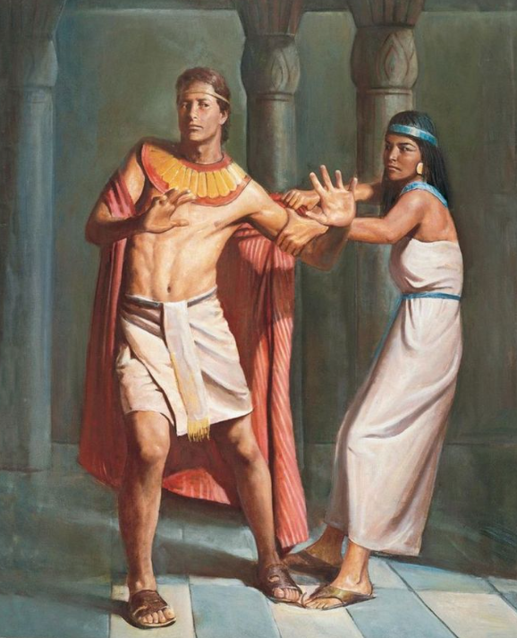

Slide 29
Genesis 39:7-10 (NIV)
No one is greater in this house than I am. My master has withheld nothing from me except you, because you are his wife. How then could I do such a wicked thing and sin against God?’ And though she spoke to Joseph day after day, he refused to go to bed with her or even be with her.”

Slide 30
Romans 13:13-14 (NIV)
“Let us behave decently, as in the daytime, not in carousing and drunkenness, not in sexual immorality and debauchery, not in dissension and jealousy. Rather, clothe yourselves with the Lord Jesus Christ, and do not think about how to gratify the desires of the flesh.”

Slide 31
2 Timothy 2:22 (NKJV)
“Flee the evil desires of youth and pursue righteousness …”.

Slide 32
Genesis 39:17-20a (NIV)
“Then she told him this story: ‘That Hebrew slave you brought us came to me to make sport of me. But as soon as I screamed for help, he left his cloak beside me and ran out of the house.’ When his master heard the story his wife told him, saying, ‘This is how your slave treated me,’ he burned with anger. Joseph’s master took him and put him in prison, the place where the king’s prisoners were confined.”

Slide 33
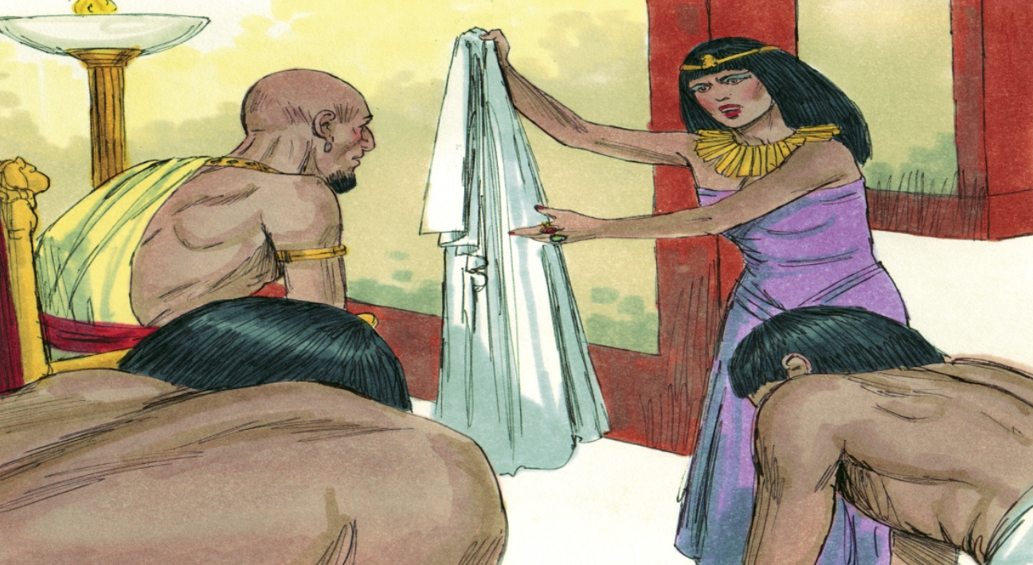

Slide 34
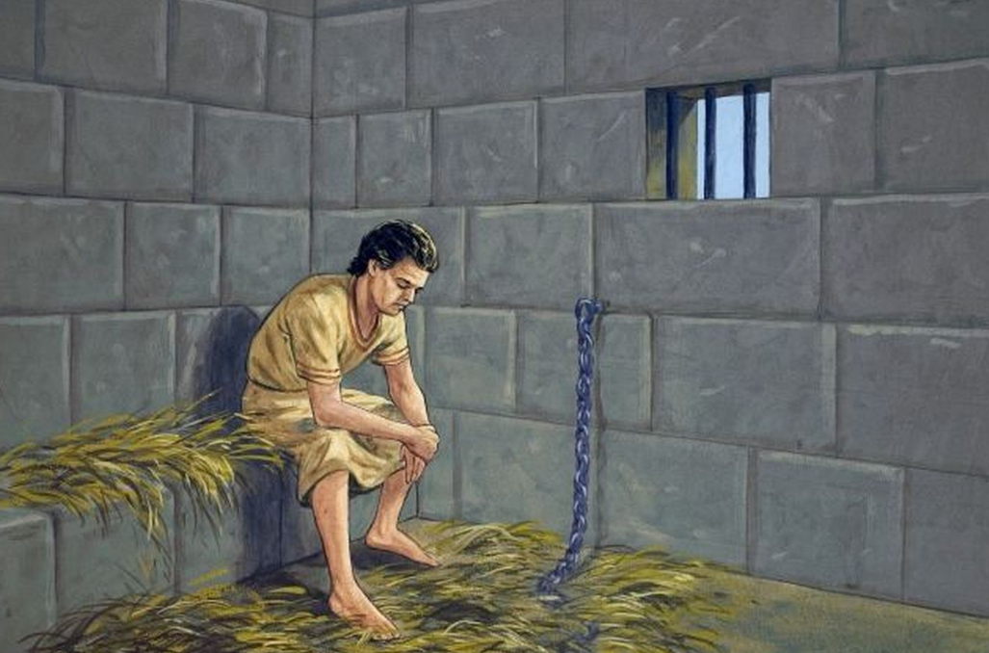

Slide 35
Genesis 39:20b-23 (NIV)
“But while Joseph was there in the prison, the LORD was with him; He showed him kindness and granted him favor in the eyes of the prison warden. So the warden put Joseph in charge of all those held in the prison, and he was made responsible for all that was done there. The warden paid no attention to anything under Joseph’s care, because the LORD was with Joseph and gave him success in whatever he did.”

Slide 36
Genesis 41:44-45 (NIV)
“Then Pharaoh said to Joseph, ‘I am Pharaoh, but without your word no one will lift hand or foot in all Egypt.’ Pharaoh gave Joseph the name Zaphenath-Paneah and gave him Asenath daughter of Potiphera, priest of On, to be his wife. And Joseph went throughout the land of Egypt.”

Slide 37
Genesis 41:50-52 (NIV)
“Before the years of famine came, two sons were born to Joseph by Asenath daughter of Potiphera, priest of On. Joseph named his firstborn Manasseh and said, ‘It is because God has made me forget all my trouble and all my father’s household.’ The second son he named Ephraim and said, ‘It is because God has made me fruitful in the land of my suffering.’”

Slide 38
Psalm 105:16-22(NASB)
“And He called for a famine upon the land; He broke the whole staff of bread. He sent a man before them, Joseph, who was sold as a slave. They afflicted his feet with fetters, He himself was laid in irons; until the time that his word came to pass, the word of the LORD tested him.

Slide 39
Psalm 105:16-22(NASB)
The king sent and released him, the ruler of peoples, and set him free. He made him lord of his house, And ruler over all his possessions, to imprison his princes at will, that he might teach his elders wisdom.”

Slide 40
Psalm 105:16-22(NASB)
“And He called for a famine upon the land; He broke the whole staff of bread. He sent a man before them, Joseph, who was sold as a slave. They afflicted his feet with fetters, He himself was laid in irons; until the time that his word came to pass, the word of the LORD tested him.

Slide 41
James 1:2-4 (NIV)
“Consider it pure joy, my brothers and sisters, whenever you face trials of many kinds, because you know that the testing of your faith produces perseverance. Let perseverance finish its work so that you may be mature and complete, not lacking anything.”

