Slide 1


Slide 2
Providence

Slide 3
God’s providence in our lives
is just as real and true as the
prophecies He gives in His Word
regarding prophetic events.

Slide 4
Just as God knew everything that had to take place for His prophecies to come to be, God also knows everything in our lives and works through our lives so that He can mold us into what He wants us to be.

Slide 5
Jeremiah 29:11 (NIV)
“For I know the plans I have for you,” declares the LORD, “plans to prosper you and not to harm you, plans to give you hope and a future.”

Slide 6
Jeremiah 29:4-14 (NIV)
“This is what the LORD Almighty, the God of Israel, says to all those I carried into exile from Jerusalem to Babylon: “Build houses and settle down; plant gardens and eat what they produce. Marry and have sons and daughters; find wives for your sons and give your daughters in marriage, so that they too may have sons and daughters. Increase in number there; do not decrease. Also,

Slide 7
Jeremiah 29:4-14 (NIV)
seek the peace and prosperity of the city to which I have carried you into exile. Pray to the LORD for it, because if it prospers, you too will prosper.” Yes, this is what the LORD Almighty, the God of Israel, says: Do not let the prophets and diviners among you deceive you. Do not listen to the dreams you encourage them to have. They are prophesying lies to you in my name. I have not sent them,”

Slide 8
Jeremiah 29:4-14 (NIV)
declares the LORD. This is what the LORD says: “When seventy years are completed for Babylon, I will come to you and fulfill my good promise to bring you back to this place. For I know the plans I have for you,” declares the LORD, “plans to prosper you and not to harm you, plans to give you hope and a future. Then you will call on me and come and pray to me, and I will listen to you.

Slide 9
Jeremiah 29:4-14 (NIV)
You will seek me and find me when you seek me with all your heart. I will be found by you,” declares the LORD, “and will bring you back from captivity. I will gather you from all the nations and places where I have banished you,” declares the LORD, “and will bring you back to the place from which I carried you into exile.”

Slide 10
Romans 8:28
“And we know that in all things God works for the good of those who love Him, who have been called according to His purpose.”

Slide 11
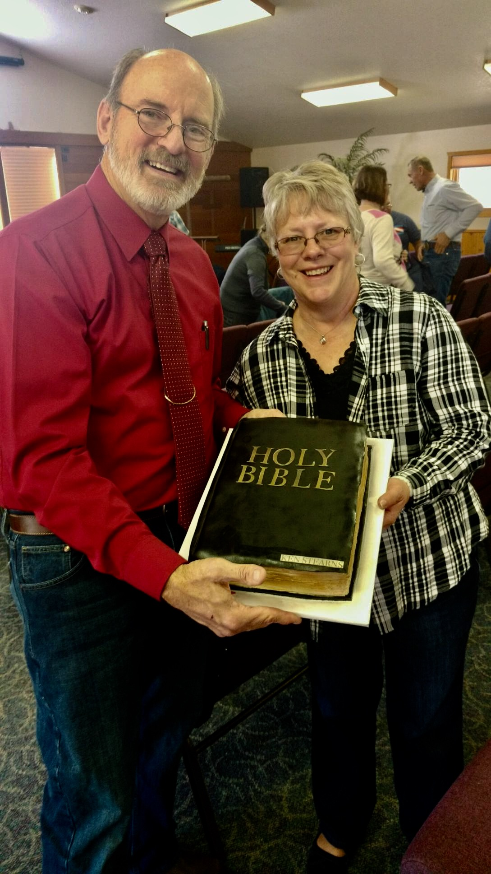

Slide 12


Slide 13
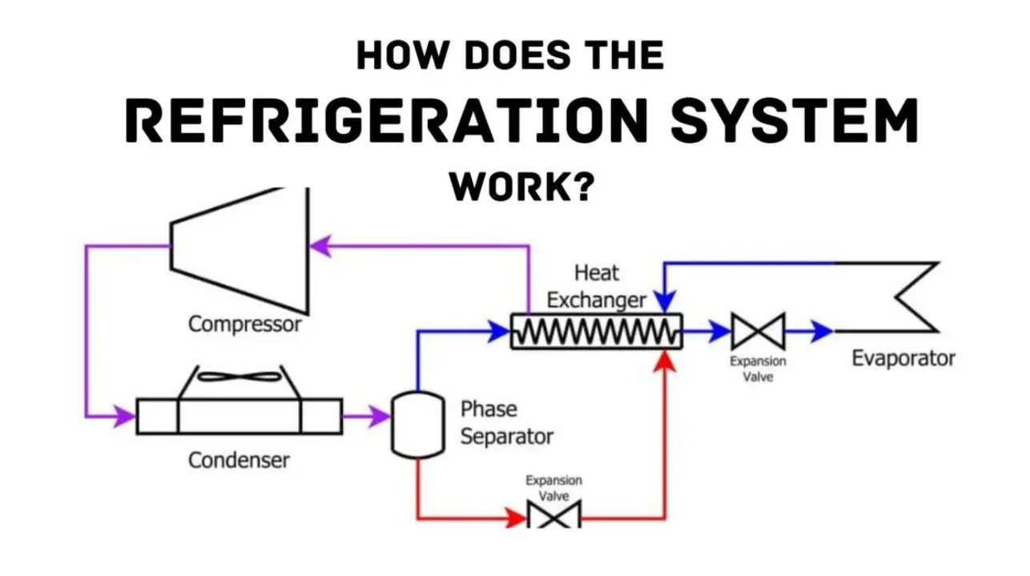

Slide 14
Restaurant Equipment
Cooking Equipment …
ovens, griddles, broilers, microwave ovens, steamers, kettles, fryers, commercial toasters, etc.

Slide 15
Restaurant Equipment
Refrigeration Equipment …
Walk-in Coolers and Freezers, smaller coolers and freezers, ice machines, soft-serve ice cream machines, etc.

Slide 16
Restaurant Equipment
Ventilation Equipment …
Exhaust systems
Heating systems
Air Conditioning systems

Slide 17
Restaurant Equipment
Plumbing Equipment …
Sinks, toilets, and urinals
Faucets and water heaters
Commercial dishwashers

Slide 18
Restaurant Equipment
Different fuels …
Electricity
Natural Gas
Propane

Slide 19
Could I be used in missions as a support-type missionary?

Slide 20
I wasn’t ready spiritually nor experientially. God still had work to do in me.

Slide 21
“Live minutes from great skiing, fishing and hunting. Mountainous region in Colorado needs HVAC, restaurant and refrigeration equipment technician. Send resume to …”.

Slide 22
We got involved in a church in Frisco, Colorado and ended up making three mission’s trips to Russia in the early 90’s when the iron curtain was beginning to break up..

Slide 23
Providence …
“God’s working in advance to arrange circumstances and situations for the fulfilling of His purposes.”

Slide 24
Providence in my life …
God was literally preparing me over the prior 17 years to be able to do what I had to do in serving Him there at Frontier.

Slide 25
Providence in my life …
God also prepared me musically to do the music program at Frontier for all those years.

Slide 26
Providence in my life …
We’re now here at Centennial, and God prepared us for that, too.

Slide 27
Providence in your life …
God has a plan for
each of you, too.

Slide 28
Jeremiah 29:11 (NIV)
“For I know the plans I have for you,” declares the LORD, “plans to prosper you and not to harm you, plans to give you hope and a future.”

Slide 29
Ephesians 2:8-10
“For by grace you have been saved through faith, and that not of yourselves; it is the gift of God, not of works, lest anyone should boast. For we are His workmanship, created in Christ Jesus for good works, which God prepared beforehand that we should walk in them.”

