Slide 1
Ephesians

Slide 2
“Ephesians is addressed to a group of believers who are rich beyond measure in Jesus Christ, yet living as beggars, and only because they are ignorant of their wealth. Since they have yet to accept their wealth, they relegate themselves to living as spiritual paupers.”
Talk Thru the Bible
Wilkinson and Boa

Slide 3
“I want you to write down all of the observations you come up with in these verses. I came up with 39 of them. See how many you can come up with.”

Slide 4
Ephesians 1:3-6
“Blessed be the God and Father of our Lord Jesus Christ, who has blessed us with every spiritual blessing in the heavenly places in Christ, just as He chose us in Him before the foundation of the world, that we should be holy and without blame before Him in love, having predestined us to adoption as sons by Jesus Christ to Himself, according to the good pleasure of His will, to the praise of the glory of His grace, by which He made us accepted in the Beloved.”

Slide 5
God is the active One in everything, and man is the passive one.

Slide 6
God is the active One in everything, and man is the passive one.
God is the One that does all the work, and man is the one that simply receives everything.

Slide 7
Things God has given us …
adoption, acceptance, redemption, forgiveness, wisdom, inheritance, the sealing of the Holy Spirit, life, grace, citizenship … in short, every spiritual blessing.

Slide 8
Pros Ephesious,
“To the Ephesians.”

Slide 9
en Epheso “in Ephesus”
Ephesians 1:1b
“To the saints who are in Ephesus, and faithful in Christ Jesus …”.

Slide 10
Ephesians 1:15-16
“Therefore I also, after I heard of your faith in the Lord Jesus and your love for all the saints, do not cease to give thanks for you, making mention of you in my prayers …”.

Slide 11
Ephesians 1:15-16
“Therefore I also, after I heard of your faith in the Lord Jesus and your love for all the saints, do not cease to give thanks for you, making mention of you in my prayers …”.

Slide 12
Ephesians 3:2
“if indeed you have heard of the dispensation of the grace of God which was given to me for you …”.

Slide 13
Ephesians 1:1
“Paul, an apostle of Jesus Christ by the will of God …”.

Slide 14
Ephesians 1:1
“Paul, an apostle of Jesus Christ by the will of God …”.
Ephesians 3:1
“For this reason I, Paul, the prisoner of Christ Jesus for you Gentiles …”.

Slide 15
“… this overlooks Paul’s flexibility under different circumstances,”
Talk Thru the Bible
Wilkinson and Boa

Slide 16
2 Timothy 3:16-17
“All Scripture is given by inspiration of God, and is profitable for doctrine, for reproof, for correction, for instruction in righteousness, that the man of God may be complete, thoroughly equipped for every good work.”

Slide 17
2 Timothy 3:16-17
“All Scripture is given by inspiration of God, and is profitable for doctrine, for reproof, for correction, for instruction in righteousness, that the man of God may be complete, thoroughly equipped for every good work.”
Inspiration = “divinely breathed in”

Slide 18
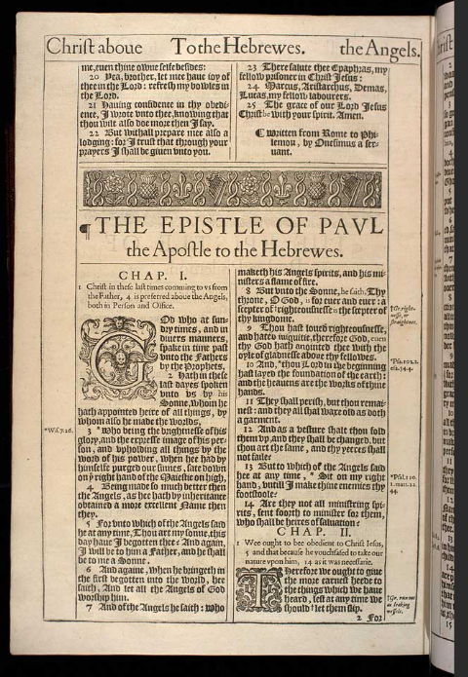

Slide 19
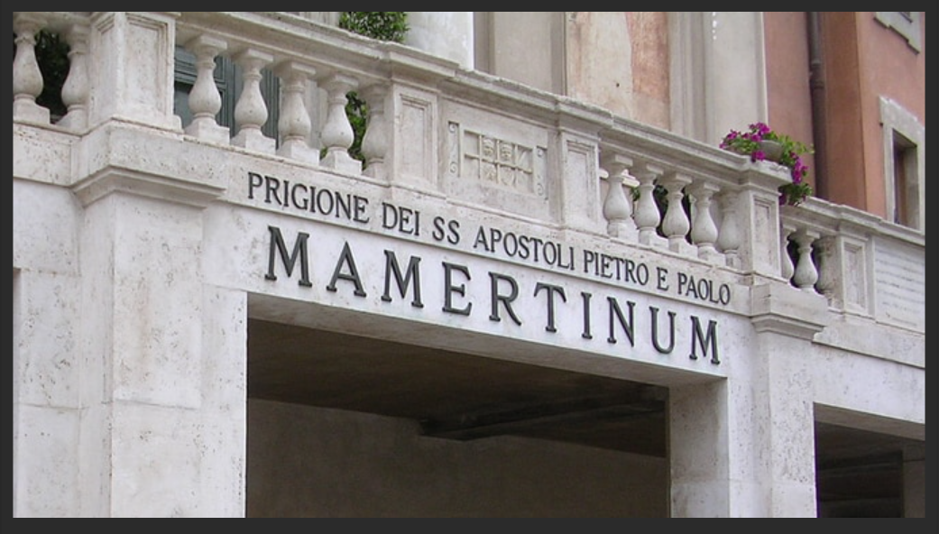

Slide 20
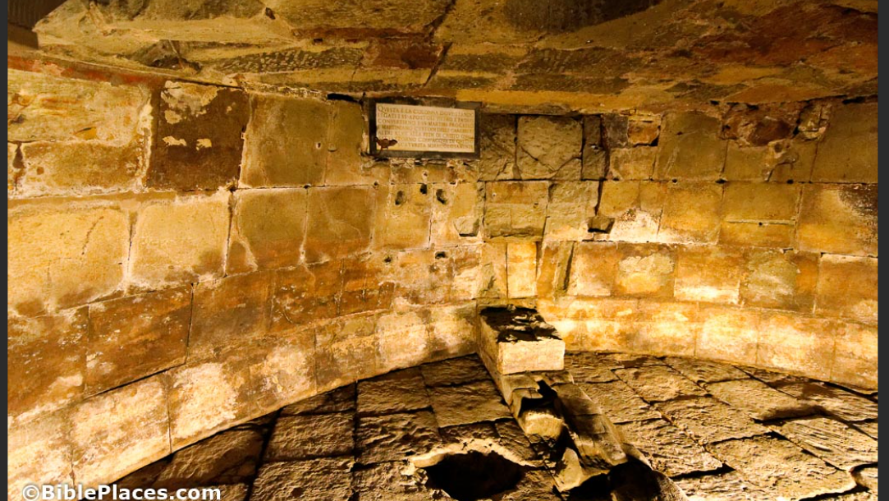

Slide 21
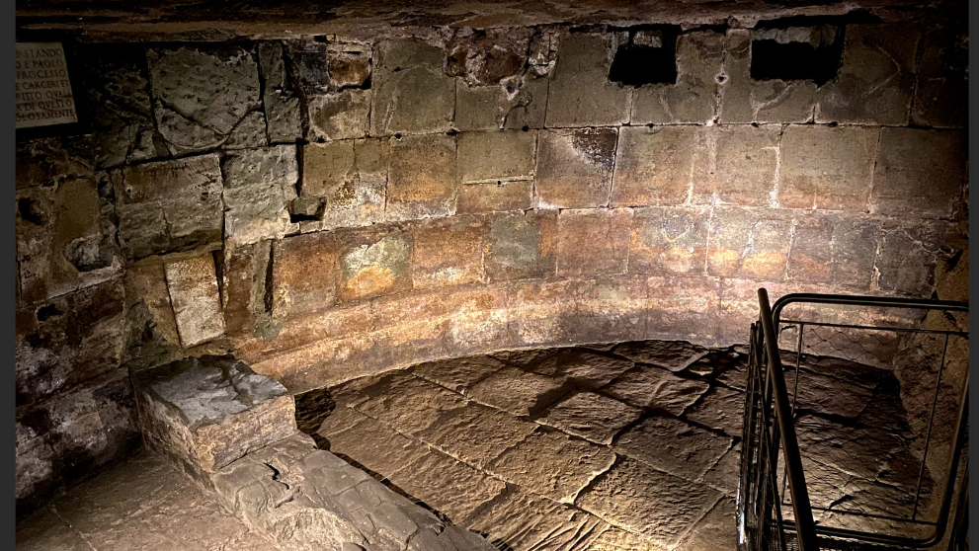

Slide 22


Slide 23
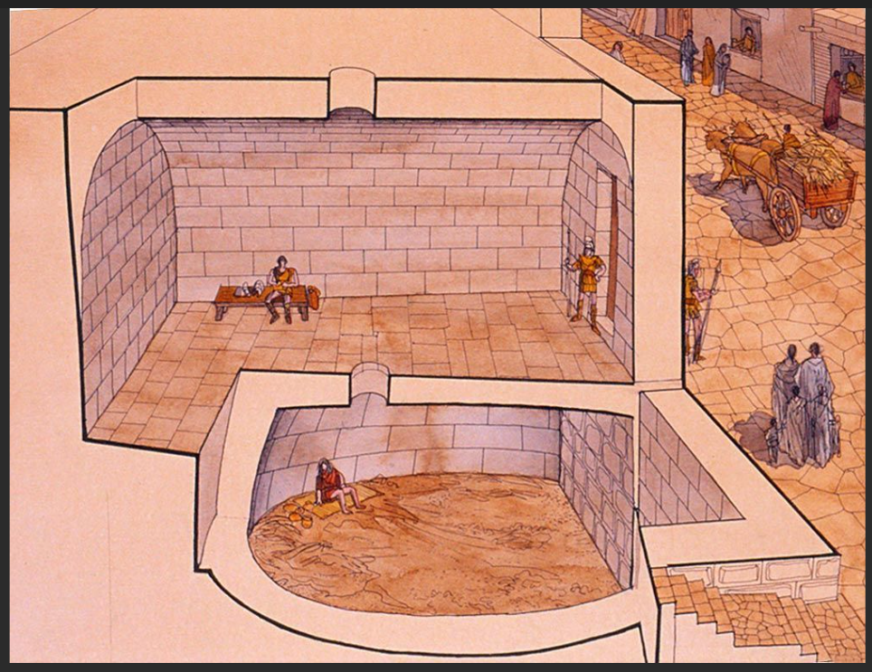

Slide 24
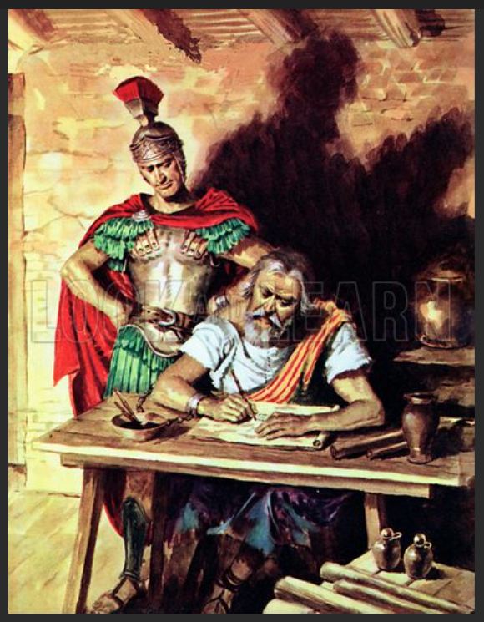

Slide 25
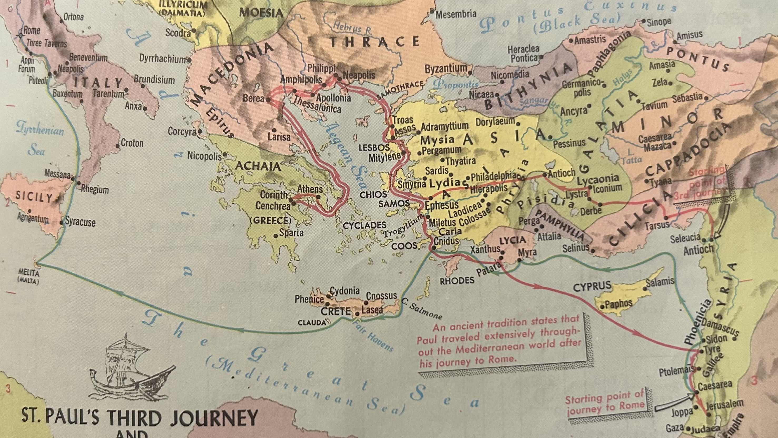

Slide 26
Acts 21:4
“And finding disciples, we stayed there seven days. They told Paul through the Spirit not to go up to Jerusalem.”

Slide 28
Acts 21:10-11
“And as we stayed many days, a certain prophet named Agabus came down from Judea. When he had come to us, he took Paul’s belt, bound his own hands and feet, and said, “Thus says the Holy Spirit, ‘So shall the Jews at Jerusalem bind the man who owns this belt, and deliver him into the hands of the Gentiles.’”

Slide 29
Acts 21:12-14
“Now when we heard these things, both we and those from that place pleaded with him not to go up to Jerusalem. Then Paul answered, “What do you mean by weeping and breaking my heart? For I am ready not only to be bound, but also to die at Jerusalem for the name of the Lord Jesus.”

Slide 30
Acts 22:24
“The commander ordered him to be brought into the barracks, and said that he should be examined under scourging, so that he might know why they shouted so against him.”

Slide 32
Acts 28:16
“Now when we came to Rome, the centurion delivered the prisoners to the captain of the guard; but Paul was permitted to dwell by himself with the soldier who guarded him.”

Slide 33
Acts 28:17-20
“And it came to pass after three days that Paul called the leaders of the Jews together. So when they had come together, he said to them: “Men and brethren, though I have done nothing against our people or the customs of our fathers, yet I was delivered as a prisoner from Jerusalem into the hands of the Romans, who, when they had examined me, wanted to

Slide 34
Acts 28:17-20
let me go, because there was no cause for putting me to death. But when the Jews spoke against it, I was compelled to appeal to Caesar, not that I had anything of which to accuse my nation. For this reason therefore I have called for you, to see you and speak with you, because for the hope of Israel I am bound with this chain.”

Slide 35
Acts 28:30-31
“Then Paul dwelt two whole years in his own rented house, and received all who came to him, preaching the kingdom of God and teaching the things which concern the Lord Jesus Christ with all confidence, no one forbidding him.”

Slide 36
Philippians 1:12-14
“But I want you to know, brethren, that the things which happened to me have actually turned out for the furtherance of the gospel, so that it has become evident to the whole palace guard, and to all the rest, that my chains are in Christ; and most of the brethren in the Lord, having become confident by my chains, are much more bold to speak the word without fear.”

Slide 37
Ephesians 4:1-3
“I, therefore, the prisoner of the Lord, beseech you to walk worthy of the calling with which you were called, with all lowliness and gentleness, with longsuffering, bearing with one another in love, endeavoring to keep the unity of the Spirit in the bond of peace.”

Slide 38
“Ephesians was not written to correct specific errors in a local church, but to prevent problems in the church as a whole by encouraging the body of Christ to mature in Him. It was also written to make believers more aware of their position in Christ because this is the basis for their practice on every level of life.”
Talk Thru the Bible
Wilkinson and Boa

Slide 39
“Ephesians was not written to correct specific errors in a local church, but to prevent problems in the church as a whole by encouraging the body of Christ to mature in Him. It was also written to make believers more aware of their position in Christ because this is the basis for their practice on every level of life.”
Talk Thru the Bible
Wilkinson and Boa

Slide 40
His Christian belief system needed to be at the core of who he is, and how he interprets the world around him, the decisions he makes in life, the way he treats others in life, and even his world view … all that needs to be guided and filtered through his core, Christian belief system and not the other way around.

Slide 41
My son needed to be “more aware of their (his) position in Christ because this is the basis for their (his) practice on every level of life.”

Slide 42
Ephesians 2:8-9
“For by grace you have been saved through faith, and that not of yourselves; it is the gift of God, not of works, lest anyone should boast.”

