Slide 1
Second
Thessalonians

Slide 2
2 Thessalonians 3:1-5
“Finally, brethren, pray for us, that the word of the Lord may run swiftly and be glorified, just as it is with you, and that we may be delivered from unreasonable and wicked men; for not all have faith. But the Lord is faithful, who will establish you and guard you from the

Slide 3
2 Thessalonians 3:1-5
evil one. And we have confidence in the Lord concerning you, both that you do and will do the things we command you. Now may the Lord direct your hearts into the love of God and into the patience of Christ.”

Slide 4
2 Thessalonians 3:1-5
“Finally, brethren, pray for us, that the word of the Lord may run swiftly and be glorified, just as it is with you, and that we may be delivered from unreasonable and wicked men; for not all have faith. But the Lord is faithful, who will establish you and guard you from the

Slide 5
Brethren …
“a fellow believer, united to another by the bond of affection,”
“brethren in Christ … Christians, as those who are exalted to the same heavenly place.”

Slide 6
2 Thessalonians 3:1-5
“Finally, brethren, pray for us, that the word of the Lord may run swiftly and be glorified, just as it is with you, and that we may be delivered from unreasonable and wicked men; for not all have faith. But the Lord is faithful, who will establish you and guard you from the

Slide 7
Hebrews 4:12 (NKJV)
“For the word of God is living and powerful, and sharper than any two-edged sword, piercing even to the division of soul and spirit, and of joints and marrow, and is a discerner of the thoughts and intents of the heart.”

Slide 8
Hebrews 4:12 (NIV)
“For the word of God is alive and active. Sharper than any double-edged sword, it penetrates even to dividing soul and spirit, joints and marrow; it judges the thoughts and attitudes of the heart.”

Slide 9
Hebrews 4:12 (NIV)
“For the word of God is alive and active. Sharper than any double-edged sword, it penetrates even to dividing soul and spirit, joints and marrow; it judges the thoughts and attitudes of the heart.”

Slide 10
Romans 12:2
“And do not be conformed to this world, but be transformed by the renewing of your mind, that you may prove what is that good and acceptable and perfect will of God.”

Slide 11
“Garbage in,
Garbage out”

Slide 12
Matthew 15:10-11
“Hear and understand: Not what goes into the mouth defiles a man; but what comes out of the mouth, this defiles a man.”

Slide 13
Matthew 15:16-20
“Are you also still without understanding? Do you not yet understand that whatever enters the mouth goes into the stomach and is eliminated? But those things which proceed out of the mouth come from the heart, and they defile a man. For out of the heart proceed evil thoughts, murders, adulteries, fornications, thefts, false witness, blasphemies. These are the things which defile a man, but to eat with unwashed hands does not defile a man.”

Slide 14
2 Thessalonians 3:1 (NKJV)
“Finally, brethren, pray for us, that the word of the Lord may run swiftly and be glorified …”
2 Thessalonians 3:1 (NLT)
“… we ask you to pray for us. Pray that the Lord’s message will spread rapidly and be honored wherever it goes …”.

Slide 15
2 Thessalonians 3:1 (NLT)
“… we ask you to pray for us. Pray that the Lord’s message will spread rapidly and be honored wherever it goes, just as when it came to you …”.

Slide 16
1 Thessalonians 1:8-9 (NKJV)
“For from you the word of the Lord has sounded forth, not only in Macedonia and Achaia, but also in every place. Your faith toward God has gone out, so that we do not need to say anything. For they themselves declare concerning us what manner of entry we had to you, and how you turned to God from idols to serve the living and true God ...”.

Slide 17
2 Thessalonians 3:1-2
“Finally, brethren, pray for us, that the word of the Lord may run swiftly and be glorified, just as it is with you, and that we may be delivered from unreasonable and wicked men; for not all have faith.”

Slide 18
2 Thessalonians 3:1-2
“Finally, brethren, pray for us, that the word of the Lord may run swiftly and be glorified, just as it is with you, and that we may be delivered from unreasonable and wicked men; for not all have faith.”

Slide 19
Acts 28:24
“And some were persuaded by the things which were spoken, and some disbelieved.”

Slide 20
John 3:17
“For God did not send His Son into the world to condemn the world, but that the world through Him might be saved”

Slide 21
2 Thessalonians 3:3
“But the Lord is faithful, who will establish you and guard you from the evil one.”

Slide 22
1 Thessalonians 5:23-24
“Now may the God of peace Himself sanctify you completely; and may your whole spirit, soul, and body be preserved blameless at the coming of our Lord Jesus Christ. He who calls you is faithful, who also will do it.”

Slide 23
Philippians 1:3-6 (NKJV)
“I thank my God upon every remembrance of you, always in every prayer of mine making request for you all with joy, for your fellowship in the gospel from the first day until now, being confident of this very thing, that He who has begun a good work in you will complete it until the day of Jesus Christ …”.

Slide 24
Philippians 1:3-6 (NLT)
“Every time I think of you, I give thanks to my God. Whenever I pray, I make my requests for all of you with joy, for you have been my partners in spreading the Good News about Christ from the time you first heard it until now. And I am certain that God, who began the good work within you, will continue His work until it is finally finished on the day when Christ Jesus returns.”

Slide 25
2 Thessalonians 3:3
“But the Lord is faithful, who will establish you and guard you from the evil one.”

Slide 26
2 Thessalonians 3:3
“But the Lord is faithful, who will establish you and guard you from the evil one.”
Establish … “to strengthen”

Slide 27
2 Thessalonians 3:3
“But the Lord is faithful, who will establish you and guard you from the evil one.”
Guard … (c.) “to guard a person (or thing) that he may remain safe … (2) to protect one from a person or thing (3) to keep from being snatched away, preserve safe and unimpaired (4) to guard from being lost or perishing.”

Slide 28
2 Thessalonians 3:3
“But the Lord is faithful, who will establish you and guard you from the evil one.”
Guard … (c.) “to guard a person (or thing) that he may remain safe … (2) to protect one from a person or thing (3) to keep from being snatched away, preserve safe and unimpaired (4) to guard from being lost or perishing.”

Slide 29
2 Thessalonians 3:3
“But the Lord is faithful, who will establish you and guard you from the evil one.”
Guard … (c.) “to guard a person (or thing) that he may remain safe … (2) to protect one from a person or thing (3) to keep from being snatched away, preserve safe and unimpaired (4) to guard from being lost or perishing.”

Slide 30
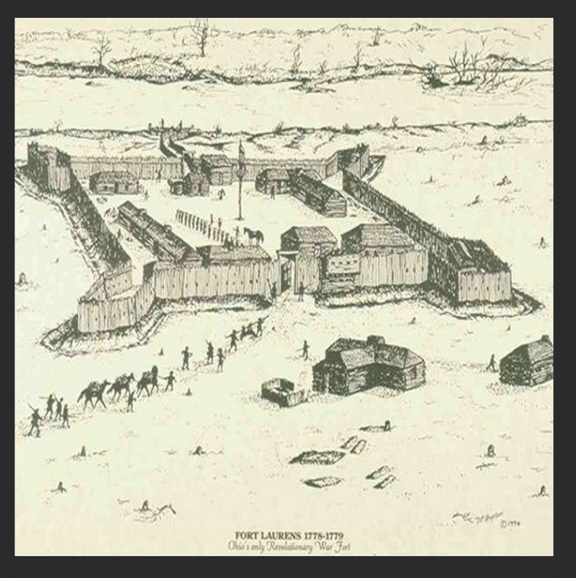

Slide 31
1 John 1:6-7
“If we say that we have fellowship with Him, and walk in darkness, we lie and do not practice the truth. But if we walk in the light as He is in the light, we have fellowship with one another, and the blood of Jesus Christ His Son cleanses us from all sin.”

Slide 32
1 John 1:6-7
“If we say that we have fellowship with Him, and walk in darkness, we lie and do not practice the truth. But if we walk in the light as He is in the light, we have fellowship with one another, and the blood of Jesus Christ His Son cleanses us from all sin.”

Slide 33
1 John 1:6-7
“If we say that we have fellowship with Him, and walk in darkness, we lie and do not practice the truth. But if we walk in the light as He is in the light, we have fellowship with one another, and the blood of Jesus Christ His Son cleanses us from all sin.”

Slide 34
2 Peter 1:3-11
“His divine power has given us everything we need for a godly life through our knowledge of Him who called us by His own glory and goodness. Through these He has given us His very great and precious promises, so that through them you may participate in the divine nature, having escaped the corruption in the world caused by evil desires. For this

Slide 35
2 Peter 1:3-11
very reason, make every effort to add to your faith goodness; and to goodness, knowledge; and to knowledge, self-control; and to self-control, perseverance; and to perseverance, godliness; and to godliness, mutual affection; and to mutual affection, love. For if you possess these qualities in increasing measure, they will keep you from being ineffective and

Slide 36
2 Peter 1:3-11
unproductive in your knowledge of our Lord Jesus Christ. But whoever does not have them is nearsighted and blind, forgetting that they have been cleansed from their past sins. Therefore, my brothers and sisters, make every effort to confirm your calling and election. For For if you do these things,

Slide 37
2 Peter 1:3-11
you will never stumble, and you will receive a rich welcome into the eternal kingdom of our Lord and Savior Jesus Christ.”

Slide 38
2 Peter 1:3-4
“His divine power has given us everything we need for a godly life through our knowledge of Him who called us by His own glory and goodness. Through these He has given us His very great and precious promises, so that through them you may participate in the divine nature, having escaped the corruption in the world caused by evil desires.”

Slide 39
2 Peter 1:3-4
“His divine power has given us everything we need for a godly life through our knowledge of Him who called us by His own glory and goodness. Through these He has given us His very great and precious promises, so that through them you may participate in the divine nature, having escaped the corruption in the world caused by evil desires.”

Slide 40
2 Peter 1:3-4
“His divine power has given us everything we need for a godly life through our knowledge of Him who called us by His own glory and goodness. Through these He has given us His very great and precious promises, so that through them you may participate in the divine nature, having escaped the corruption in the world caused by evil desires.”

Slide 41
2 Peter 1:3-4
“His divine power has given us everything we need for a godly life through our knowledge of Him who called us by His own glory and goodness. Through these He has given us His very great and precious promises, so that through them you may participate in the divine nature, having escaped the corruption in the world caused by evil desires.”

Slide 42
2 Peter 1:3-4
“His divine power has given us everything we need for a godly life through our knowledge of Him who called us by His own glory and goodness. Through these He has given us His very great and precious promises, so that through them you may participate in the divine nature, having escaped the corruption in the world caused by evil desires.”
The Subjunctive Mood

Slide 43
What is the subjunctive mood?
English has three moods. The indicative mood is for stating facts and opinions like "That cat is fabulous." The imperative mood is for giving orders and instructions, usually with you as the understood subject, as in "Look at that fabulous cat." The subjunctive mood is for expressing wishes, proposals, suggestions, or imagined situations, as in "I wish I could look at that fabulous cat all day."

Slide 44
Participating in the divine nature is not a given just because we are believers. Effort on our part is involved.

Slide 45
2 Peter 1:5-8
“For this very reason, make every effort to add to your faith goodness; and to goodness, knowledge; and to knowledge, self-control; and to self-control, perseverance; and to perseverance, godliness; and to godliness, mutual affection; and to mutual affection, love. For if you possess these qualities in increasing measure, they will keep you from being ineffective and unproductive in your knowledge of our Lord Jesus Christ.”

Slide 46
2 Peter 1:5-8
“For this very reason, make every effort to add to your faith goodness; and to goodness, knowledge; and to knowledge, self-control; and to self-control, perseverance; and to perseverance, godliness; and to godliness, mutual affection; and to mutual affection, love. For if you possess these qualities in increasing measure, they will keep you from being ineffective and unproductive in your knowledge of our Lord Jesus Christ.”

Slide 47
2 Peter 1:9
“But whoever does not have them is nearsighted and blind, forgetting that they have been cleansed from their past sins.”

Slide 48
2 Peter 1:10-11
“Therefore, my brothers and sisters, make every effort to confirm your calling and election. For if you do these things, you will never stumble, and you will receive a rich welcome into the eternal kingdom of our Lord and Savior Jesus Christ.”

Slide 49
2 Peter 1:10-11
“Therefore, my brothers and sisters, make every effort to confirm your calling and election. For if you do these things, you will never stumble, and you will receive a rich welcome into the eternal kingdom of our Lord and Savior Jesus Christ.”

Slide 50
2 Thessalonians 3:3
“But the Lord is faithful, who will establish you and guard you from the evil one.”

