Slide 1
Second
Thessalonians

Slide 2
2 Thessalonians 2:14
“… to which He called you by our gospel, for the obtaining of the glory of our Lord Jesus Christ.”

Slide 3
2 Thessalonians 2:14
“… to which He called you by our gospel, for the obtaining of the glory of our Lord Jesus Christ.”

Slide 4
If God chooses certain individuals to be saved, then I really don’t see any other way around the fact that this means there are those that God doesn’t choose, which then condemns those individuals to an eternity in the lake of fire where they will be separated from God the Father and His Son, Jesus Christ forever.

Slide 5
John 6:44
“No one can come to Me unless the Father who sent Me draws him; and I will raise him up at the last day.”

Slide 6
John 16:8
“And when He has come, He will convict the world of sin, and of righteousness, and of judgment …”.

Slide 7
John 16:8
“And when He has come, He will convict the world of sin, and of righteousness, and of judgment …”.

Slide 8
2 Thessalonians 2:14
“… to which He called you by our gospel, for the obtaining of the glory of our Lord Jesus Christ.”

Slide 9
2 Thessalonians 2:14
“… to which He called you by our gospel, for the obtaining of the glory of our Lord Jesus Christ.”

Slide 10
Gospel …
“Good News” or “Good Tidings”

Slide 11
“As the apostles spoke and witnessed to people, were the words that they spoke inspired words of God?”

Slide 12
John 14:16-18
“And I will pray the Father, and He will give you another Helper, that He may abide with you forever – the Spirit of truth, whom the world cannot receive, because it neither sees Him nor knows Him; but you know Him, for He dwells with you and will be in you. I will not leave you orphans; I will come to you.”

Slide 13
John 14:25-26
“These things I have spoken to you while being present with you. But the Helper, the Holy Spirit, whom the Father will send in My name, He will teach you all things, and bring to your remembrance all things that I said to you.”

Slide 14
John 2:19-21
“Jesus answered and said to them, “Destroy this temple, and in three days I will raise it up.” Then the Jews said, “It has taken forty-six years to build this temple, and will You raise it up in three days?” But He was speaking of the temple of His body. Therefore, when He had risen from the dead, His disciples remembered that He had said this to them; and they believed the Scripture and the word which Jesus had said.”

Slide 15
John 12:16
“His disciples did not understand these things at first; but when Jesus was glorified, then they remembered that these things were written about Him and that they had done these things to Him.”

Slide 16
Galatians 3:1-3
“O foolish Galatians! Who has bewitched you that you should not obey the truth, before whose eyes Jesus Christ was clearly portrayed among you as crucified? This only I want to learn from you: Did you receive the Spirit by the works of the law, or by the hearing of faith? Are you so foolish? Having begun in the Spirit, are you now being made perfect by the flesh?”

Slide 17
1 Corinthians 15:1-4
“Moreover, brethren, I declare to you the gospel which I preached to you, which also you received and in which you stand, by which also you are saved, if you hold fast that word which I preached to you – unless you believed in vain. For I delivered to you first of all that which I also received: that Christ died for our sins according to the Scriptures, and that He was buried, and that He rose again the third day according to the Scriptures …”.

Slide 18
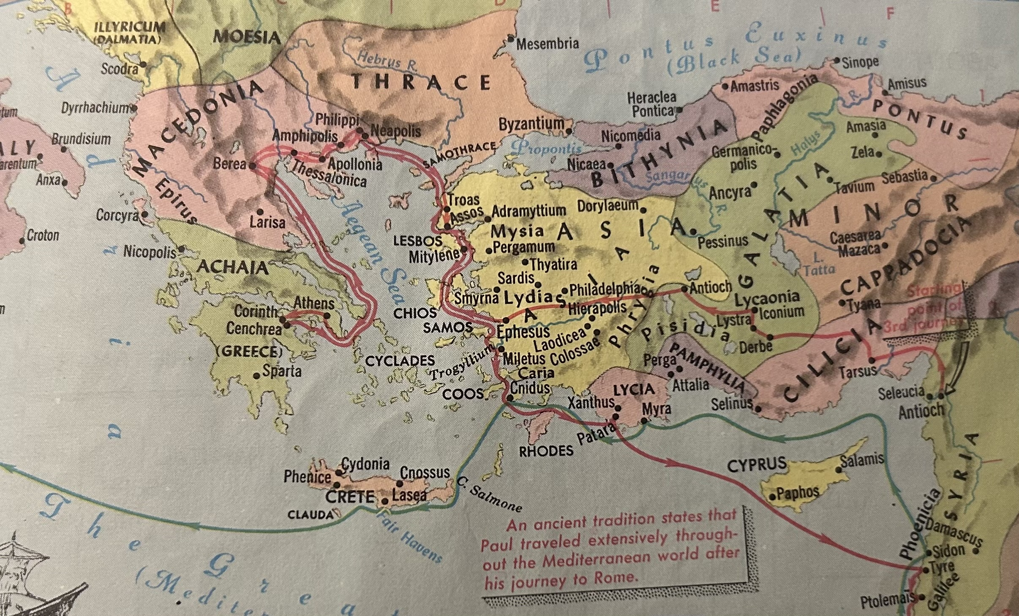

Slide 19
Acts 16:17
“These men are the servants of the Most High God, who proclaim to us the way of salvation”

Slide 20
Acts 16:20-24
“And they brought them to the magistrates, and said, “These men, being Jews, exceedingly trouble our city; and they teach customs which are not lawful for us, being Romans, to receive or observe.” Then the multitude rose up together against them; and the magistrates tore off their clothes and

Slide 21
Acts 16:20-24
commanded them to be beaten with rods. And when they had laid many stripes on them, they threw them into prison, commanding the jailer to keep them securely. Having received such a charge, he put them into the inner prison and fastened their feet in the stocks.”

Slide 22
Acts 16:25-30
“But at midnight Paul and Silas were praying and singing hymns to God, and the prisoners were listening to them. Suddenly there was a great earthquake, so that the foundations of the prison were shaken; and immediately all the doors were opened and everyone’s chains were loosed. And the keeper of the prison, awaking from sleep and

Slide 23
Acts 16:25-30
seeing the prison doors open, supposing the prisoners had fled, drew his sword and was about to kill himself. But Paul called with a loud voice, saying, “Do yourself no harm, for we are all here.” Then he called for a light, ran in, and fell down trembling before Paul and Silas. And he brought them out and said, “Sirs, what must I do to be saved?”

Slide 24
Acts 16:25-30
seeing the prison doors open, supposing the prisoners had fled, drew his sword and was about to kill himself. But Paul called with a loud voice, saying, “Do yourself no harm, for we are all here.” Then he called for a light, ran in, and fell down trembling before Paul and Silas. And he brought them out and said, “Sirs, what must I do to be saved?”

Slide 25
Acts 16:31
“So they said, “Believe on the Lord Jesus Christ, and you will be saved, you and your household.”

Slide 26
Acts 16:32-34
“Then they spoke the word of the Lord to him and to all who were in his house. And he took them the same hour of the night and washed their stripes. And immediately he and all his family were baptized. Now when he had brought them into his house, he set food before them; and he rejoiced, having believed in God with all his household.”

Slide 27
Believing is being convinced
that something is true.
When one gives evidence
of something, that is the
foundation for belief.

Slide 28
John 3:15, 16, 18; 5:24; 6:40, 47; 11:25-26 … all these verses basically say the same thing. If one believes in Christ, that person will not perish but have everlasting life.

Slide 29
John 20:30-31
“And truly Jesus did many other signs in the presence of His disciples, which are not written in this book; but these are written that you may believe that Jesus is the Christ, the Son of God, and that believing you may have life in His name.”

Slide 30
Ephesians 2:8-9
“For by grace you have been saved through faith, and that not of yourselves; it is the gift of God, not of works, lest anyone should boast.”

