Slide 1
Happy New Year

Slide 10
“On board Apollo 11 was a computer called the Apollo Guidance Computer (AGC). It had 2048 words of memory which could be used to store “temporary results” – data that is lost when there is no power. This type of memory is referred to as RAM (Random Access Memory). Each word comprised 16 binary digits (bits), with a bit being a zero or a one. This means that the Apollo computer had 32,768 bits of RAM memory. In addition, it had 72KB of Read Only Memory (ROM),

Slide 11
which is equivalent to 589,824 bits. This memory is programmed and cannot be changed once it is finalized. A single alphabetical character – say an “a” or a “b” – typically requires eight bits to be stored. That means the Apollo 11 computer would not be able to store this article in its 32,768 bits of RAM. Compare that to your mobile phone or an MP3 player and you can appreciate that they are able to store much more, often containing thousands of emails, songs and photographs.

Slide 12
To put that into more concrete terms, the latest phones typically have 4GB of RAM. That is 34,359,738,368 bits. This is more than one million (1,048,576 to be exact) times more memory than the Apollo computer had in RAM. The iPhone also has up to 512GB of ROM memory. That is 4,398,046,511,104 bits, which is seven million times more than that of the guidance computer. But memory isn’t the only thing that matters. The Apollo 11 computer had a processor –

Slide 13
an electronic circuit that performs operations on external data sources – which ran at 0.043 MHz. The latest iPhone’s processor is estimated to run at about 2490 MHz. Apple does not advertise the processing speed, but others have calculated it. This means that the iPhone in your pocket has over 100,000 times the processing power of the computer that landed man on the moon 55 years ago.”

Slide 14
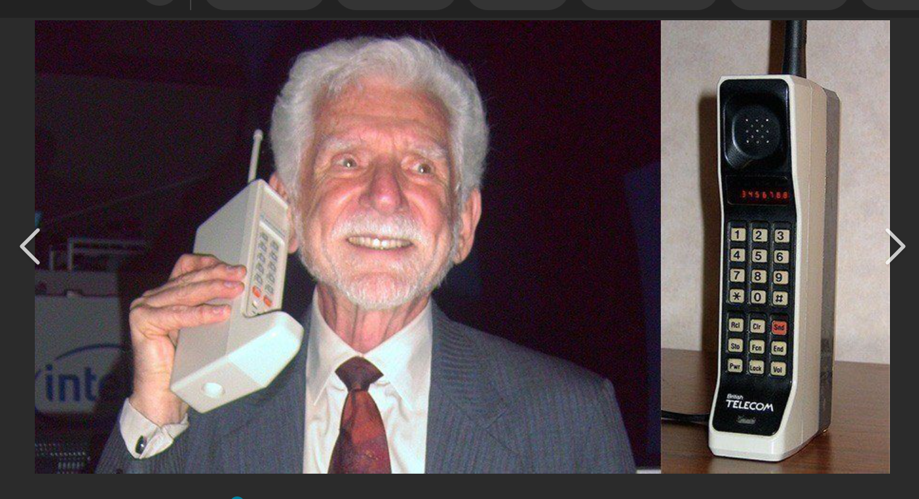

Slide 16
Homosexuality

Slide 17
Homosexuality
Transgenderism

Slide 18
Homosexuality
Transgenderism

Slide 19
Homosexuality
Transgenderism
Gender Reassignment Surgery

Slide 20
Homosexuality
Transgenderism
Abortion
Gender Reassignment Surgery

Slide 21
Antisemitism

Slide 22
Romans 1:18-32
“For the wrath of God is revealed from heaven against all ungodliness and unrighteousness of men, who suppress the truth in unrighteousness, because what may be known of God is manifest in them, for God has shown it to them. For since the creation of the world His invisible attributes are clearly seen, being understood by the things that

Slide 23
Romans 1:18-32
are made, even His eternal power and Godhead, so that they are without excuse, because, although they knew God, they did not glorify Him as God, nor were thankful, but became futile in their thoughts, and their foolish hearts were darkened. Professing to be wise, they became fools, and changed the glory of the incorruptible God into an

Slide 24
Romans 1:18-32
image made like corruptible man – and birds and four-footed animals and creeping things. Therefore God also gave them up to uncleanness, in the lusts of their hearts, to dishonor their bodies among themselves, who exchanged the truth of God for the lie, and worshiped and served the creature rather than the Creator, who is blessed

Slide 25
Romans 1:18-32
forever. Amen. For this reason God gave them up to vile passions. For even their women exchanged the natural use for what is against nature. Likewise also the men, leaving the natural use of the woman, burned in their lust for one another, men with men committing what is shameful, and receiving in themselves the penalty of their error

Slide 26
Romans 1:18-32
which was due. And even as they did not like to retain God in their knowledge, God gave them over to a debased mind, to do those things which are not fitting; being filled with all unrighteousness, sexual immorality, wickedness, covetousness, maliciousness; full of envy, murder, strife, deceit, evil-mindedness; they are whisperers, backbiters,

Slide 27
Romans 1:18-32
haters of God, violent, proud, boasters, inventors of evil things, disobedient to parents, undiscerning, untrustworthy, unloving, unforgiving, unmerciful; who, knowing the righteous judgment of God, that those who practice such things are deserving of death, not only do the same but also approve of those who practice them.”

Slide 28
“The ancient city of Corinth was one of the most wicked in the ancient world. Strabo (c. 63 BC-c.24 AD), describing Corinth in St. Paul’s day (c. 50 AD), said it was a wealthy port city not only because of its fortunate location on the isthmus connecting Asia and Italy but: “…(its) temple of Aphrodite (goddess of love) was so rich that it owned more than 1,000 temple slaves, courtesans,

Slide 29
whom both men and women had dedicated to the goddess. And therefore it was also on account of these women (temple prostitutes) that the city was crowded with people and grew rich; for instance, the ship captains freely squandered their money (in the temple brothels) and hence the common proverb: ‘Not for every man is the voyage to Corinth.’” earlychurchhistory.org

Slide 30
“So notorious for its licentiousness was Corinth that one of the Greek words for “fornication” was korinthiazomai.”
earlychurchhistory.org

Slide 31
“So notorious for its licentiousness was Corinth that one of the Greek words for “fornication” was korinthiazomai.”
“God’s love and forgiveness reached many of them. It always will. Some of the believers in that iniquitous city came out of lifestyles and habits that were hard to break. They were constantly backsliding and required constant upbraiding.”
earlychurchhistory.org

Slide 32
Ecclesiastes 1:9
“That which has been is what will be, that which is done is what will be done, and there is nothing new under the sun.”

Slide 34
2 Thessalonians 2:5, 15
“Do you not remember that when I was still with you I told you these things?”
“Therefore, brethren, stand fast and hold the traditions which you were taught, whether by word or our epistle.”

Slide 35
2 Thessalonians 2:13-17
“But we are bound to give thanks to God always for you, brethren beloved by the Lord, because God from the beginning chose you for salvation through sanctification by the Spirit and belief in the truth, to which He called you by our gospel, for the obtaining of the glory of our Lord Jesus Christ. Therefore, brethren, stand fast and hold the

Slide 36
2 Thessalonians 2:13-17
traditions which you were taught, whether by word or our epistle. Now may our Lord Jesus Christ Himself, and our God and Father, who has loved us and given us everlasting consolation and good hope by grace, comfort your hearts and establish you in every good word and work.”

Slide 37
2 Thessalonians 2:13-17
“But we are bound to give thanks to God always for you, brethren beloved by the Lord, because God from the beginning chose you for salvation through sanctification by the Spirit and belief in the truth, to which He called you by our gospel, for the obtaining of the glory of our Lord Jesus Christ. Therefore, brethren, stand fast and hold the

Slide 38
2 Thessalonians 2:13-17
“But we are bound to give thanks to God always for you, brethren beloved by the Lord, because God from the beginning chose you for salvation through sanctification by the Spirit and belief in the truth, to which He called you by our gospel, for the obtaining of the glory of our Lord Jesus Christ. Therefore, brethren, stand fast and hold the

Slide 39
2 Thessalonians 2:13-17
“But we are bound to give thanks to God always for you, brethren beloved by the Lord, because God from the beginning chose you for salvation through sanctification by the Spirit and belief in the truth, to which He called you by our gospel, for the obtaining of the glory of our Lord Jesus Christ. Therefore, brethren, stand fast and hold the

Slide 40
2 Thessalonians 2:13-17
“But we are bound to give thanks to God always for you, brethren beloved by the Lord, because God from the beginning chose you for salvation through sanctification by the Spirit and belief in the truth, to which He called you by our gospel, for the obtaining of the glory of our Lord Jesus Christ. Therefore, brethren, stand fast and hold the

Slide 41
2 Thessalonians 2:13-17
“But we are bound to give thanks to God always for you, brethren beloved by the Lord, because God from the beginning chose you for salvation through sanctification by the Spirit and belief in the truth, to which He called you by our gospel, for the obtaining of the glory of our Lord Jesus Christ. Therefore, brethren, stand fast and hold the

Slide 42
Chose
“αἱρέομαι”, “aihreomai,” “hahee-reh’-om-ahee”
“to take,” is used in the middle voice only, in the sense of taking for oneself, choosing, 2 Thess. 2:13, of a “choice” made by God. Its special significance is to select rather by the act of taking, than by showing preference or favor.”
Vine’s Dictionary of Old and New Testament Words

Slide 43
Philippians 1:20-22 (NIV)
“I eagerly expect and hope that I will in no way be ashamed, but will have sufficient courage so that now as always Christ will be exalted in my body, whether by life or by death. For to me, to live is Christ and to die is gain. If I am to go on living in the body, this will mean fruitful labor for me. Yet what shall I choose? I do not know!”

Slide 44
Philippians 1:20-22 (NIV)
“I eagerly expect and hope that I will in no way be ashamed, but will have sufficient courage so that now as always Christ will be exalted in my body, whether by life or by death. For to me, to live is Christ and to die is gain. If I am to go on living in the body, this will mean fruitful labor for me. Yet what shall I choose? I do not know!”

Slide 45
Hebrews 11:24-25
“By faith Moses, when he became of age, refused to be called the son of Pharaoh’s daughter, choosing rather to suffer affliction with the people of God than to enjoy the passing pleasures of sin …”.

Slide 46
Hebrews 11:24-25
“By faith Moses, when he became of age, refused to be called the son of Pharaoh’s daughter, choosing rather to suffer affliction with the people of God than to enjoy the passing pleasures of sin …”.

Slide 47
2 Thessalonians 2:13-17
“But we are bound to give thanks to God always for you, brethren beloved by the Lord, because God from the beginning chose you for salvation through sanctification by the Spirit and belief in the truth, to which He called you by our gospel, for the obtaining of the glory of our Lord Jesus Christ. Therefore, brethren, stand fast and hold the

Slide 48
When a person believes in Christ for His promise of everlasting life, he is set apart unto God in a positional sense.
In other words, the believer’s position never changes.

Slide 49
The believer is able to enjoy assurance of his or her salvation because our salvation is not dependent upon what we do, but is instead dependent on what Christ has already done on the believer’s behalf.

Slide 50
Individuals will be delivered from the Tribulation through sanctification by the Spirit through belief in the truth.
Those two things will result in the individual being taken up in the Rapture.

Slide 51
2 Thessalonians 2:12
“… that they all may be condemned who did not believe the truth but had pleasure in unrighteousness.”

Slide 52
Looking to God’s Word regarding future things can give us encouragement and strength to live lives that are glorifying to Christ!

