Slide 1
Second
Thessalonians

Slide 2
2 Thessalonians 2:6-7
“And now you know what is restraining, that he may be revealed in his own time. For the mystery of lawlessness is already at work; only He who now restrains will do so until He is taken out of the way.”

Slide 3
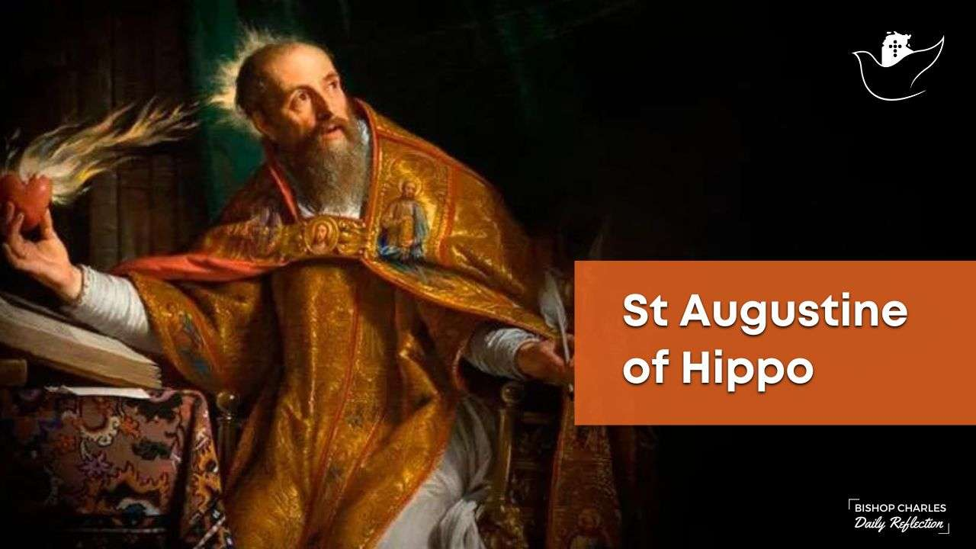

Slide 4
Matthew 24:15-22
“Therefore when you see the ‘abomination of desolation,’ spoken of by Daniel the prophet, standing in the holy place” (whoever reads, let him understand), “then let those who are in Judea flee to the mountains. Let him who is on the housetop not go down to take anything out of his house. And let him who is in the field not go back to get his clothes. But woe to those who are

Slide 5
Matthew 24:15-22
and to those who are nursing babies in those days! And pray that your flight may not be in winter or on the Sabbath. For then there will be great tribulation, such as has not been since the beginning of the world until this time, no, nor ever shall be. And unless those days were shortened, no flesh would be saved; but for the elect’s sake those days will be shortened.”

Slide 6
Matthew 24:16-20
“… then let those who are in Judea flee to the mountains. Let him who is on the housetop not go down to take anything out of his house. And let him who is in the field not go back to get his clothes. But woe to those who are pregnant and to those who are nursing babies in those days! And pray that your flight may not be in winter or on the Sabbath.”

Slide 7
Matthew 25:37-39
“Then the righteous will answer Him, saying, ‘Lord, when did we see You hungry and feed You, or thirsty and give You drink? When did we see You a stranger and take You in, or naked and clothe You? Or when did we see You sick, or in prison, and come to You?’”

Slide 8
Matthew 25:37-39
“Then the righteous will answer Him, saying, ‘Lord, when did we see You hungry and feed You, or thirsty and give You drink? When did we see You a stranger and take You in, or naked and clothe You? Or when did we see You sick, or in prison, and come to You?’”

Slide 9
Matthew 25:40
“And the King will answer and say to them, ‘Assuredly, I say to you, inasmuch as you did it to one of the least of these My brethren, you did it to Me.”

Slide 10
Matthew 25:40
“And the King will answer and say to them, ‘Assuredly, I say to you, inasmuch as you did it to one of the least of these My brethren, you did it to Me.”
Jewish Believers in Christ

Slide 11
Matthew 25:34
“Come, you blessed of My Father, inherit the kingdom prepared for you from the foundation of the world …”.

Slide 12
Matthew 5:14-16
“You are the light of the world. A city that is set on a hill cannot be hidden. Nor do they light a lamp and put it under a basket, but on a lampstand, and it gives light to all who are in the house. Let your light so shine before men, that they may see your good works and glorify your Father in heaven.”

Slide 13
1 Corinthians 15:51-53
“Behold, I tell you a mystery: We shall not all sleep, but we shall all be changed – in a moment, in the twinkling of an eye, at the last trumpet. For the trumpet will sound, and the dead will be raised incorruptible, and we shall be changed. For this corruptible must put on incorruption, and this mortal must put on immortality.”

Slide 14
Does the Holy Spirit that indwells believers go up in the air with the believers when they are raptured?

Slide 15
Does the Holy Spirit that indwells believers go up in the air with the believers when they are raptured?
Does the Holy Spirit stay upon the earth so that people can become saved down here on earth during the Tribulation Period?

Slide 16
Does the Holy Spirit that indwells believers go up in the air with the believers when they are raptured?
Does the Holy Spirit stay upon the earth so that people can become saved down here on earth during the Tribulation Period?

Slide 17
Ephesians 4:30
“And do not grieve the Holy Spirit of God, by whom you were sealed for the day of redemption.”

Slide 18
Ephesians 4:30
“And do not grieve the Holy Spirit of God, by whom you were sealed for the day of redemption.”

Slide 19
“Even if they sin and grieve the Spirit, they nevertheless are sealed unto the day of redemption, that is, until the day of resurrection or translation, when they would receive new bodies and would no longer sin.”
John Walvoord, Major Bible Themes

Slide 20
“Even if they sin and grieve the Spirit, they nevertheless are sealed unto the day of redemption, that is, until the day of resurrection or translation, when they would receive new bodies and would no longer sin.”
John Walvoord, Major Bible Themes

Slide 21
Does the Holy Spirit that indwells believers go up in the air with the believers when they are raptured?
Does the Holy Spirit stay upon the earth so that people can become saved down here on earth during the Tribulation Period?

Slide 22
Does the Holy Spirit that indwells believers go up in the air with the believers when they are raptured?
Does the Holy Spirit stay upon the earth so that people can become saved down here on earth during the Tribulation Period?
“Yes,” but He won’t be operating in quite the same way as He is during this church age.

Slide 23
The Holy Spirit has always been involved in the regeneration of the heart.

Slide 24
The Holy Spirit Baptizes Us Into One Body
1 Corinthians 12:12-13
“For as the body is one and has many members, but all the members of that one body, being many, are one body, so also is Christ. For by one Spirit we were all baptized into one body – whether Jews or Greeks, whether slaves or free – and have all be made to drink into one Spirit.”

Slide 25
The Holy Spirit Indwells the Believer
1 Corinthians 6:19-20
“Or do you not know that your body is the temple of the Holy Spirit who is in you, whom you have from God, and you are not your own? For you were bought at a price; therefore glorify God in your body and in your spirit, which are God’s.”

Slide 26
The Holy Spirit “Seals” the Believer
Ephesians 4:30
“And do not grieve the Holy Spirit of God, by whom you were sealed for the day of redemption.”

Slide 27
The Holy Spirit “Seals” the Believer
Ephesians 4:30
“And do not grieve the Holy Spirit of God, by whom you were sealed for the day of redemption.”
This also speaks to the
believer’s eternal security

Slide 28
2 Timothy 2:11-13
“This is a faithful saying: For if we died with Him, we shall also live with Him. If we endure, We shall also reign with Him. If we deny Him, He also will deny us. If we are faithless, He remains faithful; He cannot deny Himself.”

Slide 29
2 Timothy 2:11-13
“This is a faithful saying: For if we died with Him, we shall also live with Him. If we endure, We shall also reign with Him. If we deny Him, He also will deny us. If we are faithless, He remains faithful; He cannot deny Himself.”

Slide 30
Galatians 2:20
“I have been crucified with Christ; it is no longer I who live, but Christ lives in me; and the life which I now live in the flesh I live by faith in the Son of God, who loved me and gave Himself for me.”

Slide 31
2 Timothy 2:11-13
“This is a faithful saying: For if we died with Him, we shall also live with Him. If we endure, We shall also reign with Him. If we deny Him, He also will deny us. If we are faithless, He remains faithful; He cannot deny Himself.”

Slide 32
2 Timothy 2:11-13
“This is a faithful saying: For if we died with Him, we shall also live with Him. If we endure, We shall also reign with Him. If we deny Him, He also will deny us. If we are faithless, He remains faithful; He cannot deny Himself.”

Slide 33
The Holy Spirit “Fills” the Believer
Ephesians 5:18
“And do not be drunk with wine, in which is dissipation; but be filled with the Spirit …”.

Slide 34
“The filling of the Spirit is, accordingly, accomplished in every believer when he is fully yielded to the indwelling Holy Spirit, resulting in a spiritual condition in which the Holy Spirit controls and empowers the individual. While there may be degrees of manifestation of the filling of the Spirit and degrees of divine power, the central thought in the filling is that the Spirit of God is able to operate in and through the individual without hindrance, accomplishing God’s perfect will for that person.”

Slide 35
These four ministries of the Spirit – baptism, indwelling, sealing, and being filled with the Spirit … these four ministries are unique to this dispensation we are currently in.

Slide 36
John 3:3-8
“Jesus answered and said to him, “Most assuredly, I say to you, unless one is born again, he cannot see the kingdom of God.” Nicodemus said to Him, “How can a man be born when he is old? Can he enter a second time into his mother’s womb and be born?” Jesus answered, “Most assuredly, I say to you, unless one is born of water and the Spirit,

Slide 37
John 3:3-8
he cannot enter the kingdom of God. That which is born of the flesh is flesh, and that which is born of the Spirit is spirit. Do not marvel that I said to you, ‘You must be born again.’ The wind blows where it wishes, and you hear the sound of it, but cannot tell where it comes from and where it goes. So is everyone who is born of the Spirit.”

Slide 38
What is important to remember regarding what the Holy Spirit does in regenerating the heart – that is totally separate from the present-day ministries of the Holy Spirit in believer’s lives.

Slide 39
“… the Spirit’s indwelling is entirely distinct and separate from the work of the Spirit in regeneration.”
Dwight Pentecost, Things to Come

Slide 40
Genesis 15:2-6
“But Abram said, “Lord God, what will You give me, seeing I go childless, and the heir of my house is Eliezer of Damascus?” Then Abram said, “Look, You have given me no offspring; indeed one born in my house is my heir!” And behold, the word of the Lord came to him, saying, “This one shall not be your heir, but one who will come from your

Slide 41
Genesis 15:2-6
own body shall be your heir.” Then He brought him outside and said, “Look now toward heaven, and count the stars if you are able to number them.” And He said to him, “So shall your descendants be.” And he believed in the Lord, and He accounted it to him for righteousness.”

Slide 42
Genesis 15:2-6
own body shall be your heir.” Then He brought him outside and said, “Look now toward heaven, and count the stars if you are able to number them.” And He said to him, “So shall your descendants be.” And he believed in the Lord, and He accounted it to him for righteousness.”

Slide 43
Genesis 15:2-6
own body shall be your heir.” Then He brought him outside and said, “Look now toward heaven, and count the stars if you are able to number them.” And He said to him, “So shall your descendants be.” And he believed in the Lord, and He accounted it to him for righteousness.”

Slide 44
Genesis 15:2-6
own body shall be your heir.” Then He brought him outside and said, “Look now toward heaven, and count the stars if you are able to number them.” And He said to him, “So shall your descendants be.” And he believed in the Lord, and He accounted it to him for righteousness.”
JUSTIFICATION

Slide 45
Romans 4:2-5
“For if Abraham was justified by works, he has something to boast about, but not before God. For what does the Scripture say? “Abraham believed God, and it was accounted to him for righteousness.” Now to him who works, the wages are not counted as grace but as debt. But to him who does not work but believes on Him who justifies the ungodly, his faith is accounted for righteousness …”.

Slide 46
After the rapture of the church … the Holy Spirit’s operational role will return to basically what it was in the Old Testament times.

Slide 47
2 Thessalonians 2:7
“For the mystery of lawlessness is already at work; only He who now restrains will do so until He is taken out of the way.”

Slide 48
Revelation 11:3
“And I will give power to my two witnesses, and they will prophesy one thousand two hundred and sixty days, clothed in sackcloth.”

Slide 49
Revelation 7:4
“And I heard the number of those who were sealed. One hundred and forty-four thousand of all the tribes of the children of Israel were sealed …”.

Slide 50
We know who the restrainer is … the Spirit-Indwelt Church.

Slide 51
We know that the Holy Spirit will remain on the earth during the Tribulation, although His indwelling ministries will be taken away, and His operational role will return to what it was during the Old Testament times – mostly regenerating the hearts of those who believe in Christ.

Slide 52
We learned that the regenerating work the Holy Spirit does is separate and distinct from the indwelling ministries the Holy Spirit does today in the lives of believers.

