Slide 1
Second
Thessalonians

Slide 2
2 Thessalonians 2:6-7
“And now you know what is restraining, that he may be revealed in his own time. For the mystery of lawlessness is already at work; only He who now restrains will do so until He is taken out of the way.”

Slide 3
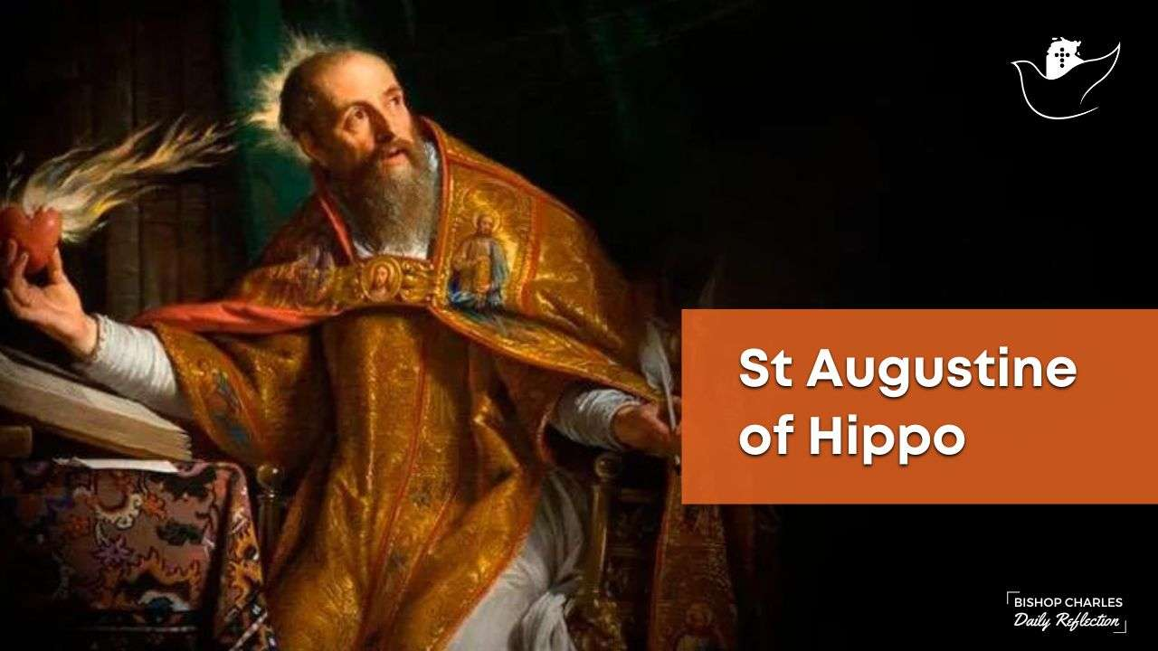

Slide 4
2 Thessalonians 2:6-7
“And now you know what is restraining, that he may be revealed in his own time. For the mystery of lawlessness is already at work; only He who now restrains will do so until He is taken out of the way.”

Slide 5
Ideas on “Who” the restrainer is:
The Roman Empire
The Jewish State
The Apostle Paul
The Preaching of the Gospel
Human Government
Satan
Elijah
Unfallen Angels
Michael the Archangel
The Holy Spirit
The Church

Slide 6
Ideas on “Who” the restrainer is:
The Roman Empire
The Jewish State
The Apostle Paul
The Preaching of the Gospel
Human Government
Satan
Elijah
Unfallen Angels
Michael the Archangel
The Holy Spirit
The Church

Slide 7
Is the Holy Spirit the restrainer?
Clues to look at …

Slide 8
Is the Holy Spirit the restrainer?
Clues to look at …
The restrainer holds back the man of sin

Slide 9
Is the Holy Spirit the restrainer?
Clues to look at …
The restrainer holds back the man of sin
The grammar used in verses 6 and 7

Slide 10
“… ‘what’ is restraining …”
Because of the noun ‘what’, the verb
‘restraining’ is in the neuter form

Slide 11
“… ‘what’ is restraining …”
‘what’ then suggests a principle as
opposed to a person doing the action
Because of the noun ‘what’, the verb
‘restraining’ is in the neuter form

Slide 12
“… ‘what’ is restraining …”
‘what’ then suggests a principle as
opposed to a person doing the action
“… ‘He’ who now restrains …”
Because of the noun ‘what’, the verb
‘restraining’ is in the neuter form
Because of the noun ‘He’, the verb
‘restrains’ is in the masculine form

Slide 13
“… ‘what’ is restraining …”
‘what’ then suggests a principle as
opposed to a person doing the action
“… ‘He’ who now restrains …”
The masculine verb suggests a person
Because of the noun ‘what’, the verb
‘restraining’ is in the neuter form
Because of the noun ‘He’, the verb
‘restrains’ is in the masculine form

Slide 14
Is the Holy Spirit the restrainer?
Clues to look at …
The restrainer holds back the man of sin
The grammar used in verses 6 and 7
Whatever the restrainer is, he or it must be removable

Slide 15
2 Thessalonians 2:6-7
“And now you know what is restraining, that he may be revealed in his own time. For the mystery of lawlessness is already at work; only He who now restrains will do so until He is taken out of the way.”

Slide 16
Is the Holy Spirit the restrainer?
Clues to look at …
The restrainer holds back the man of sin
The grammar used in verses 6 and 7
Whatever the restrainer is, he or it must be removable
The restrainer must be powerful enough to hold back the outbreak of evil under the antichrist

Slide 17
The restrainer isn’t one thing or the other – i.e., the Holy Spirit or the church, but that it is a combination of the two. In other words, the restrainer that Paul is speaking of must be the Spirit-Indwelt Church.

Slide 18
The Spirit-Indwelt Church …
The restrainer requires omnipotent power

Slide 19
Ephesians 2:2
“… in which you once walked according to the course of this world, according to the prince of the power of the air, the spirit who now works in the sons of disobedience …”

Slide 20
Ephesians 2:3
“… among whom also we all once conducted ourselves in the lusts of our flesh, fulfilling the desires of the flesh and of the mind, and were by nature children of wrath, just as the others.”

Slide 21
Ephesians 2:1
“And you He made alive, who were dead in trespasses and sins …”.

Slide 22
Ephesians 2:1
“And you He made alive, who were dead in trespasses and sins …”.

Slide 23
Ephesians 2:4-5
“But God, who is rich in mercy, because of His great love with which He loved us, even when we were dead in trespasses, made us alive together with Christ (by grace you have been saved) …”.

Slide 24
Ephesians 2:8-9
“For by grace you have been saved through faith, and that not of yourselves; it is the gift of God, not of works, lest anyone should boast.”

Slide 25
Ephesians 2:8-9
“For by grace you have been saved through faith, and that not of yourselves; it is the gift of God, not of works, lest anyone should boast.”

Slide 26
Ephesians 2:1
“And you He made alive, who were dead in trespasses and sins …”.

Slide 27
The Spirit-Indwelt Church …
The restrainer requires omnipotent power
The Spirit-Indwelt Church adequately explains the change in gender in the verses

Slide 28
The word for the Holy Spirit is “πνεῦμα”, “pnuema” and it is in the neuter gender. But we also see in many verses that the Holy Spirit is also consistently referred to by the masculine pronoun, “He”, especially in John’s gospel and chapters 14 through 16.

Slide 29
The Spirit-Indwelt Church …
The restrainer requires omnipotent power
The Spirit-Indwelt Church adequately explains the change in gender in the verses
The Scriptures speak of the Holy Spirit as restraining sin and evil in the world and in the heart of the believer

Slide 30
Genesis 6:3
“Then the Lord said, “My Spirit shall not strive with man forever, because he also is flesh; nevertheless his days shall be one hundred and twenty years.”

Slide 31
“My Spirit shall not strive with man forever …”. This translation is supported by many of the ancient versions. The first derivation sees “rûaḥ” as God’s Spirit, a convicting agent and restraining force among men. Because of the unbridled wickedness and rebellion of man, God would cease to mercifully convict and restrain, and would bring judgment.”
Paradise to Prison, John J. Davis

Slide 32
Galatians 5:16-17
“I say then: Walk in the Spirit, and you shall not fulfill the lust of the flesh. For the flesh lusts against the Spirit, and the Spirit against the flesh; and these are contrary to one another, so that you do not do the things that you wish.”

Slide 33
The Spirit-Indwelt Church …
The restrainer requires omnipotent power
The Spirit-Indwelt Church adequately explains the change in gender in the verses
The Scriptures speak of the Holy Spirit as restraining sin and evil in the world and in the heart of the believer
The Holy Spirit uses the church and its proclamation and portrayal of the gospel as the primary instrument in this age to restrain evil.

Slide 34
“What do you think this world would be like if there weren’t millions of people in it that lived godly lives that participated in church life and that stand up for things that are good, right, just, and morally acceptable, etc.?”

Slide 35
Matthew 5:13-16
“You are the salt of the earth; but if the salt loses its flavor, how shall it be seasoned? It is then good for nothing but to be thrown out and trampled underfoot by men. You are the light of the world. A city that is set on a hill cannot be hidden.

Slide 36
Matthew 5:13-16
Nor do they light a lamp and put it under a basket, but on a lampstand, and it gives light to all who are in the house. Let your light so shine before men, that they may see your good works and glorify your Father in heaven.”

Slide 37
“What makes it possible for the believer to be able to live this kind of life?”

Slide 38
“If the believer is operating on his own resolve and commitment to fulfill God’s commands, then he cannot do the things that he wishes (in other words, he will not be fulfilling the lusts of his flesh).”

Slide 39
“If the believer is operating on his own resolve and commitment to fulfill God’s commands, then he cannot do the things that he wishes (in other words, he will not be fulfilling the lusts of his flesh).”

Slide 40
1 Corinthians 6:19-20
“Or do you not know that your body is the temple of the Holy Spirit who is in you, whom you have from God, and you are not your own? For you were bought at a price; therefore glorify God in your body and in your spirit, which are God’s.”

Slide 41
2 Corinthians 1:21-22
“Now He who establishes us with you in Christ and has anointed us is God, who also has sealed us and given us the Spirit in our hearts as a guarantee.”

Slide 42
Ephesians 1:13-14
“In Him you also trusted, after you heard the word of truth, the gospel of your salvation; in whom also, having believed, you were sealed with the Holy Spirit of promise, who is the guarantee of our inheritance until the redemption of the purchased possession, to the praise of His glory.”

Slide 43
Ephesians 4:30
“And do not grieve the Holy Spirit of God, by whom you were sealed for the day of redemption.”

Slide 44
Just because the Holy Spirit lives within us, it doesn’t mean that we automatically live victorious Christian lives.

Slide 45
Reasons a victorious life isn’t automatic …

Slide 46
Reasons a victorious life isn’t automatic …
The premier aspect of God’s love is that He has given man free will

Slide 47
Reasons a victorious life isn’t automatic …
The premier aspect of God’s love is that He has given man free will
We wrestle with our own sin nature, even after we’ve believed in Jesus Christ

Slide 48
Romans 7:14-20
“So the trouble is not with the law, for it is spiritual and good. The trouble is with me, for I am all too human, a slave to sin. I don’t really understand myself, for I want to do what is right, but I don’t do it. Instead, I do what I hate. But if I know that what I am doing is wrong, this shows that I agree that the law is good. So I am not the one doing

Slide 49
Romans 7:14-20
wrong; it is sin living in me that does it. And I know that nothing good lives in me, that is, in my sinful nature. I want to do what is right, but I can’t. I want to do what is good, but I don’t. I don’t want to do what is wrong, but I do it anyway. But if I do what I don’t want to do, I am not really the one doing wrong; it is sin living in me that does it.”

Slide 50
Romans 7:21-24
“I have discovered this principle of life – that when I want to do what is right, I inevitably do what is wrong. I love God’s law with all my heart. But there is another power within me that is at war with my mind. This power makes me a slave to the sin that is still within me. Oh, what a miserable person I am! Who will free me from this life that is dominated by sin and death?”

Slide 51
Romans 7:25
“Thank God! The answer is in Jesus Christ our Lord. So you see how it is: In my mind I really want to obey God’s law, but because of my sinful nature I am a slave to sin.”

Slide 52
Romans 8:1-2
“So now there is no condemnation for those who belong to Christ Jesus. And because you belong to him, the power of the life-giving Spirit has freed you from the power of sin that leads to death.”

Slide 53
Romans 8:6-7
“Those who are dominated by the sinful nature think about sinful things, but those who are controlled by the Holy Spirit think about things that please the Spirit. So letting your sinful nature control your mind leads to death. But letting the Spirit control you mind leads to life and peace.”

Slide 54
“If the believer is operating on his own resolve and commitment to fulfill God’s commands, then he cannot do the things that he wishes (in other words, he will not be fulfilling the lusts of his flesh).”

Slide 55
THIS POWER COMES FROM THE HOLY SPIRIT
“If the believer is operating on his own resolve and commitment to fulfill God’s commands, then he cannot do the things that he wishes (in other words, he will not be fulfilling the lusts of his flesh).”

