Slide 1
Second
Thessalonians

Slide 2
2 Thessalonians 2:3-4
“Let no one deceive you by any means; for that Day will not come unless the falling away comes first, and the man of sin is revealed, the son of perdition, who opposes and exalts himself above all that is called God or that is worshiped, so that he sits as God in the temple of God, showing himself that he is God.”

Slide 3
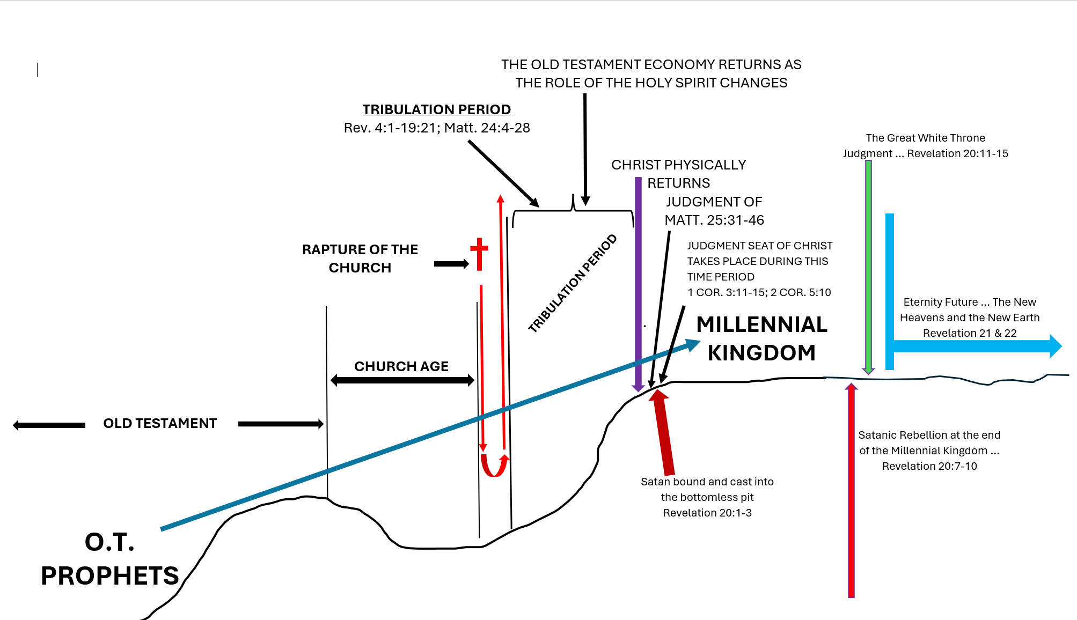

Slide 4
God’s promises to Abram (Abraham) focus on land, seed (descendants), and blessing.

Slide 5
Genesis 15:18-21
“On the same day the Lord made a covenant with Abram, saying” “To your descendants I have given this land, from the river of Egypt to the great river, the River Euphrates – the Kenites, the Kenezzites, the Kadmonites, the Hittites, the Perizzites, the Rephaim, the Amorites, the Canaanites, the Girgashites, and the Jebusites.”

Slide 6
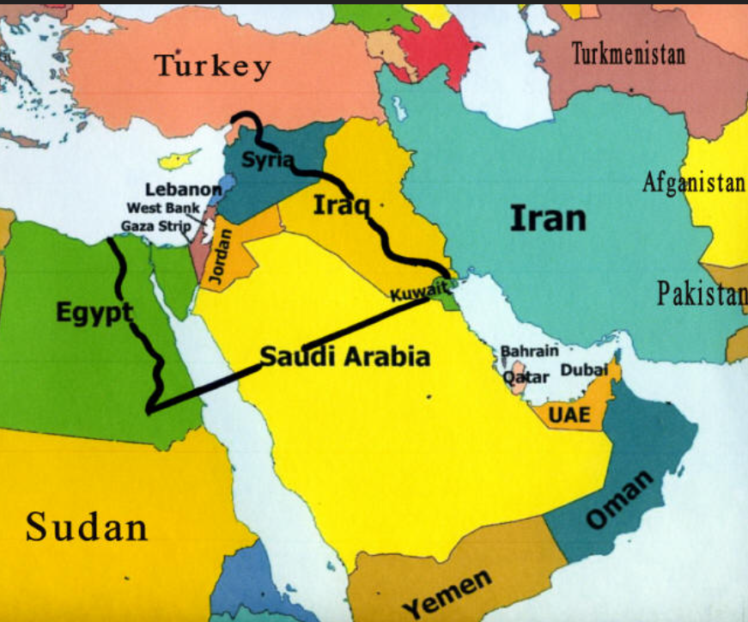

Slide 7
Abram … born around 1960 B.C.

Slide 8
Abram … born around 1960 B.C.
Received God’s promises of land, seed, and blessing at the age of 70 around 1890 B.C.

Slide 9
Genesis 12:1-2
“Now the Lord had said to Abram: “Get out of your country, from your family and from your father’s house, to a land that I will show you. I will make you a great nation; I will bless you and make your name great: and you shall be a blessing.”

Slide 10
Abram … born around 1960 B.C.
Received God’s promises of land, seed, and blessing at the age of 70 around 1890 B.C.
After Abram came his descendants, Isaac, Jacob (his 12 sons became the 12 tribes of Israel)

Slide 11
Abram … born around 1960 B.C.
Received God’s promises of land, seed, and blessing at the age of 70 around 1890 B.C.
After Abram came his descendants, Isaac, Jacob (his 12 sons became the 12 tribes of Israel)
  All the patriarchs of Israel held onto the promises of God to Abram. They knew that God would give them land, seed, and blessing.

Slide 12
After Jacob came Israel’s bondage in Egypt for 400 years with deliverance coming through Moses.

Slide 13
After Jacob came Israel’s bondage in Egypt for 400 years with deliverance coming through Moses.
God gave Moses the Law and instructions for life and worship in the Tabernacle.

Slide 14
After Jacob came Israel’s bondage in Egypt for 400 years with deliverance coming through Moses.
God gave Moses the Law and instructions for life and worship in the Tabernacle.
Moses wrote the first five books of Scripture, Genesis, Exodus, Leviticus, Numbers, and Deuteronomy from 1450 to 1410 B.C.

Slide 15
Deuteronomy 7:6
“For you are a holy people to the Lord your God; the Lord your God has chosen you to be a people for His own possession out of all the peoples who are on the face of the earth.”

Slide 16
Deuteronomy 7:7-9
“The Lord did not set His love on you nor choose you because you were more in number than any of the peoples, for you were the fewest of all peoples, but because the Lord loved you and kept the oath which He swore to your forefathers, the Lord brought you out by a mighty hand and redeemed you from the house of slavery,

Slide 17
Deuteronomy 7:7-9
from the hand of Pharaoh king of Egypt. Know therefore that the Lord your God, He is God, the faithful God, who keeps His covenant and His lovingkindness to a thousandth generation with those who love Him and keep His commandments …”.

Slide 18
Deuteronomy 7:7-9
from the hand of Pharaoh king of Egypt. Know therefore that the Lord your God, He is God, the faithful God, who keeps His covenant and His lovingkindness to a thousandth generation with those who love Him and keep His commandments …”.

Slide 19
Joshua would lead the nation of Israel into the promised land.

Slide 20
Joshua would lead the nation of Israel into the promised land.
Around 1025 B.C., Israel became a kingdom with Saul becoming the first king.

Slide 21
Joshua would lead the nation of Israel into the promised land.
Around 1025 B.C., Israel became a kingdom with Saul becoming the first king.
  God removes Saul because of disobedience.

Slide 22
Joshua would lead the nation of Israel into the promised land.
Around 1025 B.C., Israel became a kingdom with Saul becoming the first king.
  God removes Saul because of disobedience.
David becomes king of Israel around 1000 B.C.

Slide 23
2 Samuel 7:12-16
“When your days are fulfilled and you rest with your fathers, I will set up your seed after you, who will come from your body, and I will establish his kingdom. He shall build a house for My name, and I will establish the throne of his kingdom forever. I will be his Father, and he shall be My son. If he commits iniquity, I will chasten him

Slide 24
2 Samuel 7:12-16
with the rod of men and with the blows of the sons of men. But My mercy shall not depart from him, as I took it from Saul, whom I removed from before you. And your house and your kingdom shall be established forever before you. Your throne shall be established forever.”

Slide 26
Joshua would lead the nation of Israel into the promised land.
Around 1025 B.C., Israel became a kingdom with Saul becoming the first king.
  God removes Saul because of disobedience.
David becomes king of Israel around 1000 B.C.
Solomon becomes king in 960 B.C. and builds the permanent temple.

Slide 27
Solomon has a great start as king but finishes poorly.

Slide 28
Solomon has a great start as king but finishes poorly.
Rehoboam follows Solomon as king after he dies in 931 B.C.

Slide 29
Solomon has a great start as king but finishes poorly.
Rehoboam follows Solomon as king after he dies in 931 B.C.
The nation quickly divides into two nations, the northern kingdom known as Israel, and the southern kingdom known as Judah.

Slide 30
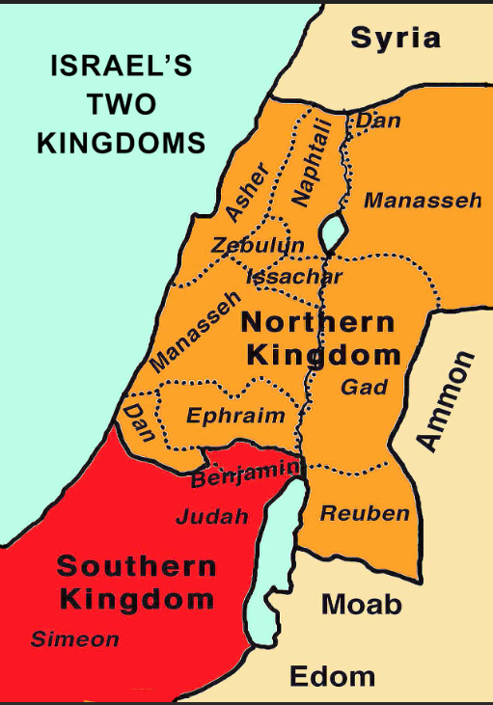

Slide 31
The northern kingdom of Israel is conquered by the Assyrians in 732 B.C. and all the people taken captive. The were assimilated into the Assyrian population and disappeared from the world scene.

Slide 32
The northern kingdom of Israel is conquered by the Assyrians in 732 B.C. and all the people taken captive. The were assimilated into the Assyrian population and disappeared from the world scene.
The southern kingdom of Judah was conquered by the Babylonians in 586 B.C. and held captive for 70 years.

Slide 33
Persia conquered Babylonia and allowed the Jews to go back to their promised land.

Slide 34
Persia conquered Babylonia and allowed the Jews to go back to their promised land.
The “Seventy Weeks of Daniel” timeclock begins in 444 B.C. when Nehemiah returns to Jerusalem to rebuild the wall.

Slide 35
Persia conquered Babylonia and allowed the Jews to go back to their promised land.
The “Seventy Weeks of Daniel” timeclock begins in 444 B.C. when Nehemiah returns to Jerusalem to rebuild the wall.
The tribes of Judah, Benjamin, and Levi that went into captivity in Babylonia – it is these same tribes that make up the population of Israel today.

Slide 36
Matthew 1:17
“So all the generations from Abraham to David are fourteen generations, from David until the captivity in Babylon are fourteen generations, and from the captivity in Babylon until the Christ are fourteen generations.”

Slide 37
Galatians 4:4-5
“But when the fullness of the time had come, God sent forth His Son, born of a woman, born under the law, to redeem those who were under the law, that we might receive the adoption as sons.”

Slide 38
Mark 11:8-10
“And many spread their clothes on the road, and others cut down leafy branches from the trees and spread them on the road. Then those who went before and those who followed cried out, saying: “Hosanna! ‘Blessed is He who comes in the name of the Lord!’ Blessed is the kingdom of our father David that comes in the name of the Lord! Hosanna in the highest!”

Slide 40
Matthew 23:37-38
“Jerusalem, Jerusalem, who kills the prophets and stones those who are sent to her! How often I wanted to gather your children together, the way a hen gathers her chicks under her wings, and you were unwilling. Behold, your house is being left to you desolate! For I say to you, from now on you will not see Me until you say, ‘BLESSED IS HE WHO COMES IN THE NAME OF THE LORD!’”

Slide 42
Romans 11:1-2
“I say then, has God cast away His people? Certainly not! For I also am an Israelite, of the seed of Abraham, of the tribe of Benjamin. God has not cast away His people whom He foreknew …”.

Slide 43
Romans 11:11-12
“… But through their fall, to provoke them to jealousy, salvation has come to the Gentiles. Now if their fall is riches for the world, and their failure riches for the Gentiles, how much more their fullness!”

Slide 44
Romans 11:11-12
“… But through their fall, to provoke them to jealousy, salvation has come to the Gentiles. Now if their fall is riches for the world, and their failure riches for the Gentiles, how much more their fullness!”

Slide 45
Romans 11:11-12
“… But through their fall, to provoke them to jealousy, salvation has come to the Gentiles. Now if their fall is riches for the world, and their failure riches for the Gentiles, how much more their fullness!”
NASB –
“how much more will their fulfillment be!”

Slide 46
Romans 11:19
“You will say then, “Branches were broken off that I might be grafted in.” Well said. Because of unbelief they were broken off, and you stand by faith …”.

Slide 47
Romans 11:19
“You will say then, “Branches were broken off that I might be grafted in.” Well said. Because of unbelief they were broken off, and you stand by faith …”.
Verse 24 … “For if you were cut out of the olive tree which is wild by nature, and were grafted contrary to nature into a cultivated olive tree, how much more will these, who are natural branches, be grafted into their own olive tree?”

Slide 48
Romans 11:25-27
“For I do not desire, brethren, that you should be ignorant of this mystery, lest you should be wise in your own opinion, that blindness in part has happened to Israel until the fullness of the Gentiles has come in. And so all Israel will be saved, as it is written: “The Deliverer will come out of Zion, and He will turn away ungodliness from Jacob; For this is My covenant with them, when I take away their sins.”

Slide 49
The biggest goal that Christ has for those in this church age is for Him to ultimately be able to reward faithful believers with the authority to co-reign with Him in His millennial kingdom.

Slide 51
Romans 11:25-27
“For I do not desire, brethren, that you should be ignorant of this mystery, lest you should be wise in your own opinion, that blindness in part has happened to Israel until the fullness of the Gentiles has come in. And so all Israel will be saved, as it is written: “The Deliverer will come out of Zion, and He will turn away ungodliness from Jacob; For this is My covenant with them, when I take away their sins.”

Slide 52
Jeremiah 31:31-34
“Behold, the days are coming, says the Lord, when I will make a new covenant with the house of Israel and with the house of Judah – not according to the covenant that I made with their fathers in the day that I took them by the hand to lead them out of the land of Egypt, My covenant which they broke,

Slide 53
Jeremiah 31:31-34
though I was a husband to them, says the Lord. But this is the covenant that I will make with the house of Israel after those days, says the Lord: I will put My law in their minds, and write it on their hearts; and I will be their God, and they shall by My people. No more shall every man teach his

Slide 54
Jeremiah 31:31-34
neighbor, and every man his brother, saying,‘Know the Lord,’ for they all shall know Me, from the least of them to the greatest of them, says the Lord. For I will forgive their iniquity, and their sin I will remember no more.”

Slide 56
“Of course, on the chart we see these different events portrayed – and placed in the basic chronological order that they will be occurring … at least according to what a literal interpretation of Scripture points out.”

