Slide 1
Second
Thessalonians

Slide 2
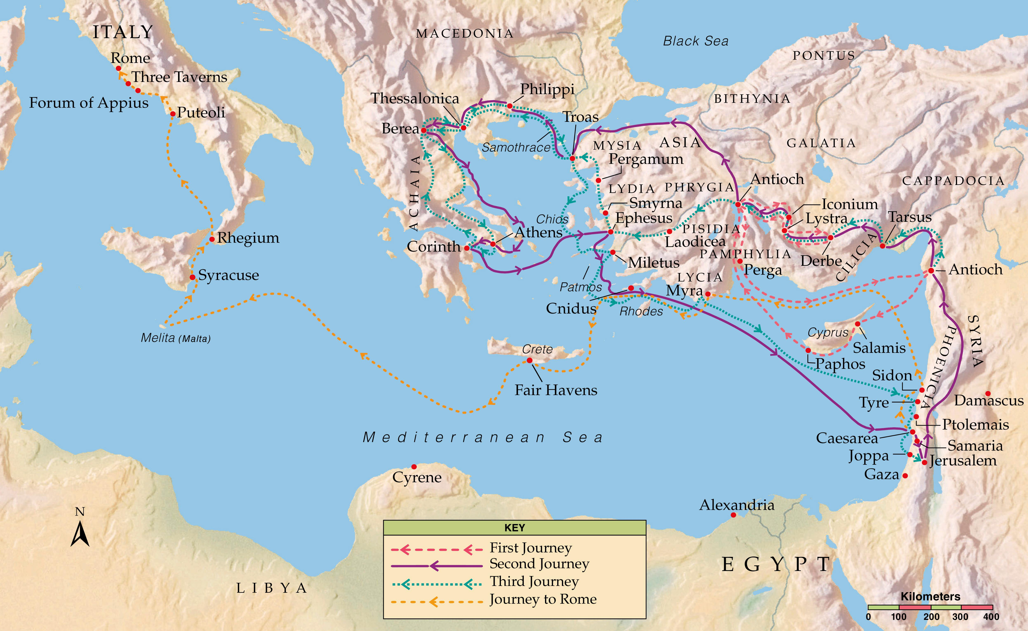

Slide 3
2 Thessalonians 2:3-4
“Let no one deceive you by any means; for that Day will not come unless the falling away comes first, and the man of sin is revealed, the son of perdition, who opposes and exalts himself above all that is called God or that is worshiped, so that he sits as God in the temple of God, showing himself that he is God.”

Slide 4
2 Thessalonians 2:3-4
“Let no one deceive you by any means; for that Day will not come unless the falling away comes first, and the man of sin is revealed, the son of perdition, who opposes and exalts himself above all that is called God or that is worshiped, so that he sits as God in the temple of God, showing himself that he is God.”

Slide 5
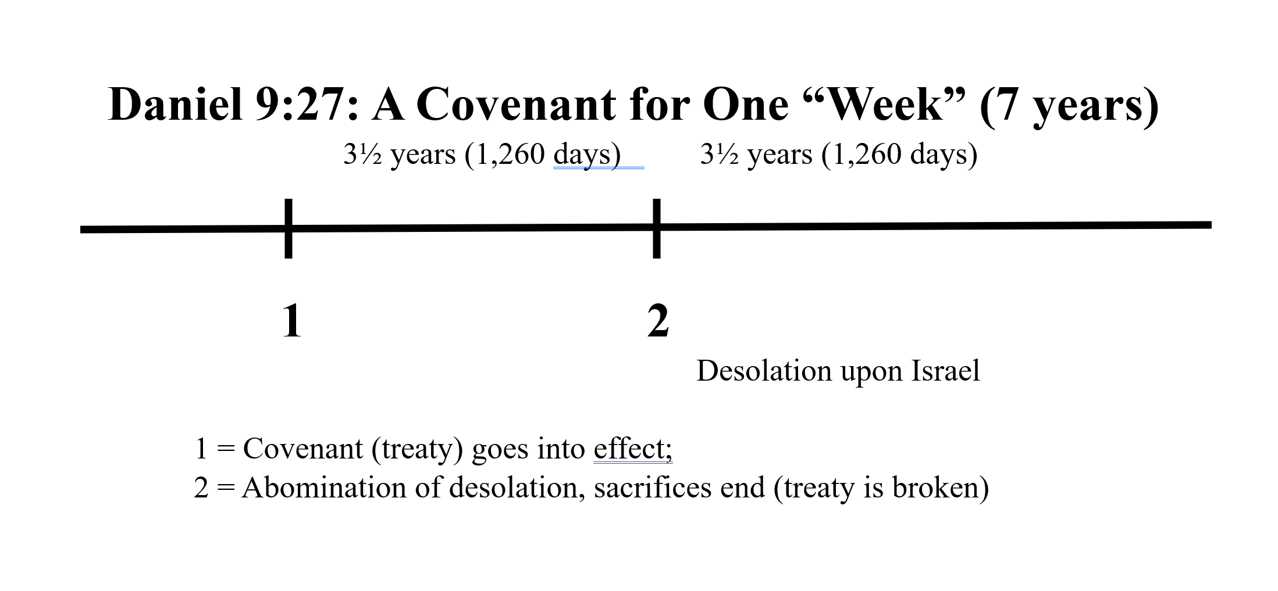
Millennial
Kingdom
30 days for the Judgment of the Nations
Daniel 12:11 – 1,290 days
45 days for the Judgment Seat of Christ
Daniel 12:12 – 1,335 days

Slide 6
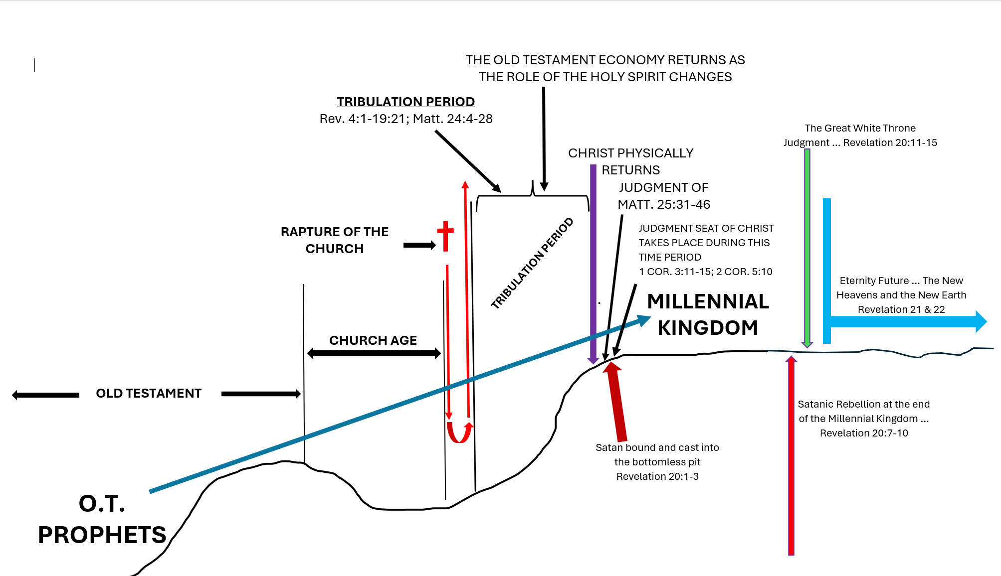

Slide 8
Deuteronomy 7:6
“For you are a holy people to the Lord your God; the Lord your God has chosen you to be a people for Himself, a special treasure above all the peoples on the face of the earth.”

Slide 9
Romans 11:25-27
“For I do not desire, brethren, that you should be ignorant of this mystery, lest you should be wise in your own opinion, that blindness in part has happened to Israel until the fullness of the Gentiles has come in. And so all Israel will be saved, as it is written: “The Deliverer will come out of Zion, and He will turn away ungodliness from Jacob; for this is My covenant with them, when I take away their sins.”

Slide 10
Romans 11:25-27
“For I do not desire, brethren, that you should be ignorant of this mystery, lest you should be wise in your own opinion, that blindness in part has happened to Israel until the fullness of the Gentiles has come in. And so all Israel will be saved, as it is written: “The Deliverer will come out of Zion, and He will turn away ungodliness from Jacob; for this is My covenant with them, when I take away their sins.”

Slide 11
Romans 11:25-27
“For I do not desire, brethren, that you should be ignorant of this mystery, lest you should be wise in your own opinion, that blindness in part has happened to Israel until the fullness of the Gentiles has come in. And so all Israel will be saved, as it is written: “The Deliverer will come out of Zion, and He will turn away ungodliness from Jacob; for this is My covenant with them, when I take away their sins.”

Slide 13
Genesis 12:1-3
“Now the Lord had said to Abram: “Get out of your country, from your family and from your father’s house, to a land that I will show you. I will make you a great nation; I will bless you and make your name great; and you shall be a blessing. I will bless those who bless you, and I will curse him who curses you; and in you all the families of the earth shall be blessed.”

Slide 14
LAND
Genesis 12:1-3
“Now the Lord had said to Abram: “Get out of your country, from your family and from your father’s house, to a land that I will show you. I will make you a great nation; I will bless you and make your name great; and you shall be a blessing. I will bless those who bless you, and I will curse him who curses you; and in you all the families of the earth shall be blessed.”
SEED
BLESSING

Slide 15
Genesis 15:1-6
“After these things the word of the Lord came to Abram in a vision, saying, “Do not be afraid, Abram. I am your shield, your exceedingly great reward.” But Abram said, “Lord God, what will You give me, seeing I go childless, and the heir of my house is Eliezer of Damascus?” Then Abram said, “Look, You have given me no offspring; indeed one born in my house is my heir!” And behold, the word of the Lord came to him,

Slide 16
Genesis 15:1-6
saying, “This one shall not be your heir, but one who will come from your own body shall be your heir.” Then He brought him outside and said, “Look now toward heaven, and count the stars if you are able to number them.” And He said to him, “So shall your descendants be.” And he believed in the Lord, and He accounted it to him for righteousness.”

Slide 17
Genesis 15:7-8
“then He said to him, “I am the Lord, who brought you out of Ur of the Chaldeans, to give you this land to inherit it.” And he said, “Lord God, how shall I know that I will inherit it?”

Slide 18
God doesn’t lie!

Slide 19
God doesn’t lie!
God’s character is based on 100% veracity … i.e., He always tells the truth!

Slide 20
Numbers 23:19
“God is not a man, that He should lie, nor a son of man, that He should repent. Has He said, and will He not do? Or has He spoken, and will He not make it good?”

Slide 21
Romans 11:25-27
“For I do not desire, brethren, that you should be ignorant of this mystery, lest you should be wise in your own opinion, that blindness in part has happened to Israel until the fullness of the Gentiles has come in. And so all Israel will be saved, as it is written: “The Deliverer will come out of Zion, and He will turn away ungodliness from Jacob; for this is My covenant with them, when I take away their sins.”

Slide 22
Romans 11:25-27
“For I do not desire, brethren, that you should be ignorant of this mystery, lest you should be wise in your own opinion, that blindness in part has happened to Israel until the fullness of the Gentiles has come in. And so all Israel will be saved, as it is written: “The Deliverer will come out of Zion, and He will turn away ungodliness from Jacob; for this is My covenant with them, when I take away their sins.”

Slide 23
“But his focus (the antichrist’s focus) for brutality will be on those Jews who believe in Christ more than it will be on Gentile believers.”

Slide 24
Matthew 25:31-40
“When the Son of Man comes in His glory, and all the holy angels with Him, then He will sit on the throne of His glory. All the nations will be gathered before Him, and He will separate them one from another, as a shepherd divides his sheep from the goats. And He will set the sheep on His right hand, but the goats on the left. Then the King will say to those on His right hand, ‘Come, you blessed of My Father, inherit the kingdom

Slide 25
Matthew 25:31-40
prepared for you from the foundation of the world: for I was hungry and you gave Me food; I was thirsty and you gave Me drink; I was a stranger and you took Me in; I was naked and you clothed Me; I was sick and you visited Me; I was in prison and you came to Me.’ “Then the righteous will answer Him, saying, ‘Lord, when did we see You hungry and feed You, or thirsty and give You drink? When did we see You a

Slide 26
Matthew 25:31-40
stranger and take You in, or naked and clothe You? Or when did we see You sick, or in prison, and come to You?’ And the King will answer and say to them, ‘Assuredly, I say to you, inasmuch as you did it to one of the least of these My brethren, you did it to Me.’”

Slide 27
The Bible classifies all peoples into two basic groups … Jew and Gentile.

Slide 28
The Bible classifies all peoples into two basic groups … Jew and Gentile.
The term, “nations” ALWAYS refers to nations other than Israel (the Jews).

Slide 29
Gentiles
Matthew 25:31-40
“When the Son of Man comes in His glory, and all the holy angels with Him, then He will sit on the throne of His glory. All the nations will be gathered before Him, and He will separate them one from another, as a shepherd divides his sheep from the goats. And He will set the sheep on His right hand, but the goats on the left. Then the King will say to those on His right hand, ‘Come, you blessed of My Father, inherit the kingdom

Slide 30
Matthew 25:31-40
“When the Son of Man comes in His glory, and all the holy angels with Him, then He will sit on the throne of His glory. All the nations will be gathered before Him, and He will separate them one from another, as a shepherd divides his sheep from the goats. And He will set the sheep on His right hand, but the goats on the left. Then the King will say to those on His right hand, ‘Come, you blessed of My Father, inherit the kingdom

Slide 31
Matthew 25:34
“Then the King will say to those on His right hand, ‘Come, you blessed of My Father, inherit the kingdom prepared for you from the foundation of the world …”.

Slide 32
Matthew 25:34
“Then the King will say to those on His right hand, ‘Come, you blessed of My Father, inherit the kingdom prepared for you from the foundation of the world …”.
Matthew 25:41
“Then He will also say to those on the left hand, ‘Depart from Me, you cursed, into the everlasting fire prepared for the devil and his angels …”.

Slide 33
Matthew 25:35-36
“… for I was hungry and you gave Me food; I was thirsty and you gave Me drink; I was a stranger and you took Me in; I was naked and you clothed Me; I was sick and you visited Me; I was in prison and you came to Me.’”

Slide 34
Matthew 25:37-39
“Then the righteous will answer Him, saying, ‘Lord, when did we see You hungry and feed You, or thirsty and give You drink? When did we see You a stranger and take You in, or naked and clothe You? Or when did we see You sick, or in prison, and come to You?’”

Slide 35
Matthew 25:40
“And the King will answer and say to them, ‘Assuredly, I say to you, inasmuch as you did it to one of the least of these My brethren, you did it to Me.’”

Slide 36
Matthew 25:40
“And the King will answer and say to them, ‘Assuredly, I say to you, inasmuch as you did it to one of the least of these My brethren, you did it to Me.’”

Slide 37
Matthew 25:40
“And the King will answer and say to them, ‘Assuredly, I say to you, inasmuch as you did it to one of the least of these My brethren, you did it to Me.’”
Jewish Believers in Christ

Slide 38
Matthew 25:41-46
“Then He will also say to those on the left hand, ‘Depart from Me, you cursed, into the everlasting fire prepared for the devil and his angels: for I was hungry and you gave Me no food; I was thirsty and you gave Me no drink; I was a stranger and you did not take Me in, naked and you did not clothe Me, sick and in prison and you did not visit Me.’ “Then they also will answer

Slide 39
Matthew 25:41-46
Him, saying, ‘Lord, when did we see You hungry or thirsty or a stranger or naked or sick or in prison, and did not minister to You?’ Then He will answer them, saying, ‘Assuredly, I say to you, inasmuch as you did not do it to one of the least of these, you did not do it to Me.’ And these will go away into everlasting punishment, but the righteous into eternal life.”

Slide 40
Matthew 25:34
“Then the King will say to those on His right hand, ‘Come, you blessed of My Father, inherit the kingdom prepared for you from the foundation of the world …”.

Slide 41
Matthew 25:34
“Then the King will say to those on His right hand, ‘Come, you blessed of My Father, inherit the kingdom prepared for you from the foundation of the world …”.

Slide 42
Matthew 24:21-22
“For then there will be great tribulation, such as has not been since the beginning of the world until this time, no, nor ever shall be. And unless those days were shortened, no flesh would be saved; but for the elect’s sake those days will be shortened.”

Slide 43
“Why is it that throughout history, antisemitism and the desire to eliminate the Jews has been the focus of so many different peoples?”

Slide 44
Satan may believe that by eliminating God’s people from the face of the earth, he could cause God’s multiple promises to Israel to not come true.

