Slide 1
Second
Thessalonians

Slide 2
2 Thessalonians 1:11-12
“Therefore we also pray always for you that our God would count you worthy of this calling, and fulfill all the good pleasure of His goodness and the work of faith with power, that the name of our Lord Jesus Christ may be glorified in you, and you in Him, according to the grace of our God and the Lord Jesus Christ.”

Slide 3
2 Thessalonians 1:11-12
“Therefore we also pray always for you that our God would count you worthy of this calling, and fulfill all the good pleasure of His goodness and the work of faith with power, that the name of our Lord Jesus Christ may be glorified in you, and you in Him, according to the grace of our God and the Lord Jesus Christ.”

Slide 4
Ephesians 2:8-9
“For by grace you have been saved through faith, and that not of yourselves; it is the gift of God, not of works, lest anyone should boast.”

Slide 5
If works did play a role in salvation …

Slide 6
If works did play a role in salvation …
Salvation wouldn’t be a gift, as salvation would be earned.

Slide 7
If works did play a role in salvation …
Salvation wouldn’t be a gift, as salvation would be earned.
The reason is given “why” works can’t have anything to do with the process, and that’s because if works were involved, then the natural result would be that everyone would boast about how good they were and how they deserved to be given everlasting life.

Slide 8
If works did play a role in salvation …
Salvation wouldn’t be a gift, as salvation would be earned.
The reason is given “why” works can’t have anything to do with the process, and that’s because if works were involved, then the natural result would be that everyone would boast about how good they were and how they deserved to be given everlasting life.

Slide 9
Romans 11:6
“And if by grace, then it is no longer of works; otherwise grace is no longer grace. But if it is of works, it is no longer grace; otherwise work is no longer work.”

Slide 10
Romans 4:1-5
“What then shall we say that Abraham our father has found according to the flesh? For if Abraham was justified by works, he has something to boast about, but not before God. For what does the Scripture say? “Abraham believed God,

Slide 11
Romans 4:1-5
and it was accounted to him for righteousness.” Now to him who works, the wages are not counted as grace but as debt. But to him who does not work but believes on Him who justifies the ungodly, his faith is accounted for righteousness …”.

Slide 12
2 Thessalonians 1:11-12
“Therefore we also pray always for you that our God would count you worthy of this calling, and fulfill all the good pleasure of His goodness and the work of faith with power, that the name of our Lord Jesus Christ may be glorified in you, and you in Him, according to the grace of our God and the Lord Jesus Christ.”

Slide 13
2 Thessalonians 1:11 (NLT)
“So we keep on praying for you, asking our God to enable you to live a life worthy of His call. May He give you the power to accomplish all the good things your faith prompts you to do.”

Slide 14
2 Thessalonians 1:11 (NLT)
“So we keep on praying for you, asking our God to enable you to live a life worthy of His call. May He give you the power to accomplish all the good things your faith prompts you to do.”

Slide 15
2 Thessalonians 1:11 (NLT)
“So we keep on praying for you, asking our God to enable you to live a life worthy of His call. May He give you the power to accomplish all the good things your faith prompts you to do.”

Slide 16
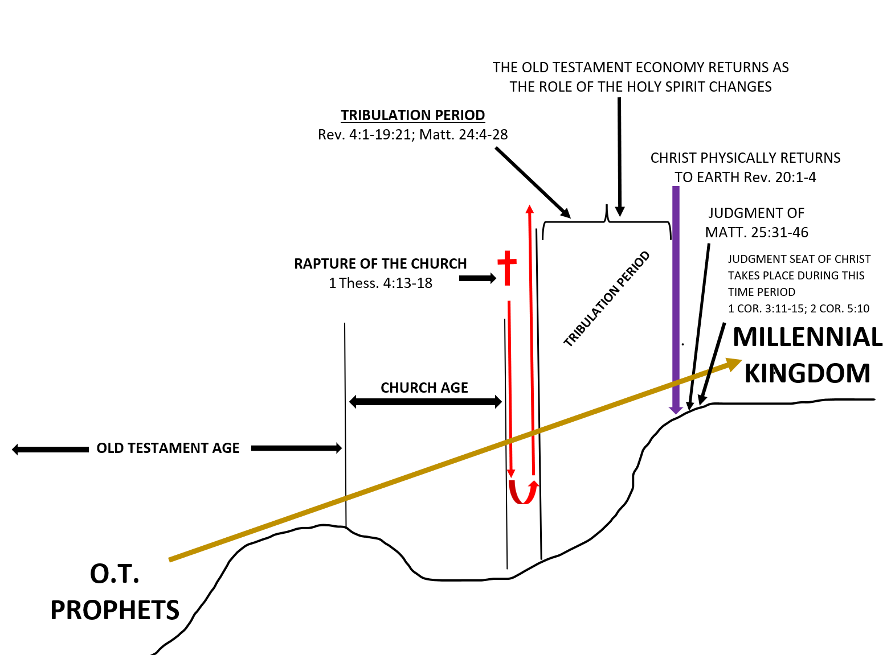

Slide 17
2 Thessalonians 1:12
“that the name of our Lord Jesus Christ may be glorified in you, and you in Him, according to the grace of our God and the Lord Jesus Christ.”

Slide 18
2 Thessalonians 1:12
“that the name of our Lord Jesus Christ may be glorified in you, and you in Him, according to the grace of our God and the Lord Jesus Christ.”

Slide 19
2 Thessalonians 1:12
“that the name of our Lord Jesus Christ may be glorified in you, and you in Him, according to the grace of our God and the Lord Jesus Christ.”

Slide 20
Luke 19:16-17
“Then came the first, saying, ‘Master, your mina has earned ten minas.’ And he said to him, ‘Well done, good servant; because you were faithful in a very little, have authority over ten cities.’”

Slide 21
Luke 19:16-17
“Then came the first, saying, ‘Master, your mina has earned ten minas.’ And he said to him, ‘Well done, good servant; because you were faithful in a very little, have authority over ten cities.’”

Slide 22
Luke 19:18-19
“And the second came, saying, ‘Master, your mina has earned five minas.’ Likewise he said to him, ‘You also be over five cities.’”

Slide 23
Luke 19:18-19
“And the second came, saying, ‘Master, your mina has earned five minas.’ Likewise he said to him, ‘You also be over five cities.’”

Slide 24
1 Corinthians 3:1-4
“And I, brethren, could not speak to you as to spiritual people but as to carnal, as to babes in Christ. I fed you with milk and not with solid food; for until now you were not able to receive it, and even now you are still not able; for you are

Slide 25
1 Corinthians 3:1-4
still carnal. For where there are envy, strife, and divisions among you, are you not carnal and behaving like mere men? For when one says, “I am of Paul,” and another, “I am of Apollos,” are you not carnal?”

Slide 26
1 Corinthians 3:5-8
“Who then is Paul, and who is Apollos, but ministers through whom you believed, as the Lord gave to each one? I planted, Apollos watered, but God gave the increase. So then neither he who plants is anything, nor he who waters,

Slide 27
1 Corinthians 3:5-8
but God who gives the increase. Now he who plants and he who waters are one, and each one will receive his own reward according to his own labor.”

Slide 28
1 Corinthians 3:5-8
but God who gives the increase. Now he who plants and he who waters are one, and each one will receive his own reward according to his own labor.”

Slide 29
2 Thessalonians 1:11 (NLT)
“So we keep on praying for you, asking our God to enable you to live a life worthy of His call. May He give you the power to accomplish all the good things your faith prompts you to do.”

Slide 30
1 Corinthians 3:9-15
“For we are God’s fellow workers; you are God’s field, you are God’s building. According to the grace of God which was given to me, as a wise master builder I have laid the foundation, and another builds on it. But let each one take heed how he builds on it. For no other foundation can anyone

Slide 31
1 Corinthians 3:9-15
lay than that which is laid, which is Jesus Christ. Now if anyone builds on this foundation with gold, silver, precious stones, wood, hay, straw, each one’s work will become clear; for the Day will declare it, because it will be revealed by fire; and the fire will test each one’s work, of what sort it

Slide 32
1 Corinthians 3:9-15
is. If anyone’s work which he has built on it endures, he will receive a reward. If anyone’s work is burned, he will suffer loss; but he himself will be saved, yet so as through fire.”

Slide 33
1 Corinthians 3:9-15
“For we are God’s fellow workers; you are God’s field, you are God’s building. According to the grace of God which was given to me, as a wise master builder I have laid the foundation, and another builds on it. But let each one take heed how he builds on it. For no other foundation can anyone

Slide 34
1 Corinthians 3:9-15
“For we are God’s fellow workers; you are God’s field, you are God’s building. According to the grace of God which was given to me, as a wise master builder I have laid the foundation, and another builds on it. But let each one take heed how he builds on it. For no other foundation can anyone

Slide 35
1 Corinthians 3:11
“For no other foundation can anyone lay than that which is laid, which is Jesus Christ.”

Slide 36
1 Corinthians 3:9-15
lay than that which is laid, which is Jesus Christ. Now if anyone builds on this foundation with gold, silver, precious stones, wood, hay, straw, each one’s work will become clear; for the Day will declare it, because it will be revealed by fire; and the fire will test each one’s work, of what sort it

Slide 37
1 Corinthians 3:13-15
“each one’s work will become clear; for the Day will declare it, because it will be revealed by fire; and the fire will test each one’s work, of what sort it is. If anyone’s work which he has built on it endures, he will receive a reward. If anyone’s work is burned, he will suffer loss; but he himself will be saved, yet so as through fire.”

Slide 38
1 Corinthians 3:13-15
“each one’s work will become clear; for the Day will declare it, because it will be revealed by fire; and the fire will test each one’s work, of what sort it is. If anyone’s work which he has built on it endures, he will receive a reward. If anyone’s work is burned, he will suffer loss; but he himself will be saved, yet so as through fire.”

Slide 39
2 Thessalonians 1:12
“that the name of our Lord Jesus Christ may be glorified in you, and you in Him, according to the grace of our God and the Lord Jesus Christ.”

Slide 40
2 Thessalonians 1:12
“that the name of our Lord Jesus Christ may be glorified in you, and you in Him, according to the grace of our God and the Lord Jesus Christ.”
Grace = Favor

Slide 41
2 Thessalonians 1:5
“may be counted worthy of the kingdom of God”
2 Thessalonians 1:11
“that our God would count you worthy of this calling”
Grace = Favor
In context here, Grace = “merited” favor

Slide 42
Christians usually think of grace as:
“Unmerited” Favor
… Because we understand that the
eternal salvation we receive from Christ
is totally undeserved

Slide 43
Galatians 2:20
“I have been crucified with Christ; it is no longer I who live, but Christ lives in me; and the life which I now live in the flesh I live by faith in the Son of God, who loved me and gave Himself for me.”

Slide 44
Galatians 2:21
“I do not set aside the grace of God; for if righteousness comes through the law, then Christ died in vain.”

Slide 45
Galatians 2:21
“I do not set aside the grace of God; for if righteousness comes through the law, then Christ died in vain.”
NLT
“I do not treat the grace of God as meaningless. For if keeping the law could make us right with God, then there was no need for Christ to die.”

Slide 46
Galatians 2:21
“I do not set aside the grace of God; for if righteousness comes through the law, then Christ died in vain.”
NLT
“I do not treat the grace of God as meaningless. For if keeping the law could make us right with God, then there was no need for Christ to die.”

Slide 47
Galatians 2:21
“I do not set aside the grace of God; for if righteousness comes through the law, then Christ died in vain.”
NLT
“I do not treat the grace of God as meaningless. For if keeping the law could make us right with God, then there was no need for Christ to die.”

Slide 48
2 Thessalonians 1:11-12
“Therefore we also pray always for you that our God would count you worthy of this calling, and fulfill all the good pleasure of His goodness and the work of faith with power, that the name of our Lord Jesus Christ may be glorified in you, and you in Him, according to the grace of our God and the Lord Jesus Christ.”

