Slide 1
Second Thessalonians

Slide 2
2 Thessalonians 1:8-9
“… in flaming fire taking vengeance on those who do not know God, and on those who do not obey the gospel of our Lord Jesus Christ. These shall be punished with everlasting destruction from the presence of the Lord and from the glory of His power …”.

Slide 3
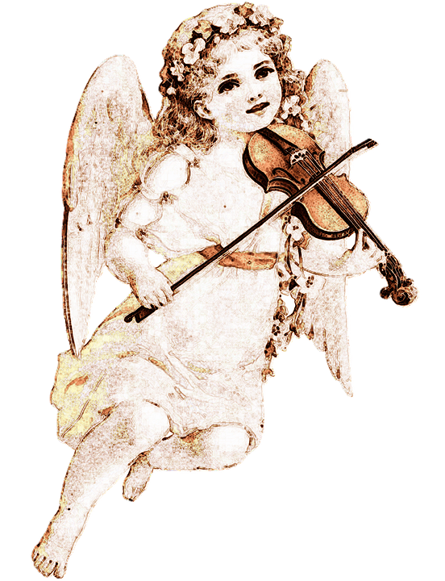

Slide 5
Revelation 21:1-4
“Now I saw a new heaven and a new earth, for the first heaven and the first earth had passed away. Also there was no more sea. Then I, John, saw the holy city, New Jerusalem, coming down out of heaven from God, prepared as a bride adorned for her husband. And I heard a loud voice from heaven saying, “Behold, the

Slide 6
Revelation 21:1-4
tabernacle of God is with men, and He will dwell with them, and they shall be His people. God Himself will be with them and be their God. And God will wipe away every tear from their eyes; there shall be no more death, nor sorrow, nor crying. There shall be no more pain, for the former things have passed away.”

Slide 7
2 Thessalonians 1:8-9
“… in flaming fire taking vengeance on those who do not know God, and on those who do not obey the gospel of our Lord Jesus Christ. These shall be punished with everlasting destruction from the presence of the Lord and from the glory of His power …”.

Slide 8
2 Thessalonians 1:9-10
“These shall be punished with everlasting destruction from the presence of the Lord and from the glory of His power, when He comes, in that Day, to be glorified in His saints and to be admired among all those who believe, because our testimony among you was believed.”

Slide 9
2 Thessalonians 1:8-10 (NLT)
“… in flaming fire, bringing judgment on those who don’t know God and on those who refuse to obey the Good News of our Lord Jesus. They will be punished with eternal destruction, forever separated from the Lord and from his glorious power. When he comes on that day, he will receive glory from his holy people – praise from all who believe. And this includes you, for you believed what we told you about him.”

Slide 10
2 Thessalonians 1:8 (NLT)
“… in flaming fire, bringing judgment on those who don’t know God and on those who refuse to obey the Good News of our Lord Jesus.”
This verse is referring to the end of the Tribulation period when Christ will return to pour out His wrath on the unbelieving Gentile nations.

Slide 11
Matthew 24:21-22
“For then there will be great tribulation, such as has not been since the beginning of the world until this time, no, nor ever shall be. And unless those days were shortened, no flesh would be saved; but for the elect’s sake those days will be shortened.”

Slide 12
2 Thessalonians 1:9 (NLT)
“They will be punished with eternal destruction, forever separated from the Lord and from his glorious power.”
This verse jumps ahead 1000 years to after the millennial kingdom of Christ to the results of the Great White Throne Judgment that Revelation 20:11-15 details.

Slide 13
Revelation 20:11
“Then I saw a great white throne and Him who sat on it …”.

Slide 14
Revelation 20:5
“But the rest of the dead did not live again until the thousand years were finished.”

Slide 15
Revelation 20:5
“But the rest of the dead did not live again until the thousand years were finished.”
Revelation 20:13
“The sea gave up the dead who were in it, and Death and Hades delivered up the dead who were in them.”

Slide 16
2 Thessalonians 1:10 (NLT)
“When he comes on that day, he will receive glory from his holy people – praise from all who believe. And this includes you, for you believed what we told you about him.”
This refers to Christ’s return at His second coming at the end of the Tribulation period.

Slide 17
2 Thessalonians 1:10 (NLT)
“When he comes on that day, he will receive glory from his holy people – praise from all who believe. And this includes you, for you believed what we told you about him.”
This refers to Christ’s return at His second coming at the end of the Tribulation period.

Slide 18
Revelation 20:11
“Then I saw a great white throne and Him who sat on it …”.

Slide 19
John 5:21
“For as the Father raises the dead and gives life to them, even so the Son gives life to whom He will.”

Slide 20
John 5:21
“For as the Father raises the dead and gives life to them, even so the Son gives life to whom He will.”
John 5:19
“Most assuredly, I say to you, the Son can do nothing of Himself, but what He sees the Father do; for whatever He does, the Son also does in like manner.”

Slide 21
Revelation 20:11
“Then I saw a great white throne and Him who sat on it …”.
John 5:22
“For the Father judges no one, but has committed all judgment to the Son …”.

Slide 22
Revelation 20:11
“Then I saw a great white throne and Him who sat on it …”.
John 5:22
“For the Father judges no one, but has committed all judgment to the Son …”.

Slide 23
2 Thessalonians 1:10 (NLT)
“When he comes on that day, he will receive glory from his holy people – praise from all who believe. And this includes you, for you believed what we told you about him.”
This refers to Christ’s return at His second coming at the end of the Tribulation period.

Slide 24
2 Thessalonians 1:10 (NLT)
“When he comes on that day, he will receive glory from his holy people – praise from all who believe. And this includes you, for you believed what we told you about him.”
This refers to Christ’s return at His second coming at the end of the Tribulation period.

Slide 25
2 Thessalonians 1:10 (NLT)
“When he comes on that day, he will receive glory from his holy people – praise from all who believe. And this includes you, for you believed what we told you about him.”

Slide 26
2 Thessalonians 1:10 (NLT)
“When he comes on that day, he will receive glory from his holy people – praise from all who believe. And this includes you, for you believed what we told you about him.”
NKJV
“to be glorified in His saints and to be admired among all those who believe …”.

Slide 27
1 John 3:2
“Beloved, now we are children of God; and it has not yet been revealed what we shall be, but we know that when He is revealed, we shall be like Him, for we shall see Him as he is.”

Slide 28
1 John 3:2
“Beloved, now we are children of God; and it has not yet been revealed what we shall be, but we know that when He is revealed, we shall be like Him, for we shall see Him as he is.”

Slide 29
1 Corinthians 15:51-53
“Behold, I tell you a mystery: We shall not all sleep, but we shall all be changed – in a moment, in the twinkling of an eye, at the last trumpet. For the trumpet will sound, and the dead will be raised incorruptible, and we shall be changed. For this corruptible must put on incorruption, and this mortal must put on immortality.”

Slide 30
1 Corinthians 15:51-53 (NLT)
“But let me reveal to you a wonderful secret. We will not all die, but we will all be transformed! It will happen in a moment, in the blink of an eye, when the last trumpet is blown. For when the trumpet sounds, those who have died will be raised to live forever. And we who are living will also be transformed. For our dying bodies must be transformed into bodies that will never die; our mortal bodies must be transformed into immortal bodies.”

Slide 31
Revelation 19:14-16
“And the armies in heaven, clothed in fine linen, white and clean, followed Him on white horses. Now out of His mouth goes a sharp sword, that with it He should strike the nations. And He Himself will rule them with a rod of iron. He Himself treads the winepress of the fierceness and wrath of Almighty God. And He has on His robe and on His thigh a name written: KING OF KINGS AND LORD OF LORDS.”

Slide 32
2 Thessalonians 1:10 (NLT)
“When he comes on that day, he will receive glory from his holy people – praise from all who believe. And this includes you, for you believed what we told you about him.”
NKJV
“to be glorified in His saints and to be admired among all those who believe …”.

Slide 33
2 Thessalonians 1:10 (NKJV)
“… when He comes, in that Day, to be glorified in His saints and to be admired among all those who believe, because our testimony among you was believed.”

Slide 34
2 Thessalonians 1:11-12
“Therefore we also pray always for you that our God would count you worthy of this calling, and fulfill all the good pleasure of His goodness and the work of faith with power, that the name of our Lord Jesus Christ may be glorified in you, and you in Him, according to the grace of our God and the Lord Jesus Christ.”

Slide 35
2 Thessalonians 1:11-12
“Therefore we also pray always for you that our God would count you worthy of this calling, and fulfill all the good pleasure of His goodness and the work of faith with power, that the name of our Lord Jesus Christ may be glorified in you, and you in Him, according to the grace of our God and the Lord Jesus Christ.”

Slide 36
2 Thessalonians 1:11-12
“Therefore we also pray always for you that our God would count you worthy of this calling, and fulfill all the good pleasure of His goodness and the work of faith with power, that the name of our Lord Jesus Christ may be glorified in you, and you in Him, according to the grace of our God and the Lord Jesus Christ.”

Slide 37
Philippians 3:14
“I press toward the goal for the prize of the upward call of God in Christ Jesus.”

Slide 38
2 Peter 1:3-10
“His divine power has given us everything we need for a godly life through our knowledge of Him who called us by His own glory and goodness. Through these He has given us His very great and precious promises, so that through them you may participate in the divine nature, having escaped the corruption in the world caused by evil desires. For this very reason, make every effort to add to your faith

Slide 39
2 Peter 1:3-10
goodness; and to goodness, knowledge; and to knowledge, self-control; and to self-control, perseverance; and to perseverance, godliness; and to godliness, mutual affection; and to mutual affection, love. For if you possess these qualities in increasing measure, they will keep you from being ineffective and unproductive in your knowledge of our Lord Jesus Christ. But whoever does not have them is nearsighted and

Slide 40
2 Peter 1:3-10
blind, forgetting that they have been cleansed from their past sins. Therefore, my brothers and sisters, make every effort to confirm your calling and election. For if you do these things, you will never stumble, and you will receive a rich welcome into the eternal kingdom of our Lord and Savior Jesus Christ.”

Slide 41
2 Peter 1:3-10
“His divine power has given us everything we need for a godly life through our knowledge of Him who called us by His own glory and goodness. Through these He has given us His very great and precious promises, so that through them you may participate in the divine nature, having escaped the corruption in the world caused by evil desires. For this very reason, make every effort to add to your faith

Slide 42
2 Peter 1:3-10
goodness; and to goodness, knowledge; and to knowledge, self-control; and to self-control, perseverance; and to perseverance, godliness; and to godliness, mutual affection; and to mutual affection, love. For if you possess these qualities in increasing measure, they will keep you from being ineffective and unproductive in your knowledge of our Lord Jesus Christ. But whoever does not have them is nearsighted and

Slide 43
2 Peter 1:3-10
blind, forgetting that they have been cleansed from their past sins. Therefore, my brothers and sisters, make every effort to confirm your calling and election. For if you do these things, you will never stumble, and you will receive a rich welcome into the eternal kingdom of our Lord and Savior Jesus Christ.”

Slide 44
2 Thessalonians 1:11 (NIV)
“With this in mind, we constantly pray for you, that our God may make you worthy of His calling, and that by His power He may bring to fruition your every desire for goodness and your every deed prompted by faith.”

Slide 45
2 Peter 1:3-10
blind, forgetting that they have been cleansed from their past sins. Therefore, my brothers and sisters, make every effort to confirm your calling and election. For if you do these things, you will never stumble, and you will receive a rich welcome into the eternal kingdom of our Lord and Savior Jesus Christ.”

Slide 46
2 Peter 1:3-10
blind, forgetting that they have been cleansed from their past sins. Therefore, my brothers and sisters, make every effort to confirm your calling and election. For if you do these things, you will never stumble, and you will receive a rich welcome into the eternal kingdom of our Lord and Savior Jesus Christ.”

Slide 47
2 Peter 1:3-10
blind, forgetting that they have been cleansed from their past sins. Therefore, my brothers and sisters, make every effort to confirm your calling and election. For if you do these things, you will never stumble, and you will receive a rich welcome into the eternal kingdom of our Lord and Savior Jesus Christ.”

Slide 48
2 Thessalonians 1:11 (NIV)
“With this in mind, we constantly pray for you, that our God may make you worthy of His calling, and that by His power He may bring to fruition your every desire for goodness and your every deed prompted by faith.”

