Slide 1
Second
Thessalonians

Slide 2
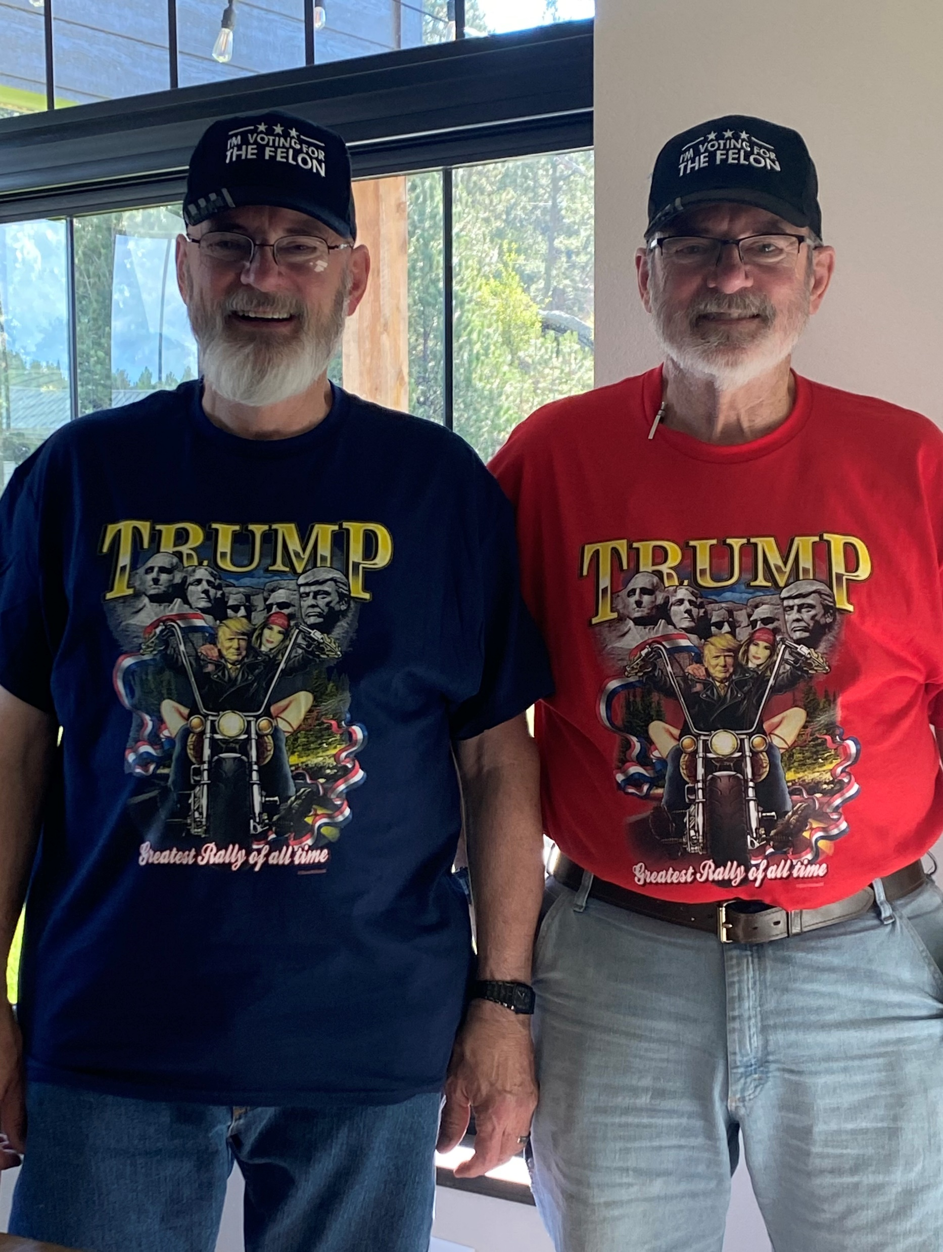

Slide 3
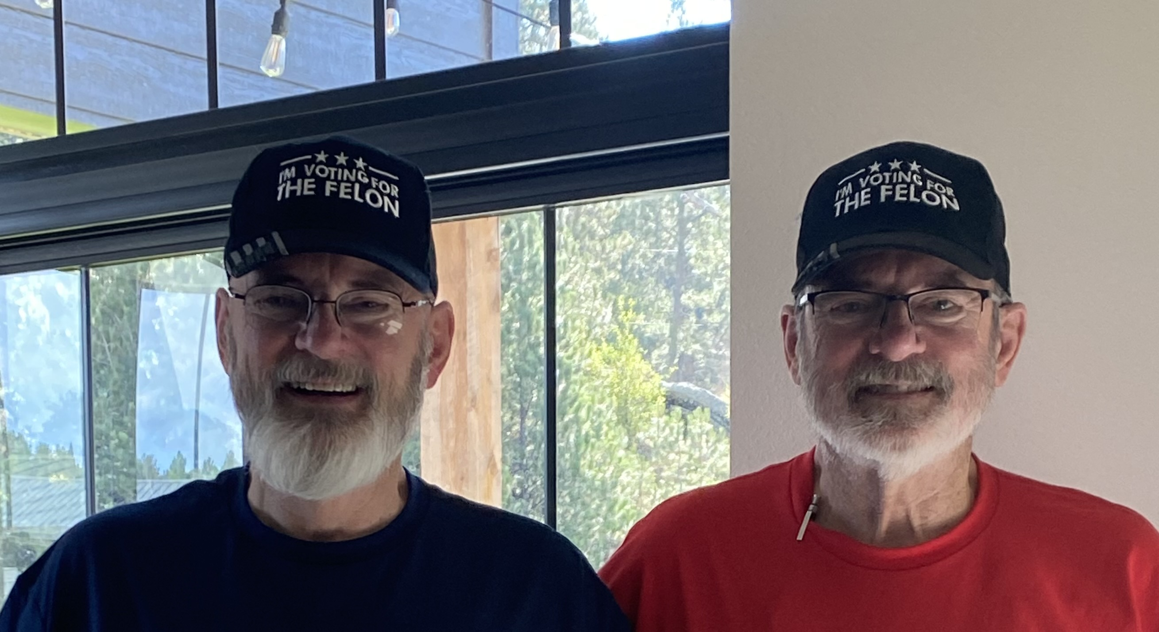

Slide 4
2 Thessalonians 1:8
“… in flaming fire taking vengeance on those who do not know God, and on those who do not obey the gospel of our Lord Jesus Christ.”

Slide 5
2 Thessalonians 1:8
“… in flaming fire taking vengeance on those who do not know God, and on those who do not obey the gospel of our Lord Jesus Christ.”

Slide 6
1 Corinthians 15:51-53
“Behold, I tell you a mystery: We shall not all sleep, but we shall all be changed – in a moment, in the twinkling of an eye, at the last trumpet. For the trumpet will sound, and the dead will be raised incorruptible, and we shall be changed. For this corruptible must put on incorruption, and this mortal must put on immortality.”

Slide 7
John 1:12
“But as many as received Him, to them He gave the right to become children of God, to those who believe in His name.”

Slide 8
Revelation 11:1-6
“Then I was given a reed like a measuring rod. And the angel stood, saying, “Rise and measure the temple of God, the altar, and those who worship there. But leave out the court which is outside the temple, and do not measure it, for it has been given to the Gentiles. And they will tread the holy city underfoot for forty-two months. And I will

Slide 9
Revelation 11:1-6
give power to my two witnesses, and they will prophesy one thousand two hundred and sixty days, clothed in sackcloth.” These are the two olive trees and the two lampstands standing before the God of the earth. And if anyone wants to harm them, fire proceeds from their mouth and devours their enemies. And if anyone wants to harm them, he must

Slide 10
Revelation 11:1-6
be killed in this manner. These have power to shut heaven, so that no rain falls in the days of their prophecy; and they have power over waters to turn them to blood, and to strike the earth with all plagues, as often as they desire.”

Slide 11
Revelation 11:1-6
“Then I was given a reed like a measuring rod. And the angel stood, saying, “Rise and measure the temple of God, the altar, and those who worship there. But leave out the court which is outside the temple, and do not measure it, for it has been given to the Gentiles. And they will tread the holy city underfoot for forty-two months. And I will

Slide 12
Revelation 11:1-6
give power to my two witnesses, and they will prophesy one thousand two hundred and sixty days, clothed in sackcloth.” These are the two olive trees and the two lampstands standing before the God of the earth. And if anyone wants to harm them, fire proceeds from their mouth and devours their enemies. And if anyone wants to harm them, he must

Slide 13
Revelation 14:1-5
“Then I looked, and behold, a Lamb standing on Mount Zion, and with Him one hundred and forty-four thousand, having His Father’s name written on their foreheads. And I heard a voice from heaven, like the voice of many waters, and like the voice of loud thunder. And I heard the sound of harpists playing their harps.

Slide 14
Revelation 14:1-5
They sang as it were a new song before the throne, before the four living creatures, and the elders; and no one could learn that song except the hundred and forty-four thousand who were redeemed from the earth. These are the ones who were not defiled with women, for they are virgins. These are the ones who follow the Lamb wherever He

Slide 15
Revelation 14:1-5
goes. These were redeemed from among men, being firstfruits to God and to the Lamb. And in their mouth was found no deceit, for they are without fault before the throne of God.”

Slide 16
Revelation 7:9-14
“After these things I looked, and behold, a great multitude which no one could number, of all nations, tribes, people, and tongues, standing before the throne and before the Lamb, clothed with white robes, with palm branches in their hands, and crying out with a loud voice, saying, “Salvation belongs to our God who sits on the throne, and to the

Slide 17
Revelation 7:9-14
Lamb!” All the angels stood around the throne and the elders and the four living creatures, and fell on their faces before the throne and worshiped God, saying: “Amen! Blessing and glory and wisdom, Thanksgiving and honor and power and might, Be to our God forever and ever. Amen.” Then one of the elders answered,

Slide 18
Revelation 7:9-14
saying to me, “Who are these arrayed in white robes, and where did they come from?” And I said to him, “Sir, you know.” So he said to me, “These are the ones who come out of the great tribulation, and washed their robes and made them white in the blood of the Lamb.”

Slide 19
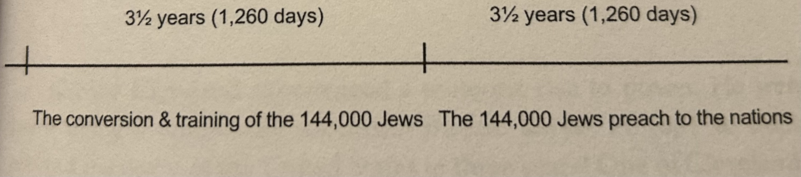
The Impending Apocalypse
by
John Claeys

Slide 20
2 Thessalonians 1:8
“… in flaming fire taking vengeance on those who do not know God, and on those who do not obey the gospel of our Lord Jesus Christ.”

Slide 21
2 Thessalonians 1:8
“… in flaming fire taking vengeance on those who do not know God, and on those who do not obey the gospel of our Lord Jesus Christ.”

Slide 22
2 Thessalonians 1:9
“These shall be punished with everlasting destruction from the presence of the Lord and from the glory of His power …”.

Slide 23
2 Thessalonians 1:9
“These shall be punished with everlasting destruction from the presence of the Lord and from the glory of His power …”.

Slide 24
There will be different levels of torment for those that ultimately end up in the lake of fire because they haven’t believed in Jesus Christ.

Slide 25
Sheol is an Old Testament Hebrew term that refers to the place where people go when they die.

Slide 26
Sheol is an Old Testament Hebrew term that refers to the place where people go when they die.
The word, “Hades” is the New Testament Greek term that refers to the same place – at least prior to Christ’s resurrection from the dead.

Slide 27
Luke 16:22-24
“So it was that the beggar died, and was carried by the angels to Abraham’s bosom. The rich man also died and was buried. And being in torments in Hades, he lifted up his eyes and saw Abraham afar off, and Lazarus in his bosom. “Then he cried and said, ‘Father Abraham, have mercy on me, and send Lazarus that he may dip the tip of his finger in water and cool my tongue; for I am tormented in this flame.’”

Slide 28
Luke 16:22-24
“So it was that the beggar died, and was carried by the angels to Abraham’s bosom. The rich man also died and was buried. And being in torments in Hades, he lifted up his eyes and saw Abraham afar off, and Lazarus in his bosom. “Then he cried and said, ‘Father Abraham, have mercy on me, and send Lazarus that he may dip the tip of his finger in water and cool my tongue; for I am tormented in this flame.’”

Slide 29
Luke 16:22-24
“So it was that the beggar died, and was carried by the angels to Abraham’s bosom. The rich man also died and was buried. And being in torments in Hades, he lifted up his eyes and saw Abraham afar off, and Lazarus in his bosom. “Then he cried and said, ‘Father Abraham, have mercy on me, and send Lazarus that he may dip the tip of his finger in water and cool my tongue; for I am tormented in this flame.’”

Slide 30
Luke 23:39-43
“Then one of the criminals who were hanged blasphemed Him, saying, “If You are the Christ, save Yourself and us.” But the other, answering, rebuked him, saying, “Do you not even fear God, seeing you are under the same condemnation? And we indeed justly,

Slide 31
Luke 23:39-43
for we receive the due reward of our deeds; but this Man has done nothing wrong.” Then he said to Jesus, “Lord, remember me when You come into Your kingdom.” And Jesus said to him, “Assuredly, I say to you, today you will be with Me in Paradise.”

Slide 32
Luke 23:39-43
for we receive the due reward of our deeds; but this Man has done nothing wrong.” Then he said to Jesus, “Lord, remember me when You come into Your kingdom.” And Jesus said to him, “Assuredly, I say to you, today you will be with Me in Paradise.”

Slide 33
Ephesians 4:8-10
“Therefore He says: “When He ascended on high, He led captivity captive, and gave gifts to men.” (Now this, “He ascended” – what does it mean but that He also first descended into the lower parts of the earth? He who descended is also the One who ascended far above all the heavens, that He might fill all things.)”

Slide 34
Ephesians 4:8-10
“Therefore He says: “When He ascended on high, He led captivity captive, and gave gifts to men.” (Now this, “He ascended” – what does it mean but that He also first descended into the lower parts of the earth? He who descended is also the One who ascended far above all the heavens, that He might fill all things.)”

Slide 35
2 Corinthians 5:8
“We are confident, yes, well pleased rather to be absent from the body and to be present with the Lord.”

Slide 36
We have these ideas that hell is going to be a place of unbearable agony and misery and maybe even torture for every single unbeliever for all of eternity.

Slide 37
Matthew 11:20-24
“Then He began to rebuke the cities in which most of His mighty works had been done, because they did not repent: “Woe to you, Chorazin! Woe to you, Bethsaida! For if the mighty works which were done in you had been done in Tyre and Sidon, they would have repented long ago in sackcloth and ashes. But I say to you, it will be more tolerable for

Slide 38
Matthew 11:20-24
Tyre and Sidon in the day of judgment than for you. And you, Capernaum, who are exalted to heaven, will be brought down to Hades; for if the mighty works which were done in you had been done in Sodom, it would have remained until this day. But I say to you that it shall be more tolerable for the land of Sodom in the day of judgment than for you.”

Slide 39
“It should surprise us which unbelievers get the more tolerable torment. Those of Sodom and Gomorrah and Tyre and Sidon were notorious sinners. Yet their torment will be more tolerable than law abiding, legalistic, self-righteous Jews of the first century who rejected the Messiah when they saw and heard Him directly. Degree of torment will be based in great part on how much revelation from God a person rejected.”
Bob Wilkin – The Ten Most Misunderstood Words in the Bible

Slide 40
2 Thessalonians 1:8
“… in flaming fire taking vengeance on those who do not know God, and on those who do not obey the gospel of our Lord Jesus Christ.”

Slide 41
2 Thessalonians 1:9
“These shall be punished with everlasting destruction from the presence of the Lord and from the glory of His power …”.

Slide 42
2 Thessalonians 1:9 (NASB)
“These will pay the penalty of eternal destruction, away from the presence of the Lord and from the glory of His power …”.

Slide 43
2 Thessalonians 1:9 (NASB)
“These will pay the penalty of eternal destruction, away from the presence of the Lord and from the glory of His power …”.

Slide 44
2 Thessalonians 1:9 (NASB)
“These will pay the penalty of eternal destruction, away from the presence of the Lord and from the glory of His power …”.
Destruction = Death

Slide 45
2 Thessalonians 1:9 (NASB)
“These will pay the penalty of eternal destruction, away from the presence of the Lord and from the glory of His power …”.
Destruction = Death

Slide 46
Revelation 21:2-4
“Then I, John, saw the holy city, New Jerusalem, coming down out of heaven from God, prepared as a bride adorned for her husband. And I heard a loud voice from heaven saying, “Behold, the tabernacle of God is with men, and He will dwell with them, and they shall be

Slide 47
Revelation 21:2-4
His people. God Himself will be with them and be their God. And God will wipe away every tear from their eyes; there shall be no more death, nor sorrow, nor crying. There shall be no more pain, for the former things have passed away.”

Slide 48
2 Thessalonians 1:9 (NASB)
“These will pay the penalty of eternal destruction, away from the presence of the Lord and from the glory of His power …”.

Slide 49
2 Thessalonians 1:9 (NASB)
“These will pay the penalty of eternal destruction, away from the presence of the Lord and from the glory of His power …”.
John 3:16
“For God so loved the world that He gave His only begotten Son, that whoever believes in Him should not perish but have eternal life.”

Slide 50
2 Thessalonians 1:9 (NASB)
“These will pay the penalty of eternal destruction, away from the presence of the Lord and from the glory of His power …”.
John 3:16
“For God so loved the world that He gave His only begotten Son, that whoever believes in Him should not perish but have eternal life.”

