Slide 1
Second
Thessalonians

Slide 2
2 Thessalonians 1:11
“Therefore we also pray always for you that our God would count you worthy of this calling, and fulfill all the good pleasure of His goodness and the work of faith with power …”.

Slide 3
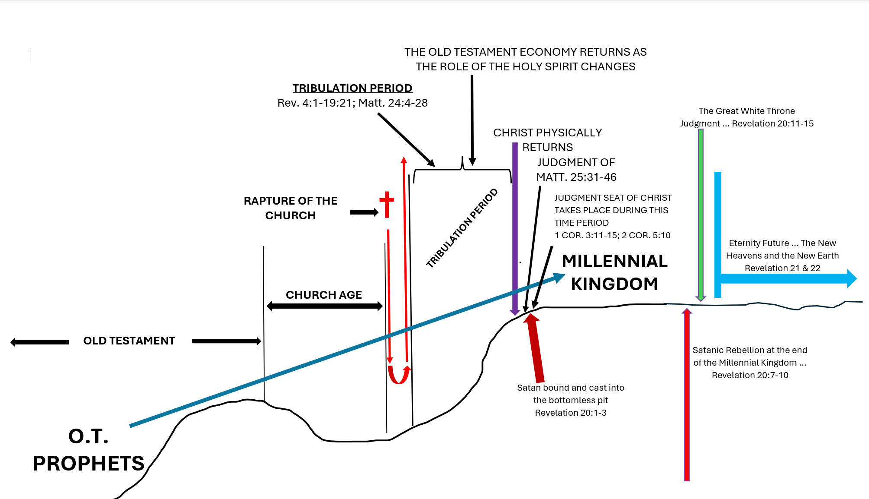

Slide 4
Revelation 20:4
“And I saw thrones, and they sat on them, and judgment was committed to them. Then I saw the souls of those who had been beheaded for their witness to Jesus and for the word of God, who had not worshiped the beast or his image, and had not received his mark on their foreheads or on their hands. And they lived and reigned with Christ for a thousand years.”

Slide 6
Revelation 20:4
“And I saw thrones, and they sat on them, and judgment was committed to them. Then I saw the souls of those who had been beheaded for their witness to Jesus and for the word of God, who had not worshiped the beast or his image, and had not received his mark on their foreheads or on their hands. And they lived and reigned with Christ for a thousand years.”

Slide 7
“The Bible teaches that Lucifer was a guardian in heaven. Before God cast him out, his job was to serve God. In the Old Testament, the job of a guardian was to provide protection. As a cherub, Lucifer had a high rank and an important role in heaven before he sinned.”
christianityfaq.com

Slide 8
Ezekiel 28:14-17
“You were the anointed cherub who covers; I established you; You were on the holy mountain of God; You walked back and forth in the midst of fiery stones. You were perfect in your ways from the day you were created, till iniquity was found in you. By the abundance of your trading you became filled with violence within, and you sinned;

Slide 9
Ezekiel 28:14-17
therefore I cast you as a profane thing out of the mountain of God; and I destroyed you, O covering cherub, from the midst of the fiery stones. Your heart was lifted up because of your beauty; you corrupted your wisdom for the sake of your splendor; I cast you to the ground, I laid you before kings, that they might gaze at you.”

Slide 10
Isaiah 14:12-14
“How you are fallen from heaven, O Lucifer, son of the morning! How you are cut down to the ground, you who weakened the nations! For you have said in your heart: ‘I will ascend into heaven, I will exalt my throne above the stars of God; I will also sit on the mount of the congregation on the farthest sides of the north; I will ascend above the heights of the clouds, I will be like the Most High.’”

Slide 11
Satan will be relegated to the bottomless pit for Christ’s 1000-year reign to prove to man that he has no one to blame for his sin problem other than his own wicked heart.

Slide 12
Revelation 20:7-10
“Now when the thousand years have expired, Satan will be released from his prison and will go out to deceive the nations which are in the four corners of the earth, God and Magog, to gather them together to battle, whose number is as the sand of the sea. They went up on the breadth of the earth and surrounded the camp of the saints

Slide 13
Revelation 20:7-10
and the beloved city. And fire came down from God out of heaven and devoured them. The devil, who deceived them, was cast into the lake of fire and brimstone where the beast and the false prophet are. And they will be tormented day and night forever and ever.”

Slide 15
The method of salvation has always been the same – it has always been through faith in Christ.
In the Old Testament, unbelievers were the ones that didn’t believe in the Messiah that was prophesied to come.

Slide 16
The method of salvation has always been the same – it has always been through faith in Christ.
In the New Testament, unbelievers are the ones that don’t believe in the Messiah that did come.

Slide 17
The method of salvation has always been the same – it has always been through faith in Christ.
In other words, the difference between the Old and New Testaments is that in the Old Testament, they were looking forward to the Messiah. In the New Testament, we look back to the Messiah.

Slide 18
Revelation 20:11-15
“Then I saw a great white throne and Him who sat on it, from whose face the earth and the heaven fled away. And there was found no place for them. And I saw the dead, small and great, standing before God, and books were opened. And another book was opened, which is the Book of Life. And the dead were judged according to their works, by the things

Slide 19
Revelation 20:11-15
which were written in the books. The sea gave up the dead who were in it, and Death and Hades delivered up the dead who were in them. And they were judged, each one according to his works. Then Death and Hades were cast into the lake of fire. This is the second death. And anyone not found written in the Book of Life was cast into the lake of fire.”

Slide 21
1 John 5:1
“Whoever believes that Jesus is the Christ is born of God …”.

Slide 22
John 20:30-31
“And truly Jesus did many other signs in the presence of His disciples, which are not written in this book; but these are written that you may believe that Jesus is the Christ, the Son of God, and that believing you may have life in His name.”

Slide 23
John 20:30-31
“And truly Jesus did many other signs in the presence of His disciples, which are not written in this book; but these are written that you may believe that Jesus is the Christ, the Son of God, and that believing you may have life in His name.”

Slide 24
The unbeliever’s works do not determine whether they are saved or not.

Slide 25
Matthew 7:21-23 (NLT)
“Not everyone who calls out to Me, ‘Lord! Lord!’ will enter the Kingdom of Heaven. Only those who actually do the will of My Father in heaven will enter. On judgment day many will say to Me, ‘Lord! Lord! We prophesied in Your name and cast out demons in Your name and performed many miracles in Your name.’ But I will reply, ‘I never knew you. Get away from Me, you who break God’s laws.’”

Slide 26
John 6:40 (NASB)
“For this is the will of My Father, that everyone who beholds the Son and believes in Him will have eternal life, and I Myself will raise him up on the last day.”

Slide 28
1 Thessalonians 4:13-18
“But I do not want you to be ignorant, brethren, concerning those who have fallen asleep, lest you sorrow as others who have no hope. For if we believe that Jesus died and rose again, even so God will bring with Him those who sleep in Jesus. For this we say to you by the word of the Lord, that we who are alive and remain until the coming of the Lord will by no means precede those who are

Slide 29
1 Thessalonians 4:13-18
asleep. For the Lord Himself will descend from heaven with a shout, with the voice of an archangel, and with the trumpet of God. And the dead in Christ will rise first. Then we who are alive and remain shall be caught up together with them in the clouds to meet the Lord in the air. And thus we shall always be with the Lord. Therefore comfort one another with these words.”

Slide 30
1 Thessalonians 5:9-10
“For God did not appoint us to wrath, but to obtain salvation through our Lord Jesus Christ, who died for us, that whether we wake or sleep, we should live together with Him.”

Slide 31
1 Thessalonians 5:9-10
“For God did not appoint us to wrath, but to obtain salvation through our Lord Jesus Christ, who died for us, that whether we wake or sleep, we should live together with Him.”

Slide 32
2 Thessalonians 1:1-2
“Now, brethren, concerning the coming of our Lord Jesus Christ and our gathering together to Him, we ask you, not to be soon shaken in mind or troubled, either by spirit or by word or by letter, as if from us, as though the day of Christ had come.”

Slide 33
2 Thessalonians 1:1-2
“Now, brethren, concerning the coming of our Lord Jesus Christ and our gathering together to Him, we ask you, not to be soon shaken in mind or troubled, either by spirit or by word or by letter, as if from us, as though the day of Christ had come.”

Slide 34
Philippians 2:14-16
“Do all things without complaining and disputing, that you may become blameless and harmless, children of God without fault in the midst of a crooked and perverse generation, among whom you shine as lights in the world, holding fast the word of life, so that I may rejoice in the day of Christ that I have not run in vain or labored in vain.”

Slide 35
Philippians 2:14-16
“Do all things without complaining and disputing, that you may become blameless and harmless, children of God without fault in the midst of a crooked and perverse generation, among whom you shine as lights in the world, holding fast the word of life, so that I may rejoice in the day of Christ that I have not run in vain or labored in vain.”

Slide 36
Philippians 1:6
“… being confident of this very thing, that He who has begun a good work in you will complete it until the day of Jesus Christ …”.

Slide 37
Philippians 1:6
“… being confident of this very thing, that He who has begun a good work in you will complete it until the day of Jesus Christ …”.
Philippians 1:10
“… that you may approve the things that are excellent, that you may be sincere and without offense till the day of Christ …”.

Slide 38
1 Corinthians 1:4-9
“I thank my God always concerning you for the grace of God which was given to you by Christ Jesus, that you were enriched in everything by Him in all utterance and all knowledge, even as the testimony of Christ was confirmed in you, so that you come short in no gift, eagerly waiting for

Slide 39
1 Corinthians 1:4-9
the revelation of our Lord Jesus Christ, who will also confirm you to the end, that you may be blameless in the day of our Lord Jesus Christ. God is faithful, by whom you were called into the fellowship of His Son, Jesus Christ our Lord.”

Slide 40
1 Corinthians 1:4-9
the revelation of our Lord Jesus Christ, who will also confirm you to the end, that you may be blameless in the day of our Lord Jesus Christ. God is faithful, by whom you were called into the fellowship of His Son, Jesus Christ our Lord.”

Slide 41
1 Corinthians 1:4-9
the revelation of our Lord Jesus Christ, who will also confirm you to the end, that you may be blameless in the day of our Lord Jesus Christ. God is faithful, by whom you were called into the fellowship of His Son, Jesus Christ our Lord.”

Slide 42
2 Thessalonians 2:5
“Do you not remember that when I was still with you I told you these things?”

