Slide 1
Second
Thessalonians

Slide 2
2 Thessalonians 1:6-8
“… since it is a righteous thing with God to repay with tribulation those who trouble you, and to give you who are troubled rest with us when the Lord Jesus is revealed from heaven with His mighty angels, in flaming fire taking vengeance on those who do not know God, and on those who do not obey the gospel of our Lord Jesus Christ.”

Slide 3
2 Thessalonians 1:6-8
“… since it is a righteous thing with God to repay with tribulation those who trouble you, and to give you who are troubled rest with us when the Lord Jesus is revealed from heaven with His mighty angels, in flaming fire taking vengeance on those who do not know God, and on those who do not obey the gospel of our Lord Jesus Christ.”

Slide 4
The fact that these things are written in Scripture for all of us to see shows that any of us can face that same reality of loss of reward if we choose to continually lapse in our obedience to Christ.

Slide 5
2 Thessalonians 1:6-8
“… since it is a righteous thing with God to repay with tribulation those who trouble you, and to give you who are troubled rest with us when the Lord Jesus is revealed from heaven with His mighty angels, in flaming fire taking vengeance on those who do not know God, and on those who do not obey the gospel of our Lord Jesus Christ.”

Slide 6
2 Thessalonians 1:8-9
“… in flaming fire taking vengeance on those who do not know God, and on those who do not obey the gospel of our Lord Jesus Christ. These shall be punished with everlasting destruction from the presence of the Lord and from the glory of His power …”.

Slide 7
2 Thessalonians 1:8-9
“… in flaming fire taking vengeance on those who do not know God, and on those who do not obey the gospel of our Lord Jesus Christ. These shall be punished with everlasting destruction from the presence of the Lord and from the glory of His power …”.

Slide 8
2 Thessalonians 1:8-9
“… in flaming fire taking vengeance on those who do not know God, and on those who do not obey the gospel of our Lord Jesus Christ. These shall be punished with everlasting destruction from the presence of the Lord and from the glory of His power …”.

Slide 9
2 Thessalonians 1:8-9
“… in flaming fire taking vengeance on those who do not know God, and on those who do not obey the gospel of our Lord Jesus Christ. These shall be punished with everlasting destruction from the presence of the Lord and from the glory of His power …”.

Slide 10
The Earth’s Current Population …
8,200,000,000 – total population

Slide 11
The Earth’s Current Population …
8,200,000,000 – total population
75% will die … 6,150,000,000

Slide 12
The Earth’s Current Population …
8,200,000,000 – total population
75% will die … 6,150,000,000
25% are believers … 1,537,500,000

Slide 13
Revelation 20:4
“And I saw thrones, and they sat on them, and judgment was committed to them. Then I saw the souls of those who had been beheaded for their witness to Jesus and for the word of God, who had not worshiped the beast or his image, and had not received his mark on their foreheads or on their hands. And they lived and reigned with Christ for a thousand years.”

Slide 14
The Earth’s Current Population …
8,200,000,000 – total population
75% will die … 6,150,000,000
25% are believers … 1,537,500,000
4,612,500,000 … remaining unbelievers, many of whom are “those who don’t know God.”

Slide 15
2 Thessalonians 1:8-9
“… in flaming fire taking vengeance on those who do not know God, and on those who do not obey the gospel of our Lord Jesus Christ. These shall be punished with everlasting destruction from the presence of the Lord and from the glory of His power …”.

Slide 16
The gospel is designed to lead people to believe in Jesus Christ for everlasting life.

Slide 17
Galatians 1:6-9
“I marvel that you are turning away so soon from Him who called you in the grace of Christ, to a different gospel, which is not another; but there are some who trouble you and want to pervert the gospel of Christ. But even if we, or an angel from heaven, preach any other

Slide 18
Galatians 1:6-9
gospel to you than what we have preached to you, let him be accursed. As we have said before, so now I say again, if anyone preaches any other gospel to you than what you have received, let him be accursed.”

Slide 19
Galatians 1:6-9
“I marvel that you are turning away so soon from Him who called you in the grace of Christ, to a different gospel, which is not another; but there are some who trouble you and want to pervert the gospel of Christ. But even if we, or an angel from heaven, preach any other

Slide 20
Gospel = “good news”

Slide 21
1 Corinthians 15:1-4
“Moreover, brethren, I declare to you the gospel which I preached to you, which also you received and in which you stand, by which also you are saved, if you hold fast that word which I preached to you – unless you believed in vain. For I delivered to you first of all that which I also received: that Christ died for our sins according to the Scriptures, and that He was buried, and that He rose again the third day according to the Scriptures …”.

Slide 22
1 Corinthians 15:1-4
“Moreover, brethren, I declare to you the gospel which I preached to you, which also you received and in which you stand, by which also you are saved, if you hold fast that word which I preached to you – unless you believed in vain. For I delivered to you first of all that which I also received: that Christ died for our sins according to the Scriptures, and that He was buried, and that He rose again the third day according to the Scriptures …”.

Slide 23
There are also those that insist that this (the death, burial, and resurrection) is what must be believed in order to receive everlasting life.

Slide 24
These three things absolutely had to happen so that mankind could even have the possibility of being saved from eternal condemnation.

Slide 25
These three things absolutely had to happen so that mankind could even have the possibility of being saved from eternal condemnation.
Without these elements, man’s eternal salvation could never have become a reality.

Slide 26
Is believing in these elements what is required for man to be saved from eternal condemnation?

Slide 27
Nowhere in Scripture does it tell us that this description of the gospel is what one must believe in order to be saved. Jesus Himself certainly never says anything of the sort, nor does anyone else in Scripture.

Slide 28
Additionally, there are many that truly believe in the death, burial, and resurrection of Jesus Christ, but they also believe in a works salvation. In other words, they believe that good works are also necessary in addition to believing in the death, burial, and resurrection of Jesus Christ.

Slide 29
Ephesians 2:8-9
“For by grace you have been saved through faith, and that not of yourselves; it is the gift of God, not of works, lest anyone should boast.”

Slide 30
John 3:16
“For God so loved the world that He gave His only begotten Son, that whoever believes in Him should not perish but have everlasting life.”

Slide 31
John 3:16
“For God so loved the world that He gave His only begotten Son, that whoever believes in Him should not perish but have everlasting life.”

Slide 32
“And God loved mankind more than anything else in the world and wanted everyone to have the opportunity to be in His presence if that was his or her desire.”

Slide 33
“And God loved mankind more than anything else in the world and wanted everyone to have the opportunity to be in His presence if that was his or her desire.”

Slide 34
John 3:16
“For God so loved the world that He gave His only begotten Son, that whoever believes in Him should not perish but have everlasting life.”
“O” = Man’s Obligation

Slide 35
John 3:16
“For God so loved the world that He gave His only begotten Son, that whoever believes in Him should not perish but have everlasting life.”
“O” = Man’s Obligation

Slide 36
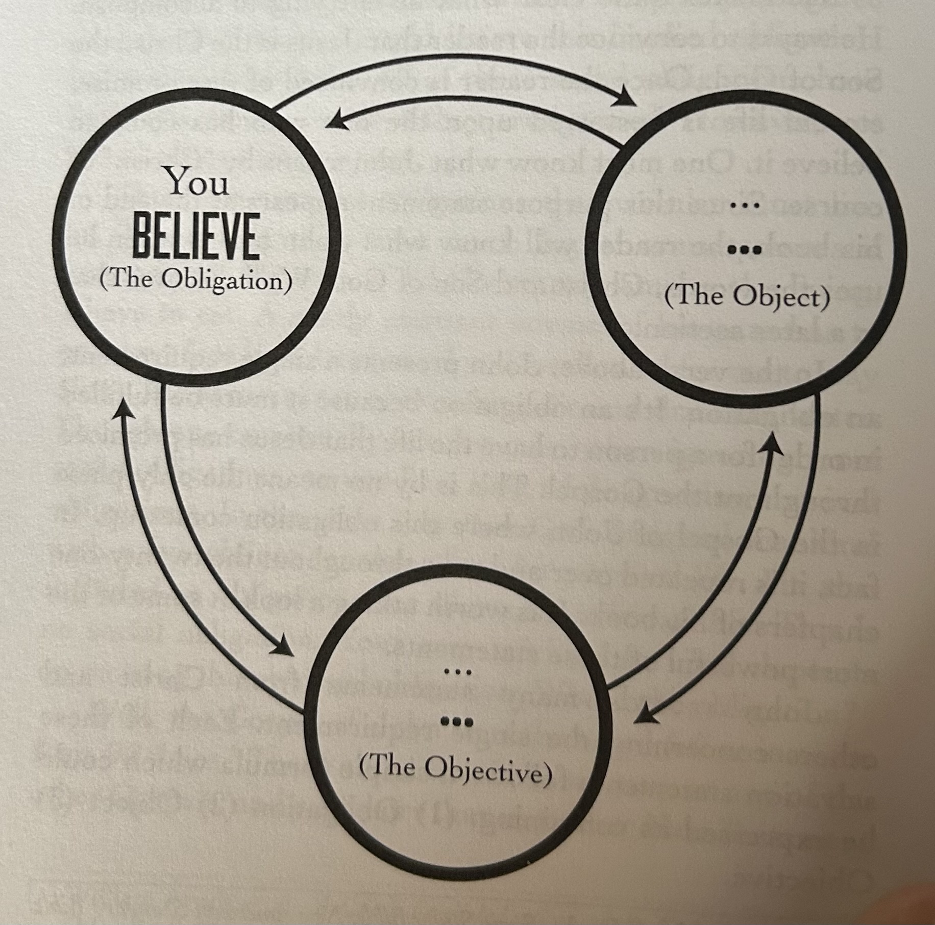

Slide 37
John 3:16
“For God so loved the world that He gave His only begotten Son, that whoever believes in Him should not perish but have everlasting life.”
“O” = Man’s Obligation
“O” = the Object

Slide 38
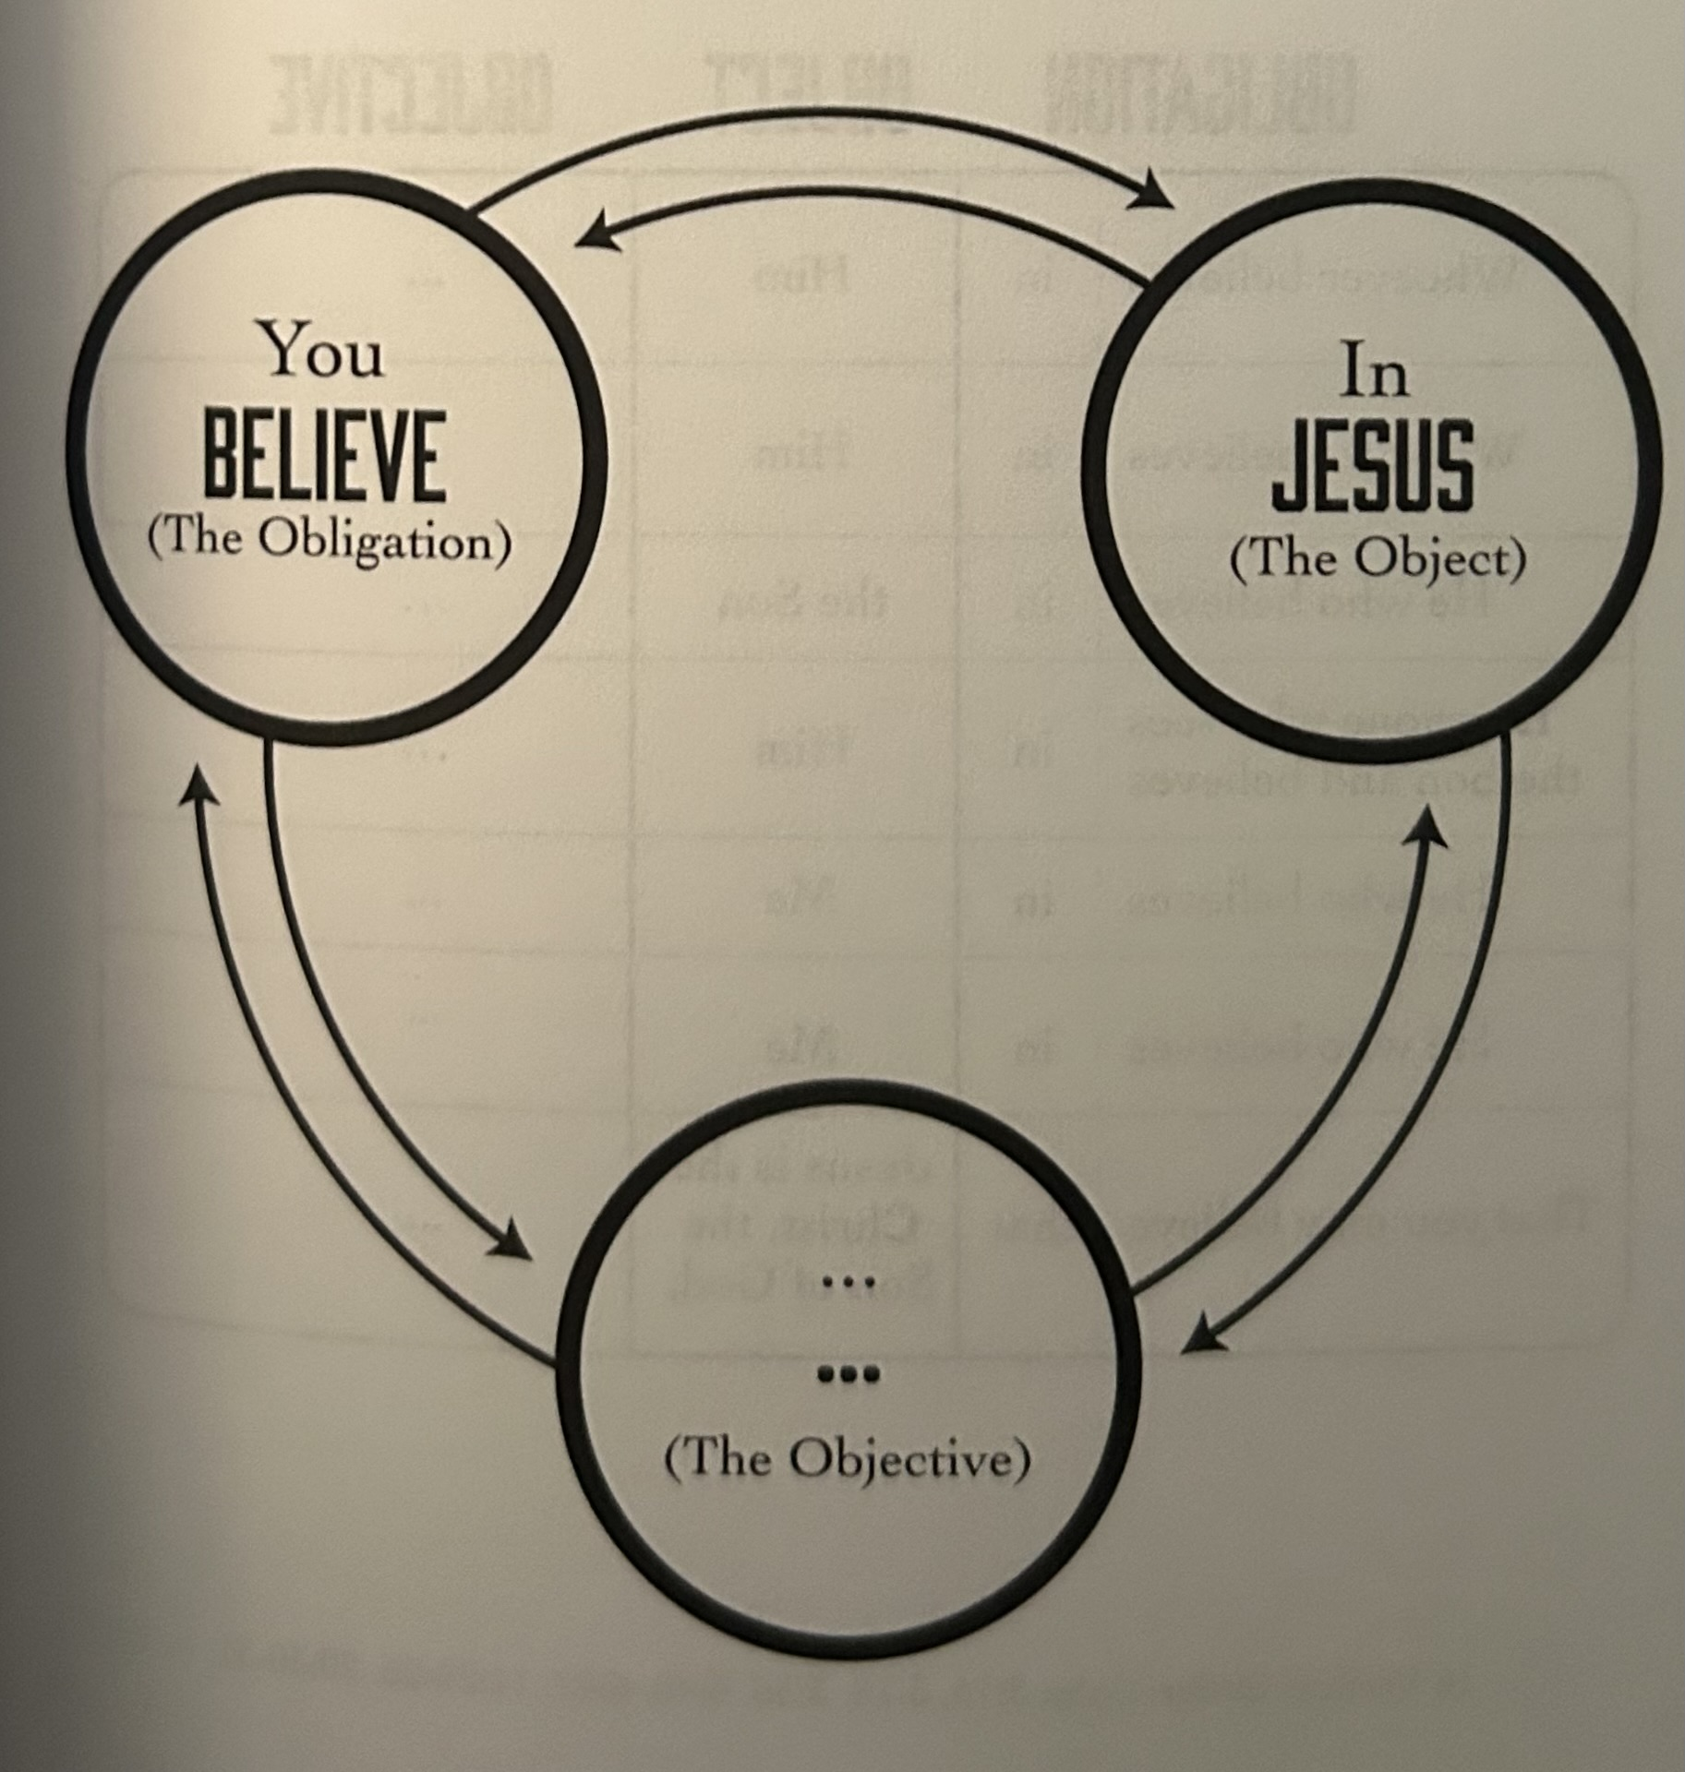

Slide 39
John 3:16
“For God so loved the world that He gave His only begotten Son, that whoever believes in Him should not perish but have everlasting life.”
“O” = Man’s Obligation
“O” = the Object
“O” = the Objective

Slide 40
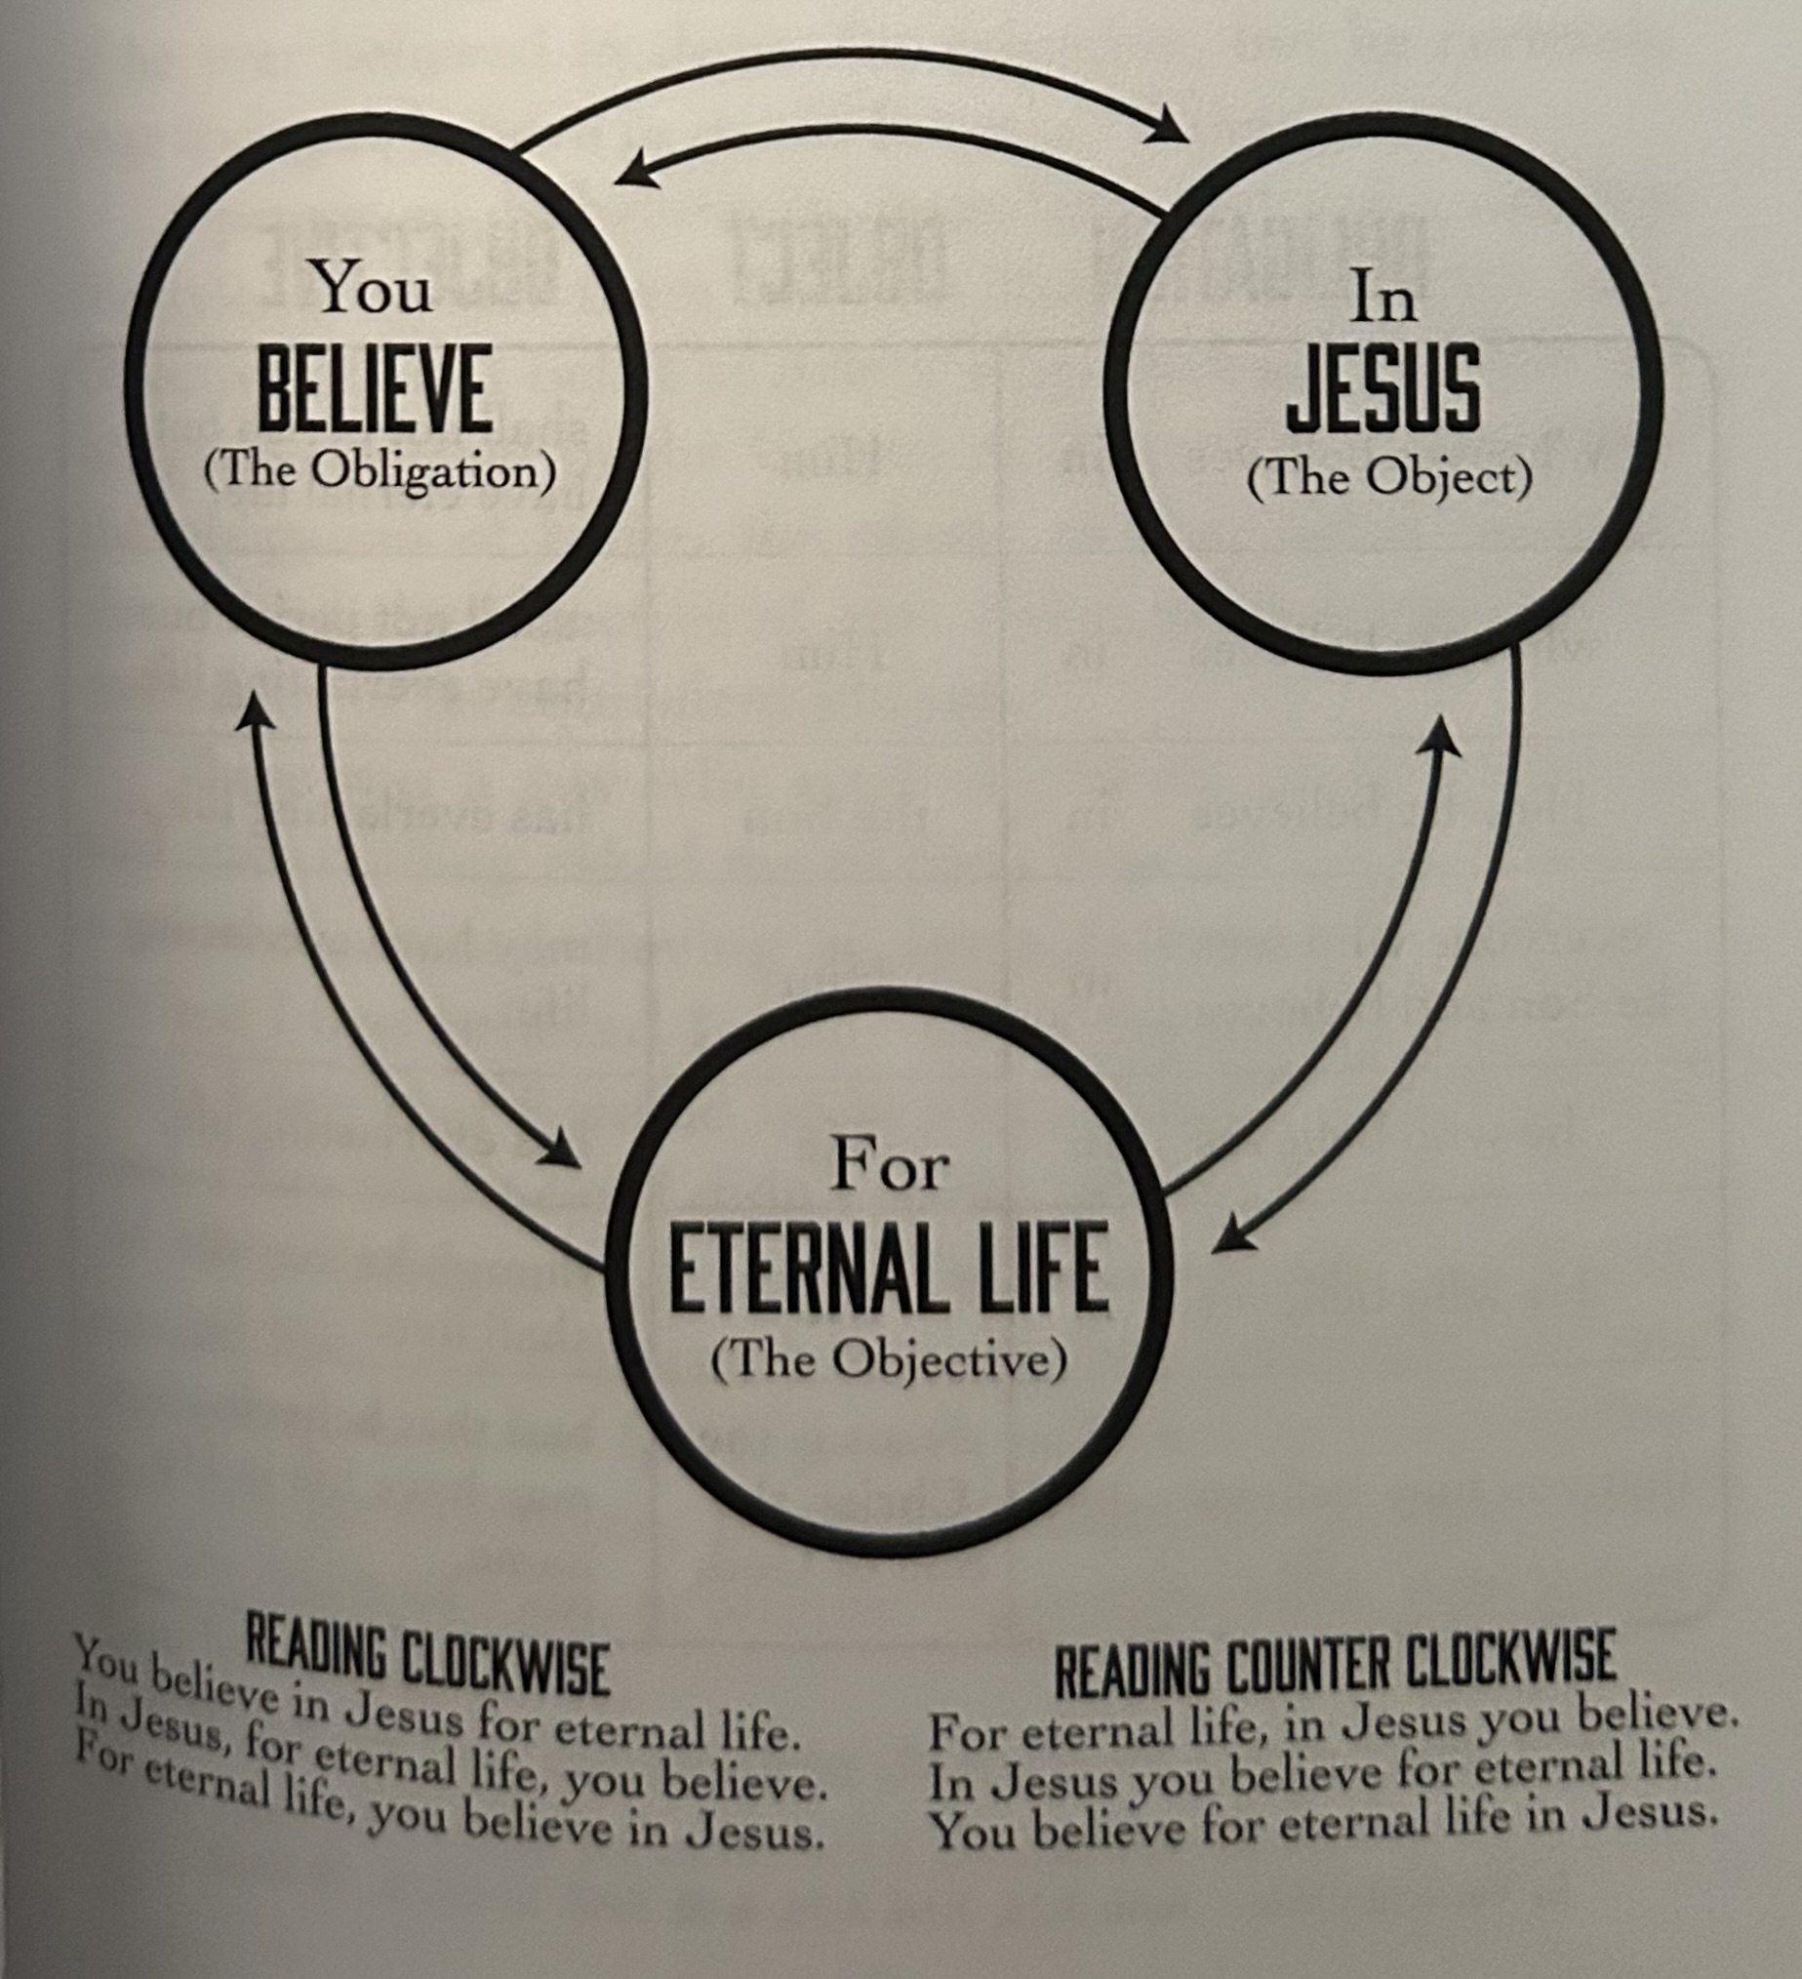

Slide 41
Galatians 2:11-16
“Now when Peter had come to Antioch, I withstood him to his face, because he was to be blamed; for before certain men came from James, he would eat with the Gentiles; but when they came, he withdrew and separated himself, fearing those who were of the circumcision. And the rest of the Jews also played the hypocrite with him, so that

Slide 42
Galatians 2:11-16
even Barnabas was carried away with their hypocrisy. But when I saw that they were not straightforward about the truth of the gospel, I said to Peter before them all, “If you, being a Jew, live in the manner of Gentiles and not as the Jews, why do you compel Gentiles to live as Jews? We who are Jews by nature, and not sinners of the

Slide 43
Galatians 2:11-16
Gentiles, knowing that a man is not justified by the works of the law but by faith in Jesus Christ, even we have believed in Christ Jesus, that we might be justified by faith in Christ and not by the works of the law; for by the works of the law no flesh shall be justified.”

Slide 44
Galatians 2:11-16
Gentiles, knowing that a man is not justified by the works of the law but by faith in Jesus Christ, even we have believed in Christ Jesus, that we might be justified by faith in Christ and not by the works of the law; for by the works of the law no flesh shall be justified.”

Slide 45
2 Thessalonians 1:8-9
“… in flaming fire taking vengeance on those who do not know God, and on those who do not obey the gospel of our Lord Jesus Christ. These shall be punished with everlasting destruction from the presence of the Lord and from the glory of His power …”.

Slide 46
Jeremiah 17:9
“The heart is deceitful above all things, and desperately wicked; who can know it?”

Slide 47
Virtually everything we do in
life is performance oriented.

Slide 48
Virtually everything we do in
life is performance oriented.
It is only natural that that fact of life transcends over into our thoughts regarding how we gain everlasting life.

Slide 49
If it were true that gaining entrance into heaven was also performance oriented, heaven would be no different than it is here. Heaven would be a place filled with people overflowing with sinful pride.

Slide 50
People accuse me of promoting easy-believe-ism. And with that they accuse me of saying it’s okay to live a sinful lifestyle if all one must do is believe in Christ.

Slide 51
Matthew 7:13-14
“Enter by the narrow gate; for wide is the gate and broad is the way that leads to destruction, and there are many who go in by it. Because narrow is the gate and difficult is the way which leads to life, and there are few who find it.”

Slide 52
The wide gate is the gate that most people inadvertently choose, and sadly, it leads to destruction.

Slide 53
The wide gate is the gate that most people inadvertently choose, and sadly, it leads to destruction.

Slide 54
By their insistence on having to work hard at getting to heaven and proving that they are a good person, they believe they are going through the narrow gate, but that’s not true.

Slide 55
Easy-believe-ism
isn’t so easy after all.

Slide 56
If everything we do in life is performance oriented, then it is not an easy thing to believe that I have absolutely nothing to do with my own salvation and instead believe completely that Christ has taken care of my salvation for me.

Slide 57
If everything we do in life is performance oriented, then it is not an easy thing to believe that I have absolutely nothing to do with my own salvation and instead believe completely that Christ has taken care of my salvation for me.

Slide 58
Matthew 7:13-14
“Enter by the narrow gate; for wide is the gate and broad is the way that leads to destruction, and there are many who go in by it. Because narrow is the gate and difficult is the way which leads to life, and there are few who find it.”

