Slide 1
Second
Thessalonians

Slide 2
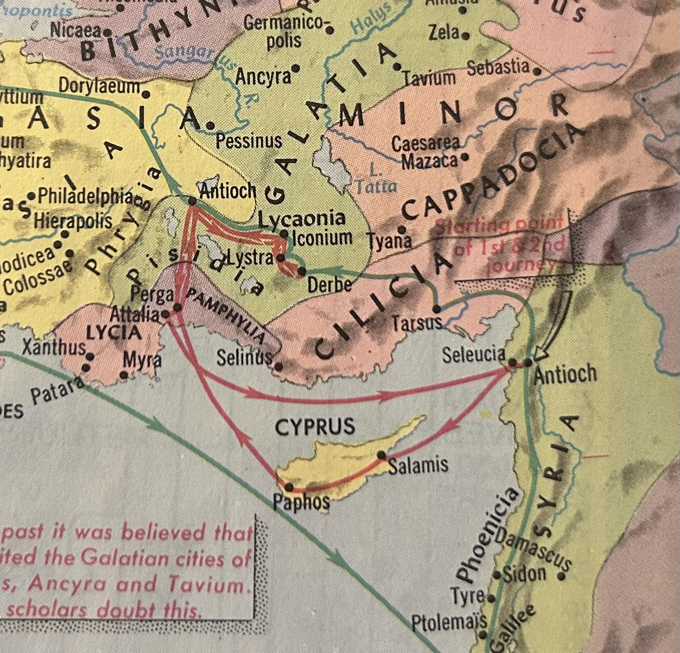

Slide 3
“Did God cause these situations or sins to take place so that the Scriptures would be written?”

Slide 4
“Did God cause these situations or sins to take place so that the Scriptures would be written?”
1 John 1:5
“… God is light and in Him is no darkness at all.”

Slide 5
Jeremiah 17:9
“The heart is deceitful above all things, and desperately wicked; Who can know it?”

Slide 6
John 20:30-31
“And truly Jesus did many other signs in the presence of His disciples, which are not written in this book; but these are written that you may believe that Jesus is the Christ, the Son of God, and that believing you may have life in His name.”

Slide 7
If man hadn’t had the problems with sin or the misunderstanding of doctrinal or prophetic truths which necessitated the need for the letters to be written, then we would have been left to communicating all these truths in the oral tradition much like Paul did in the earlier years of his ministry.

Slide 8
1 Corinthians 10:1-11
“Moreover, brethren, I do not want you to be unaware that all our fathers were under the cloud, all passed through the sea, all were baptized into Moses in the cloud and in the sea, all ate the same spiritual food, and all drank the same spiritual drink. For they drank of that spiritual Rock that followed them, and that Rock was Christ. But with most of them God was not

Slide 9
1 Corinthians 10:1-11
well pleased, for their bodies were scattered in the wilderness. Now these things became our examples, to the intent that we should not lust after evil things as they also lusted. And do not become idolaters as were some of them. As it is written, “The people sat down to eat and drink, and rose up to play.” Nor let us commit sexual immorality, as some of them did, and in one day

Slide 10
1 Corinthians 10:1-11
twenty-three thousand fell; nor let us tempt Christ, as some of them also tempted, and were destroyed by serpents; nor complain, as some of them also complained, and were destroyed by the destroyer. Now all these things happened to them as examples, and they were written for our admonition, upon whom the ends of the ages have come.”

Slide 11
Romans 15:4
“For whatever things were written before were written for our learning, that we through the patience and comfort of the Scriptures might have hope.”

Slide 12
The fact that most of what was written was because of sin that was taking place, this shows us how the basic problems of man haven’t changed. Man is still plagued by sin, and that hasn’t changed one iota since it came into existence back in the garden of Eden millennia ago.

Slide 13
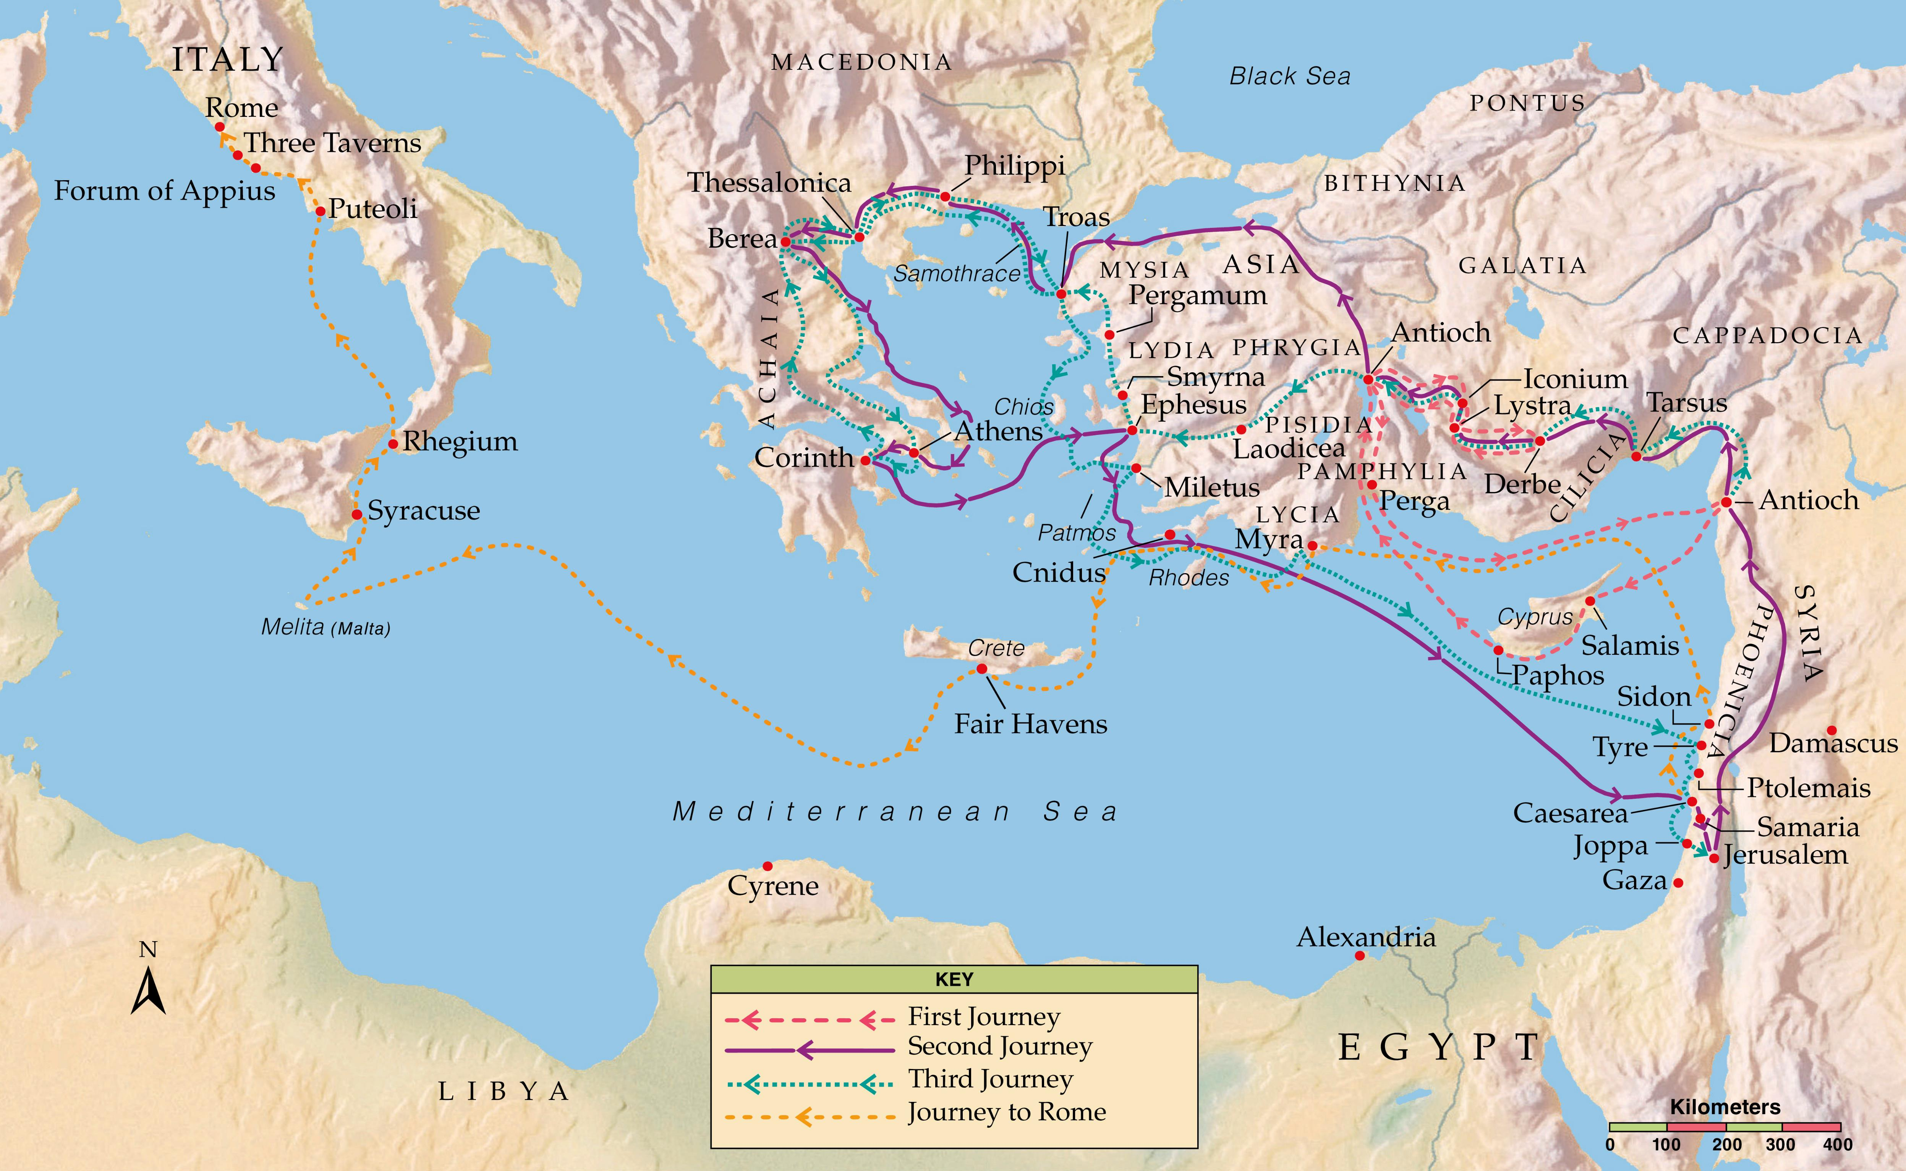

Slide 14
Acts 16:6
“Now when they had gone through Phrygia and the region of Galatia, they were forbidden by the Holy Spirit to preach the word in Asia.”

Slide 16
Acts 16:9-10
“And a vision appeared to Paul in the night. A man of Macedonia stood and pleaded with him, saying, “Come over to Macedonia and help us.” Now after he had seen the vision, immediately we sought to go to Macedonia, concluding that the Lord had called us to preach the gospel to them.”

Slide 18
Why was there a need for a second letter?

Slide 19
Why was there a need for a second letter?
In this second letter, Paul does have to deal with some things.

Slide 20
False teachers had sown the seeds of false doctrine amongst the Thessalonian believers.

Slide 21
Acts 18:9-10
“Now the Lord spoke to Paul in the night by a vision, “Do not be afraid, but speak, and do not keep silent; for I am with you, and no one will attack you to hurt you; for I have many people in this city.” And he continued there a year and six months, teaching the Word of God among them.”

Slide 22
Acts 18:5
“When Silas and Timothy had come from Macedonia, Paul was compelled by the Spirit, and testified to the Jews that Jesus is the Christ.”

Slide 24
1 Thessalonians 4:11-12
“… that you also aspire to lead a quiet life, to mind your own business, and to work with your own hand, as we commanded you, that you may walk properly toward those who are outside, and that you may lack nothing.”

Slide 25
2 Thessalonians 1:3-4
“We are bound to thank God always for you, brethren, as it is fitting, because your faith grows exceedingly, and the love of every one of you all abounds toward each other, so that we ourselves boast of you among the churches of God for your patience and faith in all your persecutions and tribulations that you endure …”.

Slide 26
2 Thessalonians 2:1-2
“Now, brethren, concerning the coming of our Lord Jesus Christ and our gathering together to Him, we ask you, not to be soon shaken in mind or troubled, either by spirit or by word or by letter, as if from us, as though the day of Christ had come.”

Slide 27
This particular letter is the shortest of Paul’s letters to the churches. But even though that is the case, this book provides crucial information concerning the end times and clarifies issues that would otherwise be very obscure.

Slide 28
1st and 2nd Thessalonians
The Olivet Discourse (Matt. 24-25)
The Book of Revelation
These three books form the three major prophetic texts of the New Testament

Slide 29
2 Thessalonians 2:15
“Therefore, brethren, stand fast and hold the traditions which you were taught, whether by word or our epistle.”

Slide 30
2 Thessalonians 2:15
“Therefore, brethren, stand fast and hold the traditions which you were taught, whether by word or our epistle.”

Slide 31
The return of Christ is mentioned more times in the New Testament than any other doctrine.

Slide 32
The return of Christ is mentioned more times in the New Testament than any other doctrine.
318 Times

