Slide 1
First Thessalonians

Slide 3
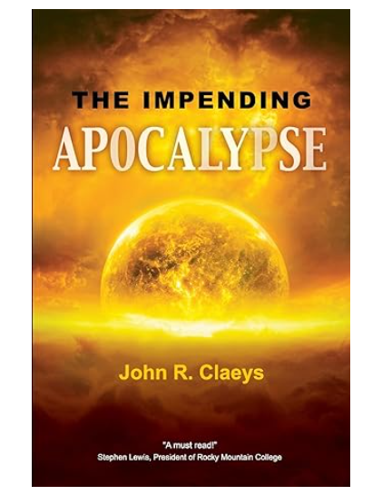

Slide 4
Mark 13:32
“But of that day and hour no one knows, not even the angels in heaven, nor the Son, but only the Father.”

Slide 5
Is it possible to have an inkling of when the Day of the Lord is near?

Slide 6
1 Peter 3:22
“… who has gone into heaven and is at the right hand of God, angels and authorities and powers having been made subject to Him.”

Slide 7
Hebrews 10:12-13
“But this Man, after He had offered one sacrifice for sins forever, sat down at the right hand of God, from that time waiting till His enemies are made His footstool. For by one offering He has perfected forever those who are being sanctified.”

Slide 8
Philippians 2:5-8 (NASB)
“Have this attitude in yourselves which was also in Christ Jesus, who, although He existed in the form of God, did not regard equality with God a thing to be grasped, but emptied Himself, taking the form of a bond-servant, and being made in the likeness of men. Being found in appearance as a man, He humbled Himself by becoming obedient to the point of death, even death on a cross.”

Slide 9
Philippians 2:5-8 (NASB)
“Have this attitude in yourselves which was also in Christ Jesus, who, although He existed in the form of God, did not regard equality with God a thing to be grasped, but emptied Himself, taking the form of a bond-servant, and being made in the likeness of men. Being found in appearance as a man, He humbled Himself by becoming obedient to the point of death, even death on a cross.”

Slide 10
Romans 6:14
“For sin shall not have dominion over you, for you are not under law but under grace.”

Slide 11
1 Thessalonians 5:4
“But you, brethren, are not in darkness, so that this Day should overtake you as a thief.”

Slide 12
1 Thessalonians 5:4
“But you, brethren, are not in darkness, so that this Day should overtake you as a thief.”
1 Thessalonians 5:2
“For you yourselves know perfectly that the day of the Lord so comes as a theif in the night.”

Slide 13
Reasons the Rapture may be near …

Slide 14
Reasons the Rapture may be near …
The Jews have been returning to the land.

Slide 15
Ezekiel 37:21
“Then say to them, ‘Thus says the Lord God: “Surely I will take the children of Israel from among the nations, wherever they have gone, and will gather them from every side and bring them into their own land …”.

Slide 17
Romans 11:25b
“… that blindness in part has happened to Israel until the fullness of the Gentiles has come in.”

Slide 19
Reasons the Rapture may be near …
The Jews have been returning to the land.
Israel’s possession of Jerusalem.

Slide 21
The land which would become Israel was for centuries part of the Turkish-ruled Ottoman Empire. After World War One and the collapse of the empire, territory known as Palestine – the portion of which west of the River Jordan was also known as the land of Israel by Jews – was marked out and assigned to Britain to administer by the victorious allied powers (soon after endorsed by the League of Nations). The terms of the mandate entrusted Britain with establishing in Palestine “a national home for the Jewish people”, so long as doing so did not prejudice the civil and religious rights of non-Jewish communities there.”

Slide 22
On May 14, 1948, the Jewish leadership in Palestine declared the establishment of the State of Israel, and on that day, the British mandate terminated.

Slide 28
Luke 21:20-24
“But when you see Jerusalem surrounded by armies, then know that its desolation is near. Then let those who are in Judea flee to the mountains, let those who are in the midst of her depart, and let not those who are in the country enter her. For these are the days of vengeance, that all things which are written may be fulfilled. But woe to

Slide 29
Luke 21:20-24
those who are pregnant and to those who are nursing babies in those days! For there will be great distress in the land and wrath upon this people. And they will fall by the edge of the sword, and be led away captive into all nations. And Jerusalem will be trampled by Gentiles until the times of the Gentiles are fulfilled.”

Slide 30
Luke 21:20-24
those who are pregnant and to those who are nursing babies in those days! For there will be great distress in the land and wrath upon this people. And they will fall by the edge of the sword, and be led away captive into all nations. And Jerusalem will be trampled by Gentiles until the times of the Gentiles are fulfilled.”

Slide 31
Reasons the Rapture may be near …
The Jews have been returning to the land.
Israel’s possession of Jerusalem.
There are three groups that have come together in Israel that are preparing for the coming of the Messiah.

Slide 34
Numbers 19:2
“This is the ordinance of the law which the Lord has commanded, saying: ‘Speak to the children of Israel, that they bring you a red heifer without blemish, in which there is no defect and on which a yoke has never come.”

Slide 35
Numbers 19:9
“Then a man who is clean shall gather up the ashes of the heifer, and store them outside the camp in a clean place; and they shall be kept for the congregation of the children of Israel for the water of purification; it is for purifying from sin.”

Slide 37
“In March 2002, in a farm in Galilee, an Israeli rancher had a cow that gave birth to a red heifer that was born without blemish that is no white hairs on her body and face. After the heifer was a month old the Temple Institute was contacted and Rabbi Menachem Makeover and Rabbi Chaim Richman to inspect her. There they found this young heifer to be kosher and a potential candidate to become the 10th red heifer in Hebrew history.”

Slide 38
“This young heifer was only a month old, yet within two to three years, if no more than three white or black hairs are found on her body, the orthodox Jews would have sufficient reason to take possession of the Temple Mount, where most of them feel the Temple of Solomon had been built and begin the construction of a new temple there.”

Slide 39
Matthew 26:57-59 (NIV)
“Those who had arrested Jesus took Him to Caiaphas the high priest, where the teachers of the law and the elders had assembled. But Peter followed Him at a distance, right up to the courtyard of the high priest. He entered and sat down with the guards to see the outcome. The chief priests and the whole Sanhedrin were looking for false evidence against Jesus so that they could put Him to death.”

Slide 40
Sanhedrin (brittanica.com) …
“any of several official Jewish councils in Palestine under Roman rule, to which various political, religious, and judicial functions have been attributed. Taken from the Greek word for council (synedrion), the term was apparently applied to various bodies but became especially the designation for the supreme Jewish legislative and judicial court—the Great Sanhedrin, or simply the Sanhedrin, in Jerusalem.”

Slide 42
Reasons the Rapture may be near …
The Jews have been returning to the land.
Israel’s possession of Jerusalem.
There are three groups that have come together in Israel that are preparing for the coming of the Messiah.

