Slide 1
First Thessalonians

Slide 2
2 Timothy 3:16
“All Scripture is given by inspiration of God, and is profitable for doctrine, for reproof, for correction, for instruction in righteousness.”

Slide 3
2 Timothy 3:16
“All Scripture is given by inspiration of God, and is profitable for doctrine, for reproof, for correction, for instruction in righteousness.”
Inspiration … “divinely breathed in”

Slide 4
“We affirm that inspiration, strictly speaking, applies only to the autographic text of Scripture, which in the providence of God can be ascertained from available manuscripts with great accuracy. We further affirm that copies and translations of Scripture are the Word of God to the extent that they faithfully represent the original.”

Slide 5
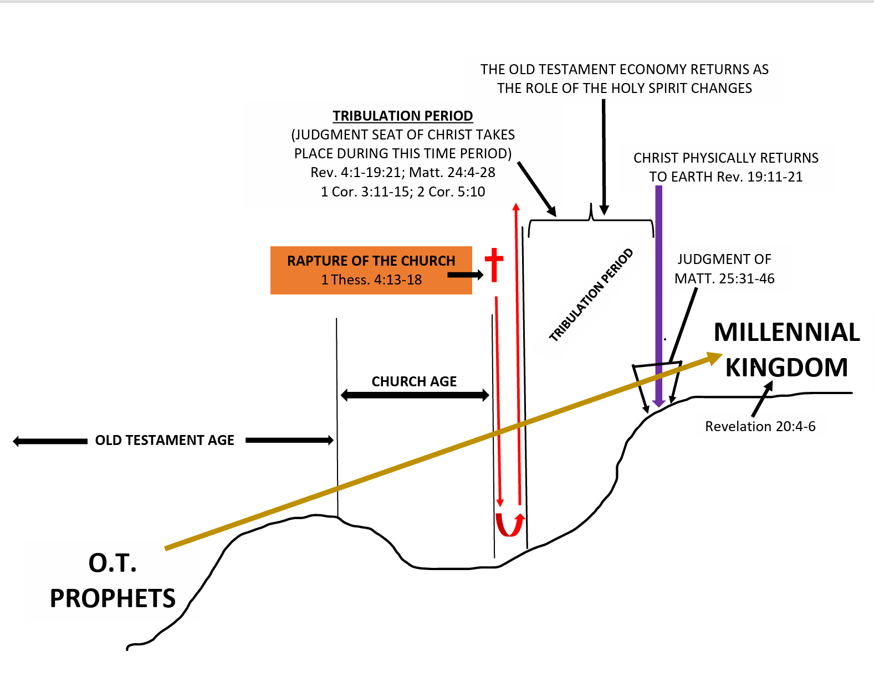

Slide 6
1 Thessalonians 4:16-17
“… And the dead in Christ will rise first. Then we who are alive and remain shall be caught up together with them in the clouds to meet the Lord in the air …”.

Slide 8
Revelation 19:11-14
“Now I saw heaven opened, and behold, a white horse. And He who sat on him was called Faithful and True, and in righteousness He judges and makes war. His eyes were like a flame of fire, and on His head were many crowns. He had a

Slide 9
Revelation 19:11-14
name written that no one know except Himself. He was clothed with a robe dipped in blood, and His name is called The Word of God. And the armies in heaven, clothed in fine linen, white and clean, followed Him on white horses.”

Slide 10
“And the armies in heaven, clothed
In fine linen, white and clean,
followed Him on white horses.”

Slide 11
1 Corinthians 15:51-52
“Behold, I tell you a mystery: We shall not all sleep, but we shall all be changed – in a moment, in the twinkling of an eye …”.

Slide 12
1 Thessalonians 4:16-17
“… And the dead in Christ will rise first. Then we who are alive and remain shall be caught up together with them in the clouds to meet the Lord in the air. And thus we shall always be with the Lord.”

Slide 13
3 ½ years of tribulation
3 ½ years of peace

Slide 14
“Now out of His mouth goes a sharp sword, that with it He should strike the nations. And He Himself will rule them with a rod of iron. He Himself treads the winepress of the fierceness and wrath of Almighty God. And He has on His robe and on His thigh a name written: KING OF KINGS and LORD OF LORDS.”

Slide 15
“Now out of His mouth goes a sharp sword, that with it He should strike the nations. And He Himself will rule them with a rod of iron. He Himself treads the winepress of the fierceness and wrath of Almighty God. And He has on His robe and on His thigh a name written: KING OF KINGS and LORD OF LORDS.”
“And I saw thrones, and they sat on them, and judgment was
committed to them. Then I saw the souls of those who had
been beheaded for their witness to Jesus and for the word of
God, who had not worshipped the beast or His image, and had
not received his mark on their foreheads or on their hands.
And they lived and reigned with Christ for a thousand years.”

Slide 16
“Then I saw an angel coming down from heaven, having the key to the bottomless pit and a great chain in his hand. He laid hold of the dragon, that serpent of old, who is the Devil and Satan, and bound him for a thousand years; and he cast Him into the bottomless pit, and shut him up, and set a seal on him, so that he should deceive the nations no more till the thousand years were finished. But after these things he must be released for a little while.”

Slide 17
1 Thessalonians 4:18
“Therefore comfort one another with these words.”

