Slide 1
First Thessalonians

Slide 2
1 Thessalonians 4:13-18
“But I do not want you to be ignorant, brethren, concerning those who have fallen asleep, lest you sorrow as others who have no hope. For if we believe that Jesus died and rose again, even so God will bring with Him those who sleep in Jesus. For this we say to you by the word of the Lord, that we who are alive and remain until the coming of the Lord will by no means precede those who are asleep. For the Lord Himself will

Slide 3
1 Thessalonians 4:13-18
descend from heaven with a shout, with the voice of an archangel, and with the trumpet of God. And the dead in Christ will rise first. Then we who are alive and remain shall be caught up together with them in the clouds to meet the Lord in the air. And thus we shall always be with the Lord. Therefore comfort one another with these words.”

Slide 4
The Old Testament has a lot of
prophecy concerning the Messiah
the Jews expected.

Slide 5
The Old Testament has a lot of
prophecy concerning the Messiah
the Jews expected.
Paul used these prophecies along with the fact of Jesus’ resurrection to prove that Jesus indeed was the Messiah.

Slide 6
We also see prophecies in the Old
Testament regarding what will
be taking place in the end times …
i.e., what will take place during
the 2nd Advent of Christ.

Slide 7
Genesis 12:1-3
“Now the Lord had said to Abram: “Get out of your country, from your family and from your father’s house, to a land that I will show you. I will make you a great nation; I will bless you and make your name great; and you shall be a blessing. I will bless those who bless you, and I will curse him who curses you; and in you all the families of the earth shall be blessed.”

Slide 8
2 Samuel 7:12-13
“When your days are fulfilled and you rest with your fathers, I will set up your seed after you, who will come from your body, and I will establish his kingdom. He shall build a house for My name, and I will establish the throne of his kingdom forever.”

Slide 9
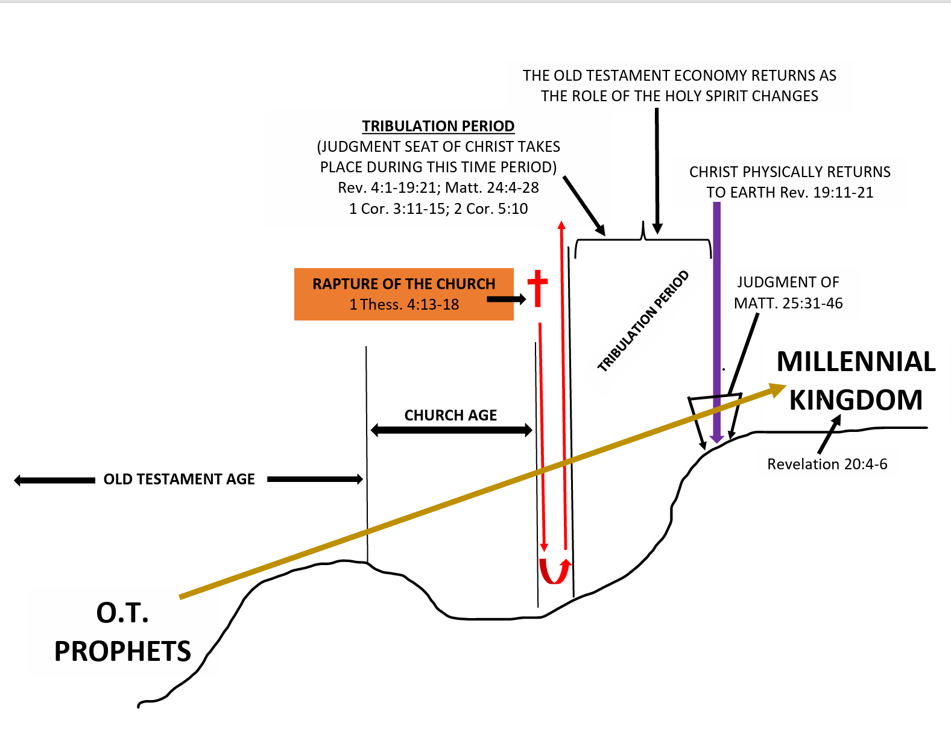

Slide 10
Luke 1:30-33
“Then the angel said to her, “Do not be afraid, Mary, for you have found favor with God. And behold, you will conceive in your womb and bring forth a Son, and shall call His name Jesus. He will be great, and will be called the Son of the Highest; and the Lord God will give Him the throne of His father David. And He will reign over the house of Jacob forever, and of His kingdom there will be no end.”

Slide 11
Some dates of the earliest Scripture writings:
James … 35 to 50 A.D.
Galatians … 49 A.D.
John’s Gospel … 40 to 49 A.D.? Or 85 to 90 A.D.?
1 Thessalonians … 51 A.D.

Slide 12
Some dates of the earliest Scripture writings:
James … 35 to 50 A.D.
Galatians … 49 A.D.
John’s Gospel … 40 to 49 A.D.? Or 85 to 90 A.D.?
1 Thessalonians … 51 A.D.
Prophetic teaching on the Rapture must have been given orally prior to Paul’s writing of First Thessalonians

Slide 13
1 Thessalonians 4:13-14
“But I do not want you to be ignorant, brethren, concerning those who have fallen asleep, lest you sorrow as others who have no hope. For if we believe that Jesus died and rose again, even so God will bring with Him those who sleep in Jesus.”

Slide 14
Ephesians 3:1-7
“For this reason I, Paul, the prisoner of Christ Jesus for you Gentiles – if indeed you have heard of the dispensation of the grace of God which was given to me for you, how that by revelation He made known to me the mystery (as I have briefly written already, by which, when you read, you may understand my knowledge in the mystery of Christ),

Slide 15
Ephesians 3:1-7
which in other ages was not made known to the sons of men, as it has now been revealed by the Spirit to His holy apostles and prophets: that the Gentiles should be fellow heirs, of the same body, and partakers of His promise in Christ through the gospel, of which I became a minister according to the gift of the grace of God given to me by the effective working of His power.”

Slide 16
Ephesians 3:1-7
which in other ages was not made known to the sons of men, as it has now been revealed by the Spirit to His holy apostles and prophets: that the Gentiles should be fellow heirs, of the same body, and partakers of His promise in Christ through the gospel, of which I became a minister according to the gift of the grace of God given to me by the effective working of His power.”

Slide 17
Ephesians 3:1-7
which in other ages was not made known to the sons of men, as it has now been revealed by the Spirit to His holy apostles and prophets: that the Gentiles should be fellow heirs, of the same body, and partakers of His promise in Christ through the gospel, of which I became a minister according to the gift of the grace of God given to me by the effective working of His power.”

Slide 18
Romans 11:16-18
“For if the firstfruit is holy, the lump is also holy; and if the root is holy, so are the branches. And if some of the branches were broken off, and you, being a wild olive tree, were grafted in among them, and with them became a partaker of the root and fatness of the olive tree, do not boast against the branches. But if you do boast, remember that you do not support the root, but the root supports you.”

Slide 19
Romans 11:25-27
“For I do not desire, brethren, that you should be ignorant of this mystery, lest you should be wise in your own opinion, that blindness in part has happened to Israel until the fullness of the Gentiles has come in. And so all Israel will be saved, as it is written: “The Deliverer will come out of Zion, and He will turn away ungodliness from Jacob; for this is My covenant with them, when I take away their sins.”

Slide 20
1 Thessalonians 4:13-18
“But I do not want you to be ignorant, brethren, concerning those who have fallen asleep, lest you sorrow as others who have no hope. For if we believe that Jesus died and rose again, even so God will bring with Him those who sleep in Jesus. For this we say to you by the word of the Lord, that we who are alive and remain until the coming of the Lord will by no means precede those who are asleep. For the Lord Himself will

Slide 21
Galatians 1:11-12
“But I make known to you, brethren, that the gospel which was preached by me is not according to man. For I neither received it from man, nor was I taught it, but it came through the revelation of Jesus Christ.”

Slide 22
Galatians 1:15-17
“But when it pleased God, who separated me from my mother’s womb and called me through His grace, to reveal His Son in me, that I might preach Him among the Gentiles, I did not immediately confer with flesh and blood, nor did I go up to Jerusalem to those who were apostles before me; but I went to Arabia, and returned again to Damascus.”

Slide 23
Galatians 1:18-19
“Then after three years I went up to Jerusalem to see Peter, and remained with him fifteen days. But I saw none of the other apostles except James, the Lord’s brother.”

Slide 24
Matthew 23:37-39
“O Jerusalem, Jerusalem, the one who kills the prophets and stones those who are sent to her! How often I wanted to gather your children together, as a hen gathers her chicks under her wings, but you were not willing! See! Your house is left to you desolate; for I say to you, you shall see Me no more till you say, ‘Blessed is He who comes in the name of the Lord!’”

Slide 25
Matthew 24:1-3
“Then Jesus went out and departed from the temple, and His disciples came up to show Him the buildings of the temple. And Jesus said to them, “Do you not see all these things? Assuredly, I say to you, not one stone shall be left here upon another, that shall not be thrown down.”

Slide 26
Matthew 24:1-3
Now as He sat on the Mount of Olives, the disciples came to Him privately, saying, “Tell us, when will these things be? And what will be the sign of Your coming, and of the end of the age?”

Slide 27
Matthew 26:1-2
“Now it came to pass, when Jesus had finished all these sayings, that He said to His disciples, “You know that after two days is the Passover, and the Son of Man will be delivered up to be crucified.”

Slide 28
John 13:31-33
“Now the Son of Man is glorified, and God is glorified in Him. If God is glorified in Him, God will also glorify Him in Himself, and glorify Him immediately. Little children, I shall be with you a little while longer. You will seek Me; and as I said to the Jews, ‘Where I am going, you cannot come,’ so now I say to you.”

Slide 29
John 13:36
“Lord, where are You going?” Jesus answered him, “Where I am going you cannot follow Me now, but you shall follow Me afterward.”

Slide 30
John 14:1-3
“Let not your heart be troubled; you believe in God, believe also in Me. In My Father’s house are many mansions; if it were not so, I would have told you. I go to prepare a place for you. And if I go and prepare a place for you, I will come again and receive you to Myself; that where I am, there you may be also.”

Slide 31
1 Corinthians 15:51-58
“Behold, I tell you a mystery: We shall not all sleep, but we shall all be changed – in a moment, in the twinkling of an eye, at the last trumpet. For the trumpet will sound, and the dead will be raised incorruptible, and we shall be changed. For this corruptible must put on incorruption, and this mortal must put on immortality.

Slide 32
1 Corinthians 15:51-58
So when this corruptible has put on incorruption, and this mortal has put on immortality, then shall be brought to pass the saying that is written: “Death is swallowed up in victory.” “O Death, where is your sting? O Hades, where is your victory?” The sting of death is sin, and the strength of sin is the law.

Slide 33
1 Corinthians 15:51-58
But thanks be to God, who gives us the victory through our Lord Jesus Christ. Therefore, my beloved brethren, be steadfast, immovable, always abounding in the work of the Lord, knowing that your labor is not in vain in the Lord.”

Slide 34
1 Corinthians 15:51-58
“Behold, I tell you a mystery: We shall not all sleep, but we shall all be changed – in a moment, in the twinkling of an eye, at the last trumpet. For the trumpet will sound, and the dead will be raised incorruptible, and we shall be changed. For this corruptible must put on incorruption, and this mortal must put on immortality.

Slide 35
1 Corinthians 15:51-58
“Behold, I tell you a mystery: We shall not all sleep, but we shall all be changed – in a moment, in the twinkling of an eye, at the last trumpet. For the trumpet will sound, and the dead will be raised incorruptible, and we shall be changed. For this corruptible must put on incorruption, and this mortal must put on immortality.

Slide 37
“Are we living our lives in such a way that we wouldn’t be embarrassed if He found us living the way we are living?”

Slide 38
“Are we living our lives in such a way that we wouldn’t be embarrassed if He found us living the way we are living?”
“Do we want to be found ‘blameless in holiness’ before our God and Father at the coming of our Lord Jesus Christ with all His saints?”

