Slide 1
First Thessalonians

Slide 2
Acts 17:1-3
“Now when they had passed through Amphipolis and Apollonia, they came to Thessalonica, where there was a synagogue of the Jews. Then Paul, as his custom was, went in to them, and for three Sabbaths reasoned with them from the Scriptures, explaining and demonstrating that the Christ had to suffer and rise again from the dead, and saying, “This Jesus whom I preach to you is the Christ.”

Slide 3
Acts 17:1-3
“Now when they had passed through Amphipolis and Apollonia, they came to Thessalonica, where there was a synagogue of the Jews. Then Paul, as his custom was, went in to them, and for three Sabbaths reasoned with them from the Scriptures, explaining and demonstrating that the Christ had to suffer and rise again from the dead, and saying, “This Jesus whom I preach to you is the Christ.”

Slide 4
Acts 17:1-3
“Now when they had passed through Amphipolis and Apollonia, they came to Thessalonica, where there was a synagogue of the Jews. Then Paul, as his custom was, went in to them, and for three Sabbaths reasoned with them from the Scriptures, explaining and demonstrating that the Christ had to suffer and rise again from the dead, and saying, “This Jesus whom I preach to you is the Christ.”

Slide 5
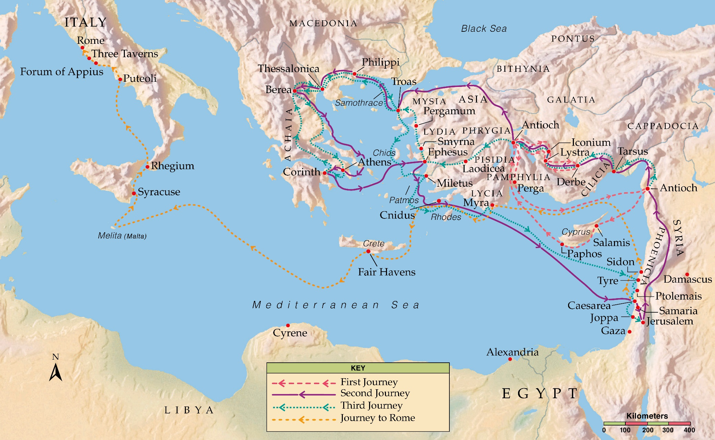

Slide 6
Acts 17:1-3
“Now when they had passed through Amphipolis and Apollonia, they came to Thessalonica, where there was a synagogue of the Jews. Then Paul, as his custom was, went in to them, and for three Sabbaths reasoned with them from the Scriptures, explaining and demonstrating that the Christ had to suffer and rise again from the dead, and saying, “This Jesus whom I preach to you is the Christ.”

Slide 7
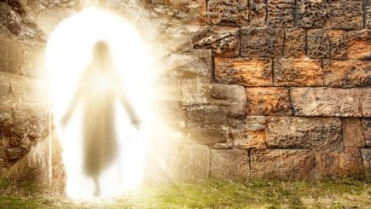

Slide 8
1 Thessalonians 4:7
“For God did not call us to uncleanness, but in holiness.”

Slide 9
1 Thessalonians 4:11
“… that you also aspire to lead a quiet life, to mind your own business, and to work with your own hands, as we commanded you.”

Slide 10
1 Thessalonians 3:1-2
“Therefore, when we could no longer endure it, we thought it good to be left in Athens alone, and sent Timothy, our brother and minister of God, and our fellow laborer in the gospel of Christ, to establish you and encourage you concerning your faith …”.

Slide 11
1 Thessalonians 4:13-18
“But I do not want you to be ignorant, brethren, concerning those who have fallen asleep, lest you sorrow as others who have no hope. For if we believe that Jesus died and rose again, even so God will bring with Him those who sleep in Jesus. For this we say to you by the

Slide 12
1 Thessalonians 4:13-18
word of the Lord, that we who are alive and remain until the coming of the Lord will by no means precede those who are asleep. For the Lord Himself will descend from heaven with a shout, with the voice of an archangel, and with the trumpet of God. And the dead in Christ

Slide 13
1 Thessalonians 4:13-18
will rise first. Then we who are alive and remain shall be caught up together with them in the clouds to meet the Lord in the air. And thus we shall always be with the Lord. Therefore comfort one another with these words.”

Slide 14
1 Thessalonians 4:13-14
“But I do not want you to be ignorant, brethren, concerning those who have fallen asleep, lest you sorrow as others who have no hope. For if we believe that Jesus died and rose again, even so God will bring with Him those who sleep in Jesus.”

Slide 15
The “meat of the Word” = prophetic teaching and more complex doctrine
The “milk of the Word” = the basic message of Life – belief in Jesus for everlasting life

Slide 16
The Thessalonian believers thought that their believing friends that already died would miss out on the resurrection and participation in the Millennial Kingdom.

Slide 17
1 Thessalonians 4:13-14
“But I do not want you to be ignorant, brethren, concerning those who have fallen asleep, lest you sorrow as others who have no hope. For if we believe that Jesus died and rose again, even so God will bring with Him those who sleep in Jesus.”

Slide 18
1 Thessalonians 4:13-14
“But I do not want you to be ignorant, brethren, concerning those who have fallen asleep, lest you sorrow as others who have no hope. For if we believe that Jesus died and rose again, even so God will bring with Him those who sleep in Jesus.”

Slide 19
Matthew 27:51-52
“Then, behold, the veil of the temple was torn in two from top to bottom; and the earth quaked, and the rocks were split, and the graves were opened; and many bodies of the saints who had fallen asleep were raised; and coming out of the graves after His resurrection, they went into the holy city and appeared to many.”

Slide 20
John 11:11-15
“These things He said, and after that He said to them, “Our friend Lazarus sleeps, but I go that I may wake him up.” Then His disciples said, “Lord, if he sleeps he will get well.” However, Jesus spoke of his death, but they thought that He was

Slide 21
John 11:11-15
speaking about taking rest in sleep. Then Jesus said to them plainly, “Lazarus is dead. And I am glad for your sakes that I was not there, that you may believe. Nevertheless let us go to him.”

Slide 22
John 11:35
“Jesus wept.”

Slide 23
2 Corinthians 5:8
“We are confident, yes, well pleased rather to be absent from the body and to be present with the Lord.”

Slide 24
2 Corinthians 5:21
“For He made Him who knew no sin to be sin for us, that we might become the righteousness of God in Him.”

Slide 25
1 Thessalonians 1:9-10
“For they themselves declare concerning us what manner of entry we had to you, and how you turned to God from idols to serve the living and true God, and to wait for His Son from heaven, whom He raised from the dead, even Jesus who delivers us from the wrath to come.”

Slide 26
1 Thessalonians 4:13-14
“But I do not want you to be ignorant, brethren, concerning those who have fallen asleep, lest you sorrow as others who have no hope. For if we believe that Jesus died and rose again, even so God will bring with Him those who sleep in Jesus.”

Slide 27
We can be thankful for what the Lord Jesus Christ has done for us – that our eternal salvation isn’t dependent upon what do, but in what He has already done for us.

