Slide 1
Those who carry us…..
Don’t strive to be a person of importance, but rather one of value.

Slide 2
Charles Schulz Quiz (credit to Jamie Phillips!)
Name the 5 wealthiest people in the world.
Name the last 5 Heisman trophy winners
Name 10 Nobel Prize winners
Name the last 10 Academy Award actor/actresses
Name the last 10 World Series winners
How did you do? These are not second-rate accomplishments; they are the very best in their respective fields!

Slide 3
Let’s see who is really important to us:
Let’s try this one:
List 2 teachers who aided you through school.
Name 3 people who have taught you something worthwhile
Name 4 friends that have helped you through difficult times
Name 5 people who you look up to for their faith in the Lord
Much easier, right? The people who make a difference in our life aren’t the ones with the awards, the credentials, the money. Simply put, they are the ones who care the most.
A man named John……..

Slide 4
Luke 5:17-26
¹⁷ Now it happened on a certain day, as He was teaching, that there were Pharisees and teachers of the law sitting by, who had come out of every town of Galilee, Judea, and Jerusalem. And the power of the Lord was present ^{[c]}to heal them. ¹⁸ Then behold, men brought on a bed a man who was paralyzed, whom they sought to bring in and lay before Him. ¹⁹ And when they could not find how they might bring him in, because of the crowd, they went up on the housetop and let him down with his bed through the tiling into the midst before Jesus.
²⁰ When He saw their faith, He said to him, “Man, your sins are forgiven you.”
²¹ And the scribes and the Pharisees began to reason, saying, “Who is this who speaks blasphemies? Who can forgive sins but God alone?”
²² But when Jesus perceived their thoughts, He answered and said to them, “Why are you reasoning in your hearts? ²³ Which is easier, to say, ‘Your sins are forgiven you,’ or to say, ‘Rise up and walk’? ²⁴ But that you may know that the Son of Man has power on earth to forgive sins”—He said to the man who was paralyzed, “I say to you, arise, take up your bed, and go to your house.”
²⁵ Immediately he rose up before them, took up what he had been lying on, and departed to his own house, glorifying God. ²⁶ And they were all amazed, and they glorified God and were filled with fear, saying, “We have seen strange things today!”

Slide 5
The ‘certain day’ that we meet His Power
¹⁷ Now it happened on a certain day,
as He was teaching, that there were Pharisees and teachers of the law sitting by, who had come out of every town of Galilee, Judea, and Jerusalem. And the power of the Lord was present ^{[c]}to heal them.

Slide 6
The power of they……
¹⁸ Then behold, men brought on a bed a man who was paralyzed, whom they sought to bring in and lay before Him. ¹⁹ And when they could not find how they might bring him in, because of the crowd, they went up on the housetop and let him down with his bed through the tiling into the midst before Jesus.

Slide 7
1 John 3:16-18
¹⁶ By this we know love, because He laid down His life for us. And we also ought to lay down our lives for the brethren. ¹⁷ But whoever has this world’s goods, and sees his brother in need, and shuts up his heart from him, how does the love of God abide in him?
¹⁸ My little children, let us not love in word or in tongue, but in deed and in truth.
We _____________ doesn’t mean we ___________, allow me to self examine:

Slide 8
E.H.E.H.S. (Gee, thanks Dallas)

Slide 9
Earlier in the chapter, we see Him doing the big miracles, here we see Him at work in the life of an individual!
²⁰ When He saw their faith, He said to him “Man, your sins are forgiven you.”

Slide 10
Jesus didn’t come to start a religion; He came to set His people free from religion!
²¹ And the scribes and the Pharisees began to reason, saying, “Who is this who speaks blasphemies? Who can forgive sins but God alone?”
²² But when Jesus perceived their thoughts, He answered and said to them, “Why are you reasoning in your hearts? ²³ Which is easier, to say, ‘Your sins are forgiven you,’ or to say, ‘Rise up and walk’?

Slide 11
For God sent His Son…..
²⁴ But that you may know that the Son of Man has power on earth to forgive sins”

Slide 12
A clear example is found in John 9:1-3
Now as Jesus passed by, He saw a man who was blind from birth. ² And His disciples asked Him, saying, “Rabbi, who sinned, this man or his parents, that he was born blind?”
³ Jesus answered, “Neither this man nor his parents sinned, but that the works of God should be revealed in him.”

Slide 13
John 9:5
^{5 ”}As long as I am in the world, I am the light of the world.”
He is STILL shining His light in the world, through you!
Your brokenness is a better bridge for people than our pretend wholeness ever was!

Slide 14
Couch potato or ministry partner?
—He said to the man who was paralyzed, “I say to you, arise, take up your bed, and go to your house.”
²⁵ Immediately he rose up before them, took up what he had been lying on, and departed to his own house, glorifying God.

Slide 15
Psalm 40:9-10 If they don’t hear it from us, who will they hear it from??
I have proclaimed the good news of righteousness In the great assembly; Indeed, I do not restrain my lips, O Lord, You Yourself know. ¹⁰ I have not hidden Your righteousness within my heart; I have declared Your faithfulness and Your salvation; I have not concealed Your lovingkindness and Your truth From the great assembly.

Slide 16
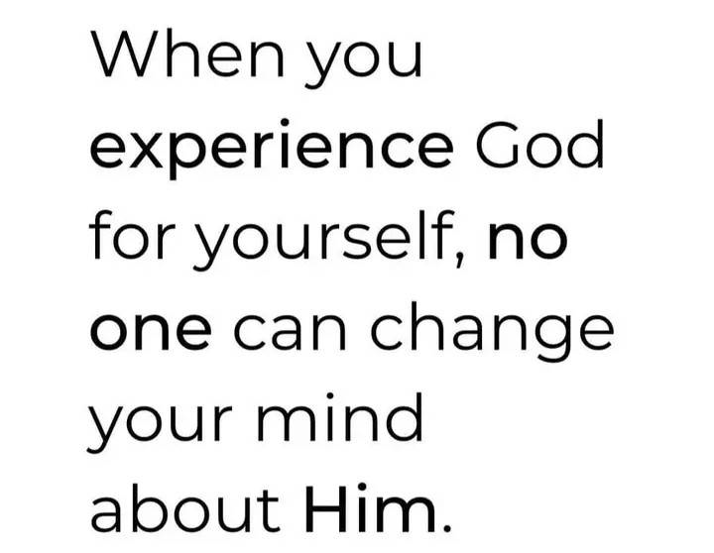
Was the paralytic an example of Conviction or Compromise?
²⁶ And they were all amazed, and they glorified God and were filled with fear, saying, “We have seen strange things today!”

Slide 17
The spiritually lame are made to walk again
Buffalo, Wyoming Newspaper, the Buffalo Bulletin, posted this advertisement in the Lost & Found: “Lost on Goose Creek, one prosthetic leg. Reward if found.”
????????????????????????????????????????????????????????????????????????????????????????????????????????????????????????????????????????????????????????????????????????????????????????????????????????????????????????????????????????????????????!!!!!!!!!!!!!!!!!!!!!!!!!!!!!!!!!!!!!!!!!!!!!!!!!!!!!!!!!!!!!

Slide 18
Agape love, love in action. Christ didn’t preach to the guy; He went to work! Heaven is our home, we’re all still here recruiting! CVCC is a driving force in reaching others for Christ!

Slide 19
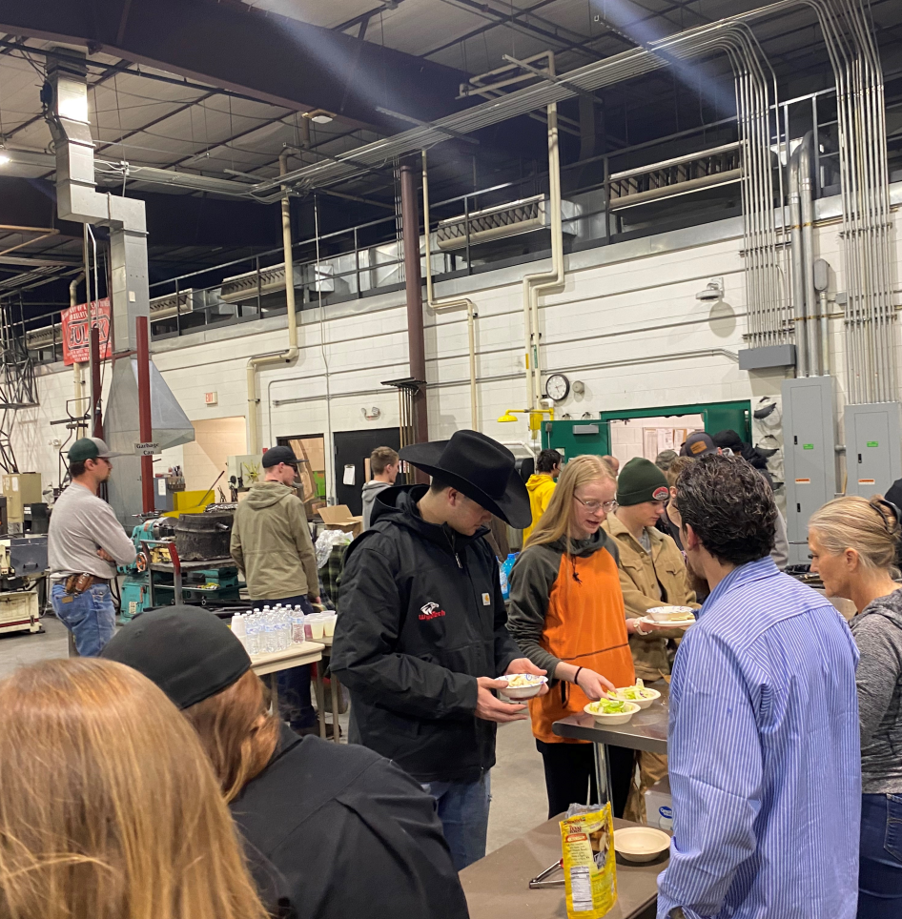
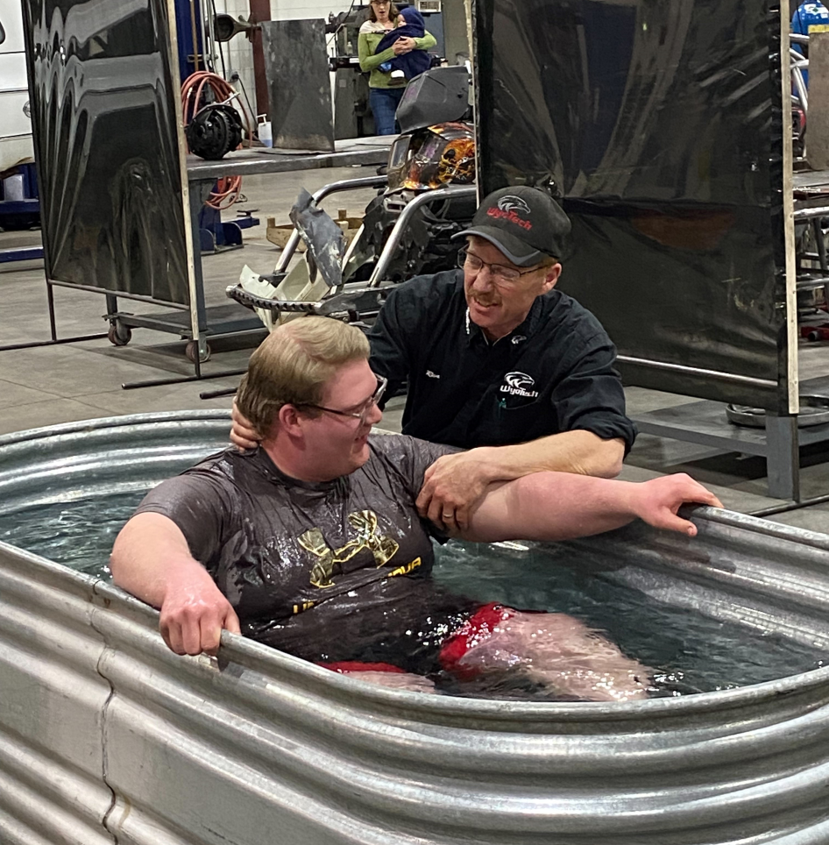
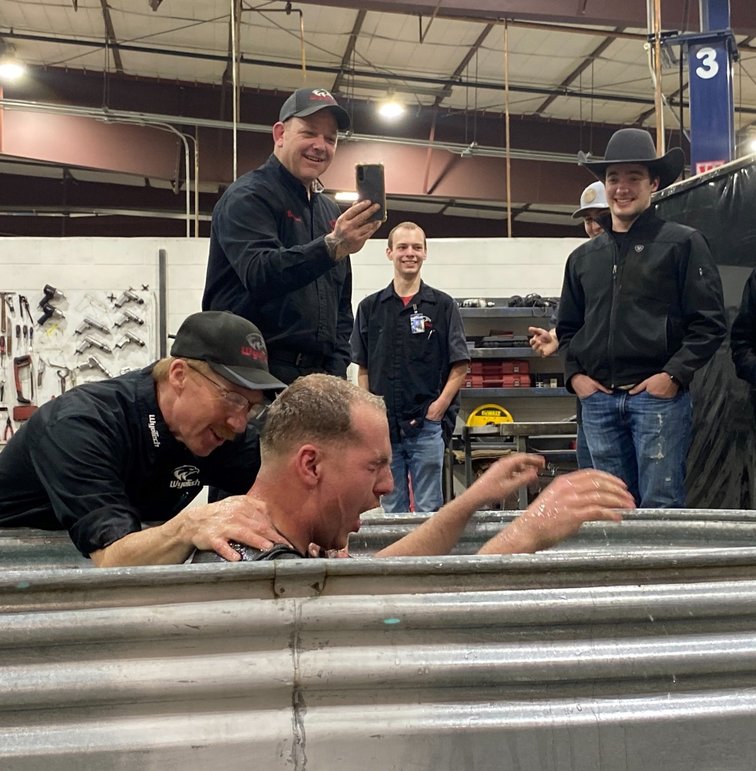
These are the faces that you support, those that you carry to Jesus!
You are changing lives every week, often changing eternities!

Slide 20
The paralytic’s walk was changed by Christ, is mine?

Slide 21
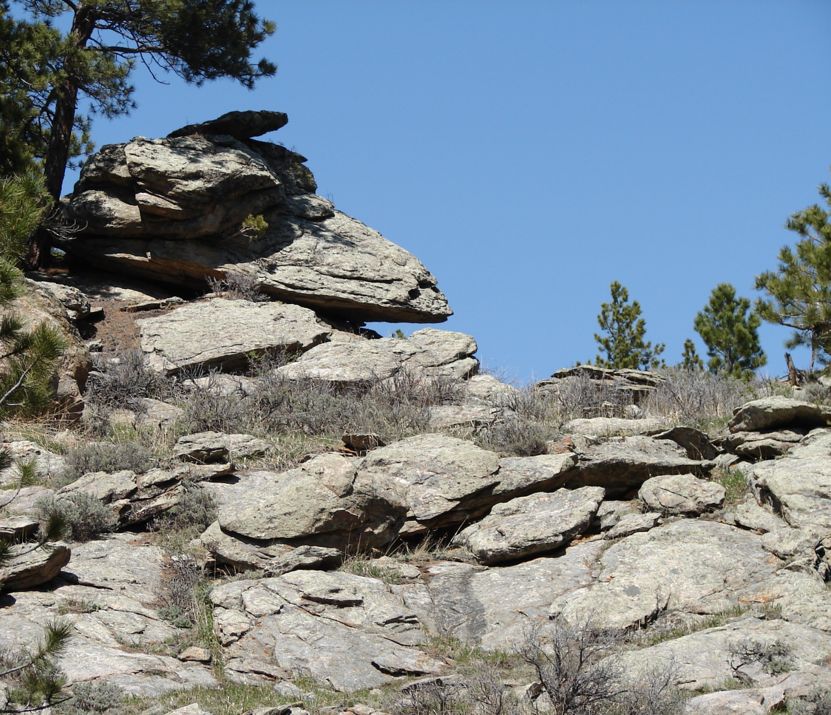
Margaret Sloan Kirby Wilson Shannon Schreyer

Slide 22
To whom it may concern:
2 Corinthians 3:2-3 “You are our epistle written in our hearts, known and read by all men; ³ clearly you are an epistle of Christ, ministered by us, written not with ink but by the Spirit of the living God, not on tablets of stone but on tablets of flesh, that is, of the heart.”
You. Me. Us.
We are the modern world’s ‘they’ that Luke wrote about. Will we be those who watched, or will we emulate the paralyzed mans friends who saw a need, knew of a Healer, and went? To repeat, I know what I’ll do for an elk, what will I do for a friend, a brother in Christ or perhaps more importantly, one who does not yet know Him?

Slide 23
When we meet Jesus, I pray that there are those waiting who will introduce us to Him, telling Him that “When I needed it most, they went to You for me.”

