Slide 1
First Thessalonians

Slide 2
1 Thessalonians 4:3
“For this is the will of God, your sanctification: that you should abstain from sexual immorality …”.

Slide 3
“We live in a world where sexual temptation is more readily accessible than at any other time in history. When I was a young man, it wasn’t nearly as easy to view pornography as it is now. Then, you had to deliberately search it out, often in sleazy stores where you wouldn’t want to be caught dead. Now, it just takes a few clicks on your smartphone. In 1988, before the internet or smartphones

Slide 4
existed, Leadership journal (Winter, 1988, p. 24) did a survey on sex and the American clergy. Of the pastors responding to the survey, 20 percent said that they looked at sexually oriented print, video, or movies at least once a month! And 38 percent of these pastors said they find themselves fantasizing about sex with someone other than their spouse at least once a month. The same

Slide 5
survey found that 12 percent of pastors admitted to committing adultery since entering local church ministry! Leadership asked the same questions of readers of Christianity Today magazine who were not pastors. The incidences of immorality were nearly double, with 23 percent admitting to extramarital sex (p. 12)! More than a decade ago, Al Mohler wrote (cited without reference

Slide 6
by Ligon Duncan in a sermon on Ephesians 5:3, June 4, 2006, at: fpcjackson.org/resources/sermons/Ephesians): ‘The statistics are truly frightening. According to industry studies, 70% percent of 18-24 year old men visit pornographic sites in a typical month. These young men represent something like one-fourth of all visitors to pornographic sites on the internet. The next

Slide 7
largest group of users are young men in their 20’s and 30’s, 66% of whom report being regular users of pornography …. Today the average teenage boy is likely to have seen thousands of explicit sexual images, ranging across the spectrum of sexualities and perversions. Many of these boys and young men are driven by sexual fantasies that previous generations of young men would not

Slide 8
have even known existed …. Today Americans rent more than 800 million pornographic videos and DVD’s every year. About 20% of all video rentals are pornographic. At least 11,000 pornographic videos are produced annually, amounting to revenue for the adult film industry estimated at between 5 and 10 billion dollars a year.’”
bible.org website

Slide 9
“Of course, with the invention of the smartphone, those statistics are probably not nearly as high as they would be now. And if you think that Christian men are exempt from this temptation, you’re not in touch with reality. It is a huge problem in the evangelical church! And I’ve read that the problem exists among Christian women, also.” bible.org website

Slide 10
Ecclesiastes 1:9
“That which has been is what will be, That which is done is what will be done, And there is nothing new under the sun.”

Slide 11
1 Thessalonians 4:7
“For God did not call us to uncleanness, but in holiness.”

Slide 12
1 Thessalonians 4:8
“Therefore he who rejects this does not reject man, but God, who has also given us His Holy Spirit.”

Slide 13
1 Thessalonians 4:7
“For God did not call us to uncleanness, but in holiness.”

Slide 14
1 Thessalonians 4:7
“For God did not call us to uncleanness, but in holiness.”
1 Thessalonians 4:8
“Therefore he who rejects this does not reject man, but God, who has also given us His Holy Spirit.”

Slide 15
1 Thessalonians 4:7
“For God did not call us to uncleanness, but in holiness.”
1 Thessalonians 4:8
“Therefore he who rejects this does not reject man, but God, who has also given us His Holy Spirit.”

Slide 16
1 Thessalonians 4:7
“For God did not call us to uncleanness, but in holiness.”
1 Thessalonians 4:8
“Therefore he who rejects this does not reject man, but God, who has also given us His Holy Spirit.”

Slide 17
1 Thessalonians 4:9-10
“But concerning brotherly love you have no need that I should write to you, for you yourselves are taught by God to love one another; and indeed you do so toward all the brethren who are in all Macedonia.”

Slide 18
1 Thessalonians 4:9-10
“But concerning brotherly love you have no need that I should write to you, for you yourselves are taught by God to love one another; and indeed you do so toward all the brethren who are in all Macedonia.”

Slide 19
1 Thessalonians 4:9-12
“But concerning brotherly love you have no need that I should write to you, for you yourselves are taught by God to love one another; and indeed you do so toward all the brethren who are in all Macedonia. But we urge you, brethren,

Slide 20
1 Thessalonians 4:9-12
that you increase more and more; that you also aspire to lead a quiet life, to mind your own business, and to work with your own hands, as we commanded you, that you may walk properly toward those who are outside, and that you may lack nothing.”

Slide 21
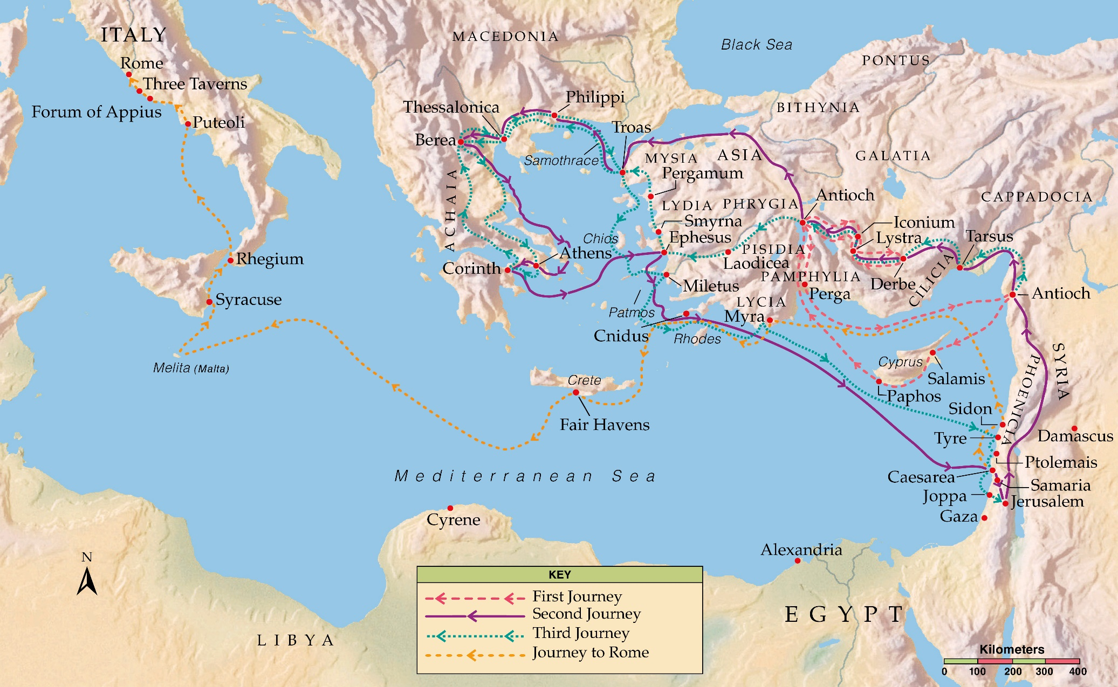

Slide 22
James 2:15-16
“If a brother or sister is naked and destitute of daily food, and one of you says to them, “Depart in peace, be warmed and filled,” but you do not give them the things which are needed for the body, what does it profit?”

Slide 23
1 John 3:16-18
“By this we know love, because He laid down His life for us. And we also ought to lay down our lives for the brethren. But whoever has this world’s goods, and sees his brother in need, and shuts up his heart from him, how does the love of God abide in him? My little children, let us not love in word or in tongue, but in deed and in truth.”

Slide 24
“It is not enough to say nice things. It is not enough to tell someone he is being prayed for. It is not enough to smile and pat people on the back. Believers should actually give needed money, lift a hand, and provide needed help.”
The Grace New Testament Commentary

Slide 25
1 Thessalonians 4:10
“But we urge you, brethren, that you increase more and more …”.

Slide 26
1 Corinthians 10:11-12
“Now all these things happened to them as examples, and they were written for our admonition, upon whom the ends of the ages have come. Therefore let him who thinks he stands take heed lest he fall.”

Slide 27
1 Thessalonians 4:11
“… that you also aspire to lead a quiet life, to mind your own business, and to work with your own hands, as we commanded you …”.

Slide 28
“His words may reflect less than ideal conditions in their church.”
The Bible Knowledge Commentary

Slide 29
1 Thessalonians 4:11
“… that you also aspire to lead a quiet life, to mind your own business, and to work with your own hands, as we commanded you …”.

Slide 30
1 Timothy 2:1-4
“Therefore I exhort first of all that supplications, prayers, intercessions, and giving of thanks be made for all men, for kings and all who are in authority, that we may lead a quiet and peaceable life in all godliness and reverence. For this is good and acceptable in the sight of God our Savior, who desires all men to be saved and to come to the knowledge of the truth.”

Slide 31
1 Timothy 2:1-4
“Therefore I exhort first of all that supplications, prayers, intercessions, and giving of thanks be made for all men, for kings and all who are in authority, that we may lead a quiet and peaceable life in all godliness and reverence. For this is good and acceptable in the sight of God our Savior, who desires all men to be saved and to come to the knowledge of the truth.”

Slide 32
1 Timothy 2:1-4
“Therefore I exhort first of all that supplications, prayers, intercessions, and giving of thanks be made for all men, for kings and all who are in authority, that we may lead a quiet and peaceable life in all godliness and reverence. For this is good and acceptable in the sight of God our Savior, who desires all men to be saved and to come to the knowledge of the truth.”

Slide 33
1 Thessalonians 4:11
“… that you also aspire to lead a quiet life, to mind your own business, and to work with your own hands, as we commanded you …”.

Slide 34
2 Thessalonians 3:11
“For we hear that there are some who walk among you in a disorderly manner, not working at all, but are busybodies.”

Slide 35
Busybodies …
Thayer’s – “used apparently of a person officiously inquisitive about other’s affairs.”

Slide 36
Busybodies …
Thayer’s – “used apparently of a person officiously inquisitive about other’s affairs.”
Officiously – (Webster’s) “volunteering one’s services where they are neither asked nor needed.”

Slide 37
1 Peter 4:15
“But let none of you suffer as a murderer, a thief, an evildoer, or as a busybody in other people’s matters.”

Slide 38
Proverbs 25:17
“Seldom set foot in your neighbor’s house, lest he become weary of you and hate you.”

Slide 39
1 Thessalonians 4:11
“… that you also aspire to lead a quiet life, to mind your own business, and to work with your own hands, as we commanded you …”.

Slide 40
1 Thessalonians 2:9
“For you remember, brethren, our labor and toil; for laboring night and day, that we might not be a burden to any of you, we preached to you the gospel of God.”

Slide 41
1 Thessalonians 4:12
“… that you may walk properly toward those who are outside, and that you may lack nothing.”

Slide 42
1 Thessalonians 4:12
“… that you may walk properly toward those who are outside, and that you may lack nothing.”

Slide 43
2 Purposes to Paul’s Exhortations:

Slide 44
2 Purposes to Paul’s Exhortations:
His exhortations, if followed, will enable the believer to enjoy a closer relationship with Christ.

Slide 45
2 Purposes to Paul’s Exhortations:
His exhortations, if followed, will enable the believer to enjoy a closer relationship with Christ.
His exhortations always have in mind our testimony before an unbelieving world.

