Slide 1
Colossians

Slide 2
Colossians 3:16
“Let the word of Christ dwell in you richly in all wisdom, teaching and admonishing one another in psalms and hymns and spiritual songs, singing with grace in your hearts to the Lord.”

Slide 3
John 1:1, 14
“In the beginning was the Word, and the Word was with God, and the Word was God. … And the Word became flesh and dwelt among us, and we beheld His glory, the glory as of the only begotten of the Father, full of grace and truth.”

Slide 4
Colossians 3:16
“Let the word of Christ dwell in you richly in all wisdom, teaching and admonishing one another in psalms and hymns and spiritual songs, singing with grace in your hearts to the Lord.”

Slide 5
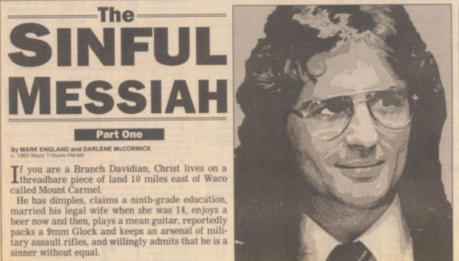
David Koresh and the Branch Davidians

Slide 6
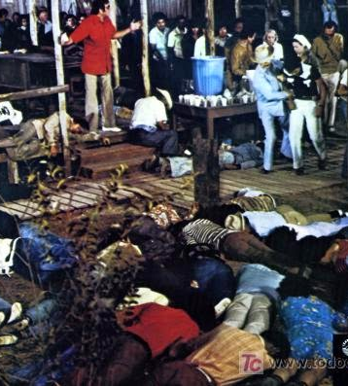

Slide 9
2 Timothy 3:16-17
“All Scripture is given by inspiration of God, and is profitable for doctrine, for reproof, for correction, for instruction in righteousness, that the man of God may be complete, thoroughly equipped for every good work.”

Slide 10
2 Timothy 3:16-17
“All Scripture is given by inspiration of God, and is profitable for doctrine, for reproof, for correction, for instruction in righteousness, that the man of God may be complete, thoroughly equipped for every good work.”
God
“Theos”

Slide 11
2 Timothy 3:16-17
“All Scripture is given by inspiration of God, and is profitable for doctrine, for reproof, for correction, for instruction in righteousness, that the man of God may be complete, thoroughly equipped for every good work.”
God
“Theopneustos”
“divinely breathed in”
God
“Theos”

Slide 12
Hebrews 4:12
“For the word of God is living and powerful, and sharper than any two-edged sword, piercing even to the division of soul and spirit, and of joints and marrow, and is a discerner of the thoughts and intents of the heart.”

Slide 13
Isaiah 55:11
“So shall My word be that goes forth from My mouth. It shall not return to Me void, but it shall accomplish what I please, and it shall prosper in the thing for which I sent it.”

Slide 14
Colossians 3:16
“Let the word of Christ dwell in you richly in all wisdom, teaching and admonishing one another in psalms and hymns and spiritual songs, singing with grace in your hearts to the Lord.”

Slide 15
Colossians 3:16
“Let the word of Christ dwell in you richly in all wisdom, teaching and admonishing one another in psalms and hymns and spiritual songs, singing with grace in your hearts to the Lord.”

Slide 16
“Richly”
Strong’s
“copiously: - abundantly, richly”
Thayer’s
“abundantly, richly”

Slide 17
“Copiously” (Webster’s)
“yielding something abundantly, plentiful in number.”

Slide 18
“Copiously” (Webster’s)
“yielding something abundantly, plentiful in number.”
“full of thought, information, or matter.”

Slide 19
Colossians 3:16
“Let the word of Christ dwell in you richly in all wisdom, teaching and admonishing one another in psalms and hymns and spiritual songs, singing with grace in your hearts to the Lord.”

Slide 20
“Wisdom”
Strong’s … “wisdom (higher or lower worldly or spiritual): - wisdom.”

Slide 21
“Wisdom”
Strong’s … “wisdom (higher or lower worldly or spiritual): - wisdom.”
Thayer’s … “wisdom, broad and full of intelligence; used of the knowledge of very diverse matters.”

Slide 22
“Wisdom”
Strong’s … “wisdom (higher or lower worldly or spiritual): - wisdom.”
Thayer’s … “wisdom, broad and full of intelligence; used of the knowledge of very diverse matters.”
a. the wisdom which belongs to men
b. supreme intelligence, such as belongs to God

Slide 23
Supreme intelligence, such as belongs to God
To Christ
the wisdom of God as evinced [to constitute outward evidence of, to display clearly] in forming and executing counsels in the formation and government of the world and the Scriptures.”

Slide 24
Supreme intelligence, such as belongs to God
To Christ
the wisdom of God as evinced [to constitute outward evidence of, to display clearly] in forming and executing counsels in the formation and government of the world and the Scriptures.”
Richly – “full of thought, information, or matter”

Slide 25
God’s plan of salvation is meant to be uncomplicated

Slide 26
God’s plan of salvation is meant to be uncomplicated
Salvation by grace alone, through faith alone, in Christ alone!

Slide 27
John 3:16
“For God so loved the world that He gave His only begotten Son, that whoever believes in Him should not perish but have everlasting life.”

Slide 28
John 5:24
“Most assuredly, I say to you, he who hears My word and believes in Him who sent Me has everlasting life, and shall not come into judgment, but has passed from death into life.”

Slide 29
John 6:47
“Most assuredly, I say to you, he who believes in Me has everlasting life.”

Slide 30
Belief in Christ for everlasting life is uncomplicated … but belief in Christ alone is not an easy thing to do, because it goes against every fiber of our being to do that.

Slide 31
Colossians 3:16
“Let the word of Christ dwell in you richly in all wisdom, teaching and admonishing one another in psalms and hymns and spiritual songs, singing with grace in your hearts to the Lord.”

Slide 32
Wisdom which belongs to men …

Slide 33
Wisdom which belongs to men …
Specifically, the varied knowledge of things human and divine, acquired by acuteness and experience, and summed up in maxims and proverbs

Slide 34
Wisdom which belongs to men …
Specifically, the varied knowledge of things human and divine, acquired by acuteness and experience, and summed up in maxims and proverbs
Skill in the management of affairs

Slide 35
Wisdom which belongs to men …
Specifically, the varied knowledge of things human and divine, acquired by acuteness and experience, and summed up in maxims and proverbs
Skill in the management of affairs
Devout and proper prudence in intercourse with men not disciples of Christ, skill and discretion in imparting Christian truth

Slide 36
Wisdom which belongs to men …
Specifically, the varied knowledge of things human and divine, acquired by acuteness and experience, and summed up in maxims and proverbs
Skill in the management of affairs
Devout and proper prudence in intercourse with men not disciples of Christ, skill and discretion in imparting Christian truth
The knowledge and practice of the requisites for godly and upright living

Slide 37
Wisdom which belongs to men …
Specifically, the varied knowledge of things human and divine, acquired by acuteness and experience, and summed up in maxims and proverbs

Slide 38
Wisdom which belongs to men …
Specifically, the varied knowledge of things human and divine, acquired by acuteness and experience, and summed up in maxims and proverbs

Slide 39
Psalm 37:4
“Delight yourself also in the Lord, and He shall give you the desires of your heart.”

Slide 40
Wisdom which belongs to men …
Specifically, the varied knowledge of things human and divine, acquired by acuteness and experience, and summed up in maxims and proverbs
“Wisdom is the application of knowledge”

Slide 41
Wisdom which belongs to men …
Specifically, the varied knowledge of things human and divine, acquired by acuteness and experience, and summed up in maxims and proverbs
Skill in the management of affairs

Slide 42
Wisdom which belongs to men …
Specifically, the varied knowledge of things human and divine, acquired by acuteness and experience, and summed up in maxims and proverbs
Skill in the management of affairs
Devout and proper prudence in intercourse with men not disciples of Christ, skill and discretion in imparting Christian truth

Slide 43
2 Timothy 2:15
“Be diligent to present yourself approved to God, a worker who does not need to be ashamed, rightly dividing the word of truth”

Slide 44
Wisdom which belongs to men …
Specifically, the varied knowledge of things human and divine, acquired by acuteness and experience, and summed up in maxims and proverbs
Skill in the management of affairs
Devout and proper prudence in intercourse with men not disciples of Christ, skill and discretion in imparting Christian truth

Slide 45
Explaining different doctrines

Slide 46
Explaining different doctrines
Differentiating between salvation truths and discipleship truths

Slide 47
Explaining different doctrines
Differentiating between salvation truths and discipleship truths
Teaching about future prophetic events

Slide 48
Explaining different doctrines
Differentiating between salvation truths and discipleship truths
Teaching about future prophetic events
Overcoming the influence of poor teaching and mistaken ideas formed over a lifetime

Slide 49
Explaining different doctrines
Differentiating between salvation truths and discipleship truths
Teaching about future prophetic events
Overcoming the influence of poor teaching and mistaken ideas formed over a lifetime
Defending our faith when skeptics and doubters confront us

Slide 50
Explaining different doctrines
Differentiating between salvation truths and discipleship truths
Teaching about future prophetic events
Overcoming the influence of poor teaching and mistaken ideas formed over a lifetime
Defending our faith when skeptics and doubters confront us
Discerning when to withhold spiritual truth

Slide 51
Matthew 7:6
“Do not give what is holy to the dogs; nor cast your pearls before swine, lest they trample them under their feet, and turn and tear you in pieces.”

Slide 52
Only the Gospel of John was written for the express purpose of leading men to Christ.
John 20:30-31 “And truly Jesus did many other signs in the presence of His disciples, which are not written in this book; but these are written that you may believe that Jesus is the Christ, the Son of God, and that believing you may have life in His name.”

Slide 53
Three overarching purposes of the NT

Slide 54
Three overarching purposes of the NT
For man to know who God is and see His infinite love for all of mankind in giving His Son as the Savior and Redeemer of the World.

Slide 55
Three overarching purposes of the NT
For man to know who God is and see His infinite love for all of mankind in giving His Son as the Savior and Redeemer of the World.
To show believers not only how to live for Christ but also how to treat their fellow man.

Slide 56
Three overarching purposes of the NT
For man to know who God is and see His infinite love for all of mankind in giving His Son as the Savior and Redeemer of the World.
To show believers not only how to live for Christ but also how to treat their fellow man.
To give believers all they need to know for their own and other’s spiritual growth.

Slide 57
Hebrews 5:12-14
“For though by this time you ought to be teachers, you need someone to teach you again the first principles of the oracles of God; and you have come to need milk and not solid food. For everyone who partakes only of milk is unskilled in the word of righteousness, for he is a babe. But solid food belongs to those who are full age, that is, those who by reason of use have their senses exercised to discern both good and evil.”

Slide 58
Wisdom which belongs to men …
Specifically, the varied knowledge of things human and divine, acquired by acuteness and experience, and summed up in maxims and proverbs
Skill in the management of affairs
Devout and proper prudence in intercourse with men not disciples of Christ, skill and discretion in imparting Christian truth
The knowledge and practice of the requisites for godly and upright living

Slide 59
The knowledge and practice of the requisites for godly and upright living

Slide 60
The knowledge and practice of the requisites for godly and upright living
Requisites – “needed for a particular purpose”

Slide 61
The knowledge and practice of the requisites for godly and upright living
Requisites – “needed for a particular purpose”
“Wisdom is the knowledge and practice of what is needed for godly and upright living.”

Slide 62
Colossians 3:16
“Let the word of Christ dwell in you richly in all wisdom, teaching and admonishing one another in psalms and hymns and spiritual songs, singing with grace in your hearts to the Lord.”
Full of thought, information, or matter

Slide 63
Romans 12:2
“And do not be conformed to this world, but be transformed by the renewing of your mind, that you may prove what is that good and acceptable and perfect will of God.”

