Slide 1
Colossians

Slide 2
Colossians 3:5-9
“Therefore put to death your members which are on the earth: fornication, uncleanness, passion, evil desire, and covetousness, which is idolatry. Because of these things the wrath of God is coming upon the sons of disobedience, in which you yourselves once walked when you lived in them. But now you yourselves are to put off all these: anger, wrath, malice, blasphemy, filthy language out of your mouth. Do not life to one another, since you have put off the old man with his deeds …”.

Slide 3
God’s Three Primary Concerns …

Slide 4
God’s Three Primary Concerns …
Loss of Fellowship with Him

Slide 5
Romans 6:20-23
“For when you were slaves of sin, you were free in regard to righteousness. What fruit did you have then in the things of which you are now ashamed? For the end of those things is death. But now having been set free from sin, and having become slaves of God, you have your fruit to holiness, and the end, everlasting life. For the wages of sin is death, but the gift of God is eternal life in Christ Jesus our Lord.”

Slide 6
Romans 6:20-23
“For when you were slaves of sin, you were free in regard to righteousness. What fruit did you have then in the things of which you are now ashamed? For the end of those things is death. But now having been set free from sin, and having become slaves of God, you have your fruit to holiness, and the end, everlasting life. For the wages of sin is death, but the gift of God is eternal life in Christ Jesus our Lord.”

Slide 7
When unbelievers physically die, their death will become eternal.

Slide 8
When unbelievers physically die, their death will become eternal.
Before the unbeliever physically dies, he has a present experience of death when he sins.

Slide 9
Believers also have a present experience of death when they sin.

Slide 10
“While disobedient believers can live experiencing death [separation], this is always an unnatural Christian experience, which is Paul’s point contextually. He contrasts this living death with what Christians should experience: everlasting life.” … “Everlasting life does not begin when a believer dies, but when he first believes, and some of the benefits and blessings of everlasting life can be enjoyed and experienced now by the believer who obeys God.”

Slide 11
Believers also have a present experience of death (separation) when they sin.
The believer that obeys God enjoys fellowship with Him – no separation.

Slide 12
Romans 6:20-23
“For when you were slaves of sin, you were free in regard to righteousness. What fruit did you have then in the things of which you are now ashamed? For the end of those things is death. But now having been set free from sin, and having become slaves of God, you have your fruit to holiness, and the end, everlasting life. For the wages of sin is death, but the gift of God is eternal life in Christ Jesus our Lord.”

Slide 13
The two options for a believer …
Choosing sin leads to experiencing present-tense death
Choosing to obey God results in the present-tense experience of eternal life.

Slide 14
Romans 6:20-23
“For when you were slaves of sin, you were free in regard to righteousness. What fruit did you have then in the things of which you are now ashamed? For the end of those things is death. But now having been set free from sin, and having become slaves of God, you have your fruit to holiness, and the end, everlasting life. For the wages of sin is death, but the gift of God is eternal life in Christ Jesus our Lord.”

Slide 15
1 John 1:6
“If we say that we have fellowship with Him, and walk in darkness, we lie and do not practice the truth.”

Slide 16
1 John 1:6
“If we say that we have fellowship with Him, and walk in darkness, we lie and do not practice the truth.”
verse 7
“But if we walk in the light as He is in the light, we have fellowship with one another, and the blood of Jesus Christ His Son cleanses us from all sin.”

Slide 17
If fellowship is stymied,
then so is discipleship.

Slide 18
John 15:4-5
“Abide in Me, and I in you. As the branch cannot bear fruit of itself, unless it abides in the vine, neither can you, unless you abide in Me. “I am the vine, you are the branches. He who abides in Me, and I in him, bears much fruit; for without Me you can do nothing.”

Slide 19
Abide
Strong’s … “abide, continue, dwell, endure, be present, remain, stand, tarry.”
Thayer’s … “to remain, abide”
To sojourn, tarry
2. Not to depart
a. to continue to be present
b. to be held, kept, continually.

Slide 20
God’s Three Primary Concerns …
Loss of Fellowship with Him
Loss of Reward

Slide 21
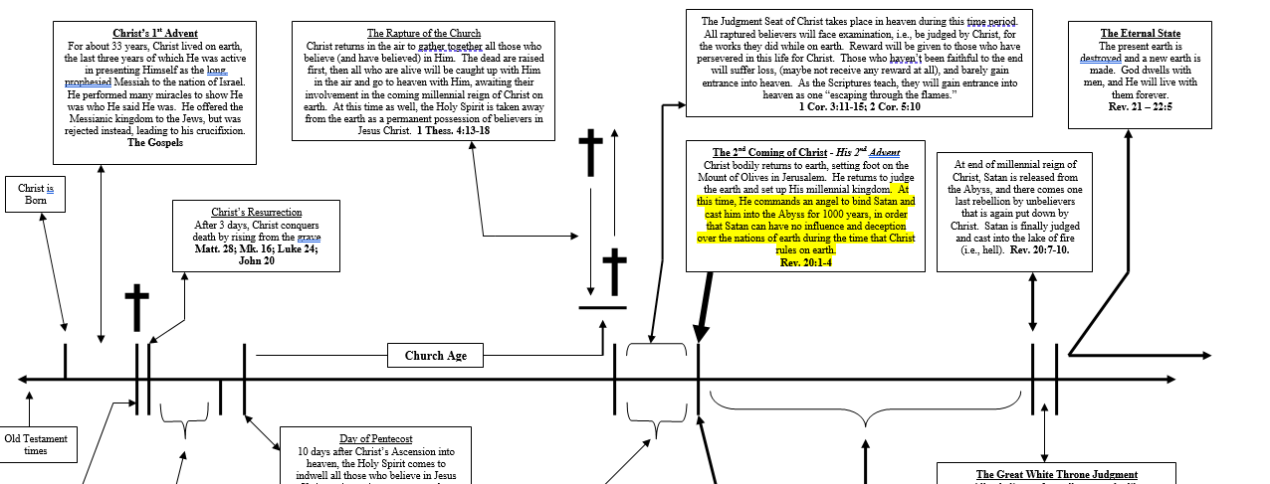

Slide 22
2 Timothy 2:11-13
“This is a faithful saying: for if we died with Him, we shall also live with Him. If we endure, we shall also reign with Him. If we deny Him, He also will deny us. If we are faithless, He remains faithful; He cannot deny Himself.

Slide 23
Why do people go to hell?

Slide 24
Why do people go to hell?
Is it because of their sin?

Slide 25
1 John 2:2
“And He Himself is the propitiation for our sins, and not for ours only but also for the whole world.”

Slide 26
1 John 2:2
“And He Himself is the propitiation for our sins, and not for ours only but also for the whole world.”
2 Corinthians 5:21
“For He made Him who knew no sin to be sin for us, that we might become the righteousness of God in Him.”

Slide 27
John 1:29
“Behold! The Lamb of God who takes away the sin of those who believe in Him.”

Slide 28
John 1:29
“Behold! The Lamb of God who takes away the sin of those who believe in Him.”

Slide 29
John 1:29
“Behold! The Lamb of God who takes away the sin of those who believe in Him.”
“Behold the Lamb of God who covers the sin of the world.”

Slide 30
John 1:29
“Behold! The Lamb of God who takes away the sin of those who believe in Him.”
“Behold the Lamb of God who covers the sin of the world.”

Slide 31
John 1:29
“Behold! The Lamb of God who takes away the sin of those who believe in Him.”
“Behold the Lamb of God who covers the sin of the world.”
“Behold the Lamb of God who takes away the sin of the world.”

Slide 32
Why do people go to hell?
Is it because of their sin?
The reason men go to hell is because their name is not written in the Book of Life.

Slide 33
Revelation 20:12-15
“And I saw the dead, small and great, standing before God, and books were opened. And another book was opened, which is the Book of Life. And the dead were judged according to their works, by the things which were written in the books. The sea gave up the dead who were in it, and Death and Hades delivered up the dead who were in them. And they were judged, each one according to his works. Then Death and Hades were cast into the lake of fire. This is the second death. And anyone not found written in the Book of Life was cast into the lake of fire.”

Slide 34
John 3:18
“He who believes in Him is not condemned; but he who does not believe is condemned already, because he has not believed in the name of the only begotten Son of God.”

Slide 35
The judgment seat of Christ is not where sin is judged in the life of the believer, it is judging the productiveness of the Christian’s life while on earth … the lack of productiveness being the result of willful sin or lackadaisicalness of effort or spiritual care in the Christian life.

Slide 36
Revelation 3:21
“To him who overcomes I will grant to sit with Me on My throne, as I also overcame and sat down with My Father on His throne.”

Slide 37
God’s Three Primary Concerns …
Loss of Fellowship with Him
2. Loss of Reward
3. The Believer’s Testimony

Slide 38
2 Corinthians 5:20
“Now then, we are ambassadors for Christ, as though God were pleading through us …”.

Slide 39
2 Corinthians 5:20
“Now then, we are ambassadors for Christ, as though God were pleading through us …”.
Ambassador
Strong’s … “act as a representative.”

Slide 40
John 14:6
“I am the way, the truth, and the life.”

Slide 41
John 14:6
“I am the way, the truth, and the life.”
John 17:17
“Sanctify them by Your truth. Your word is truth.”

Slide 42
God’s Three Primary Concerns …
Loss of Fellowship with Him
Loss of Reward
The Believer’s Testimony

Slide 43
Philippians 2:14-16
“Do all things without complaining and disputing, that you may become blameless and harmless, children of God without fault in the midst of a crooked and perverse generation, among whom you shine as lights in the world, holding fast the word of life …”.

Slide 44
Matthew 5:14-16
“You are the light of the world. A city that is set on a hill cannot be hidden. Nor do they light a lamp and put it under a basket, but on a lampstand, and it gives light to all who are in the house. Let your light so shine before men, that they may see your good works and glorify your Father in heaven.”

